Slide 1
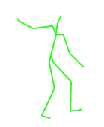
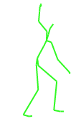
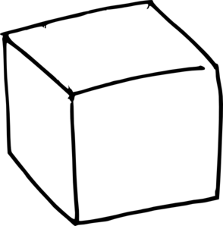
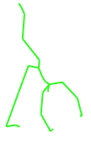
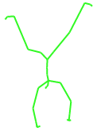
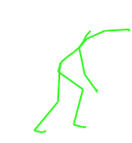
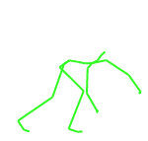
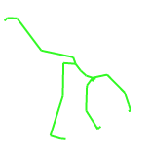



Similarity Search in 3D Human Motion Data
Jan Sedmidubsky Pavel Zezula
xsedmid@fi.muni.cz zezula@fi.muni.cz
[Jan Sedmidubsky and Pavel Zezula. Similarity Search in 3D Human Motion Data. ACM International Conference on Multimedia Retrieval (ICMR). ACM, pp. 5–6, 2019.]
https://dl.acm.org/citation.cfm?id=3326589
Laboratory of Data Intensive Systems and Applications
disa.fi.muni.cz
Faculty of Informatics, Masaryk University, Czech Republic
fi.muni.cz
Supported by the Czech Science Foundation project “Searching, Mining, and Annotating Human Motion Streams” No. GA19-02033S.

Slide 2
Outline
Outline
Motion Data: Acquisition and Applications
Challenges in Motion Data Processing
Similarity as a General Concept of Data Understanding
Similarity of Actions
Metric Searching as a Data-Access Paradigm
Action Recognition
Indexing and Searching in Long Motion Sequences
Subsequence Search in Long Sequences
Stream-based Event Detection
Conclusions and Discussion
Coffee break

Slide 3
1
Motion Capture Data: Acquisition and Applications
1.1 Motion Capture Data
1.2 Capturing Devices
1.3 Applications

Slide 4
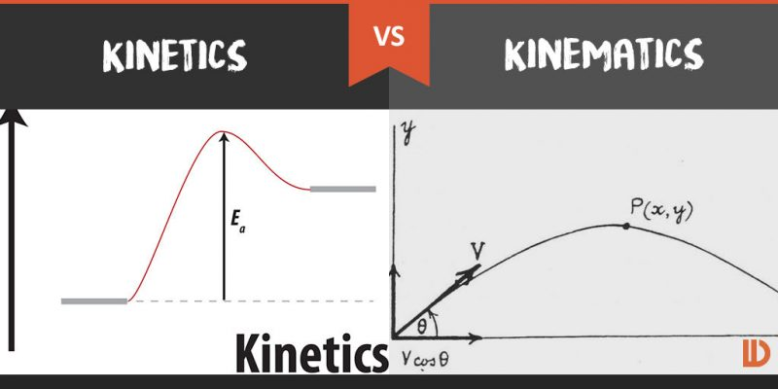
1.1 Motion Data
Motion data
A digital representation of a human motion
Types of data:
Kinematic – motion capture data, recorded by synchronized cams
Kinetic – ground-reaction force data, obtained by pressure plates

Slide 5
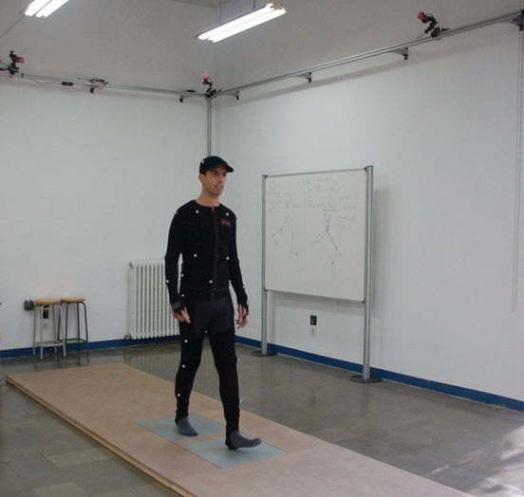






1.1 Motion Capture Data
Motion Capture Data ~ MoCap Data ~ Motion Data
Spatio-temporal 3D representation of a human motion
Synchronized
cameras

Slide 6


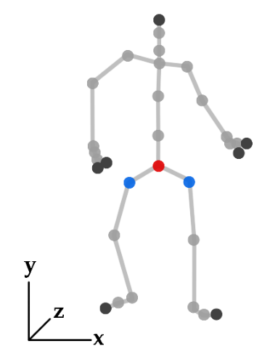
1.1 Motion Capture Data
Motion capture data
Continuous spatio-temporal characteristics of a human motion simplified into a discrete sequence of skeleton poses
Skeleton pose:
Skeleton configuration in a given time moment
3D positions of body landmarks, denoted as joints
Different views on motion data:
A sequence of skeleton poses
A set of 3D trajectories of joints
Pose captured
in a given
time moment

Slide 7
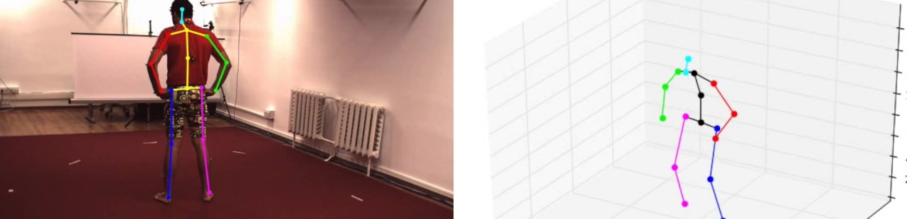
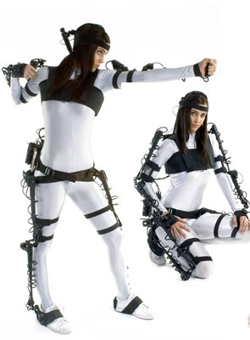
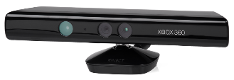
1.2 Capturing Motion Data
3D motion capture principles
Estimating 3D poses from a single 2D video camera
Not so precise but a great applicability
Applying 3D motion capture technologies
Precise but expensive and with a limited applicability
Technologies:
Optical
Marker-based (invasive)
Marker-less (non-invasive)
Other – inertial, magnetic, mechanical, radio frequency
Notes:
Sensors in mobile phones
Possibility to model MoCap data from ordinary videos

Slide 8
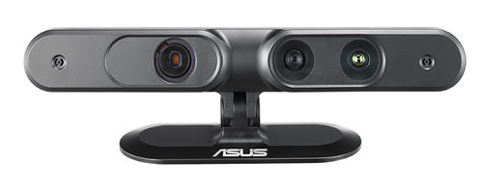
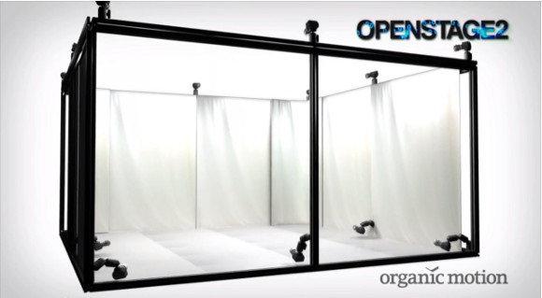

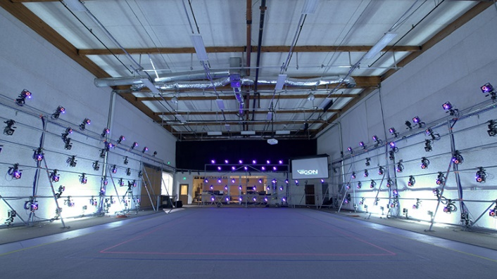
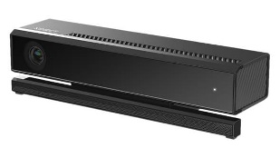
1.2 3D Motion Capture Devices
Accuracy of 3D motion capture devices
Device | Range [m] | Framerate [Hz] | Invasive | View field [°] | Tracked subjects | Positional accuracy [mm] | Rotational accuracy [°] | Landmark count
Kinect v1 | 0.8—4 | 30 | No | 57 | 2 | 50—150 | ? | 20
Kinect v2 | 0.5—4.5 | 30 | No | 70 | 6 | ? | 1—3 | 25
ASUS Xtion | 0.8—3.5 | 30 | No | 58 | ? | ? | ? | ?
Vicon MX40 | space 7x7 | 120 | Markers | 360 | ? | 0.063 | ? | 32
Xsens MVN | ? | 120 | Sensors | ? | 1 | - | 0.5—1 | 22
Organic Motion | space 4.3x3.8 | 120 | No | 360 | 5 | 1 | 1—2 | 22

Slide 9
1.2 3D Motion Capture Devices
3D motion capture devices
Optical-based devices are the most commonly used
Advantages/disadvantages:
Invasive – accurate | large space | markers | expensive
Vicon, MotionAnalysis
Non-invasive – no markers | small space
Accurate but expensive – Organic Motion
Less accurate but cheap – Microsoft Kinect, ASUS Xtion
Hardware devices and applicable software tools are usually independent
iPi Soft – marker-less, up to 16 cameras or 4 Kinects
Captured motion data serve as an input for our research
Notes:
Optical-based devices are the most commonly used
A single RGB camera + depth sensing
Multiple instances of synchronized RGB cameras

Slide 10
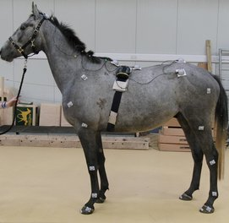
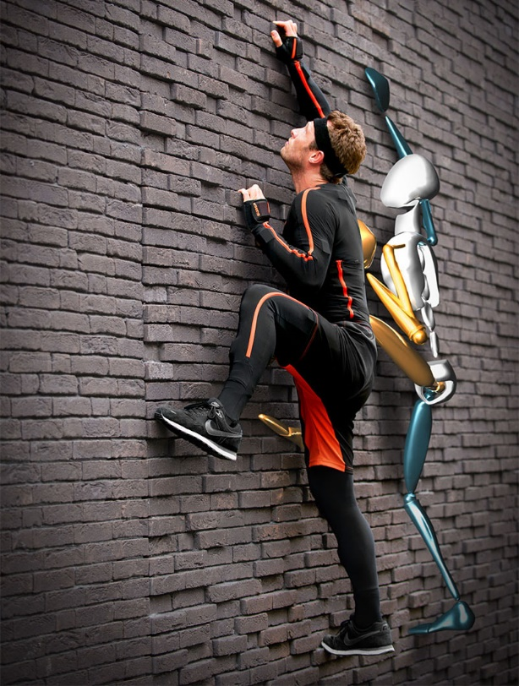
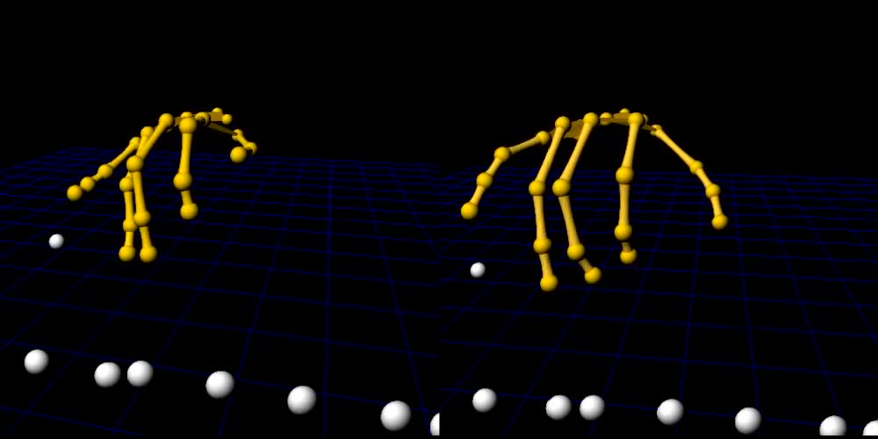
1.3 Applications
Applications
Many application domains where motion data have a great potential to be utilized and automatically processed
Computer animation & human-computer interaction
Military
Sports
Medicine
Other domains

Slide 11
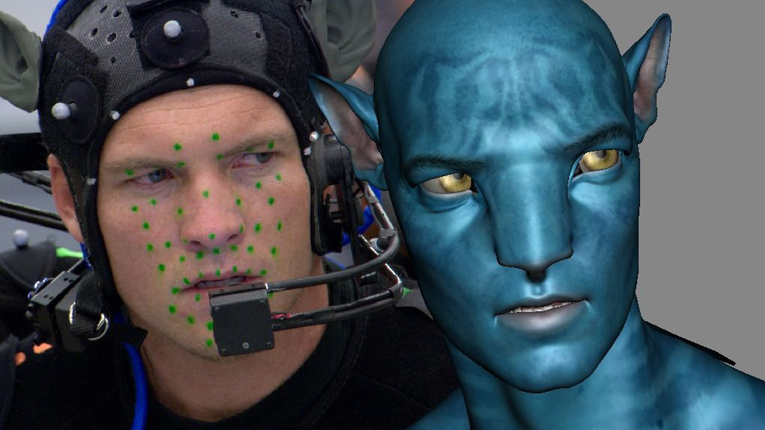
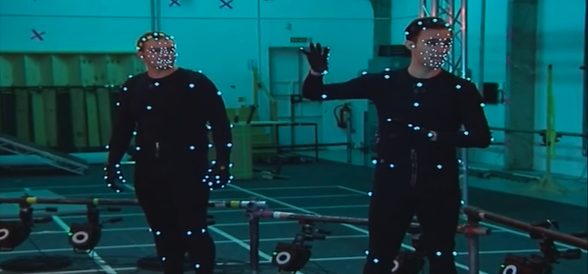
1.3 Applications
Computer animation
Make subject (human) movements in movies and computer games as much realistic as possible
Games: Far Cry 4, GTA V
Movies: Avatar, The Lord of the Rings
Generate artificial motions by merging real movements that follow each other

Slide 12
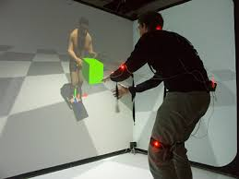
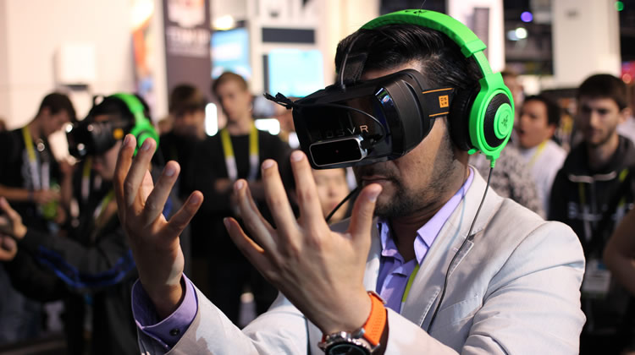
1.3 Applications
Human computer interaction, augmented reality
Detection of gestures/actions to enable real-time interactions

Slide 13
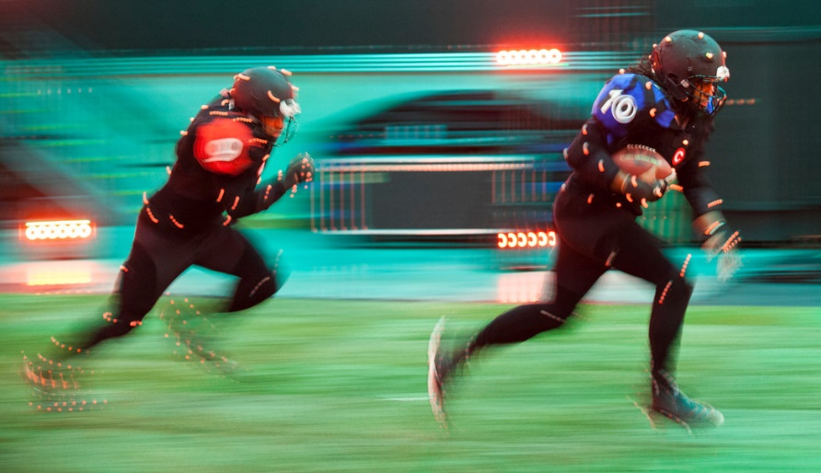
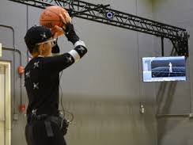
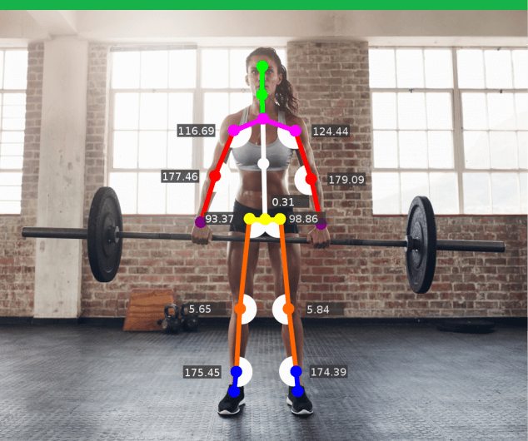
1.3 Applications
Sports
Digital referees – detection of fouls
Digital judges – assignment of scores
Movement analysis to quantify an improvement or loss of performance

Slide 14
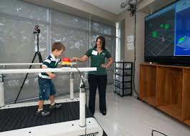
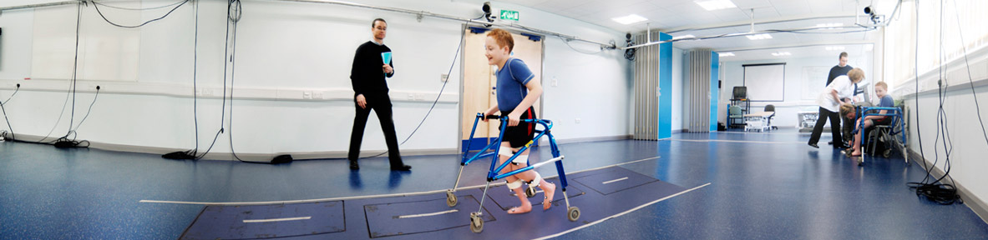
1.3 Applications
Medicine
Improvement of the education and training of healthcare personnel including physicians, paramedics and nurses
Creation of a roadmap to help each patient by showing exactly where and how he or she has gotten better
Recognition of developmental disabilities or movement disorders
Notes:
Motion capture technology is also proving useful in improving the education and training of healthcare personnel including physicians, paramedics and nurses. One example involves capturing the detailed movements needed to perform endotracheal intubation. Usually done under emergency circumstances, endotracheal intubation takes not only thorough knowledge of anatomy and physiology, but also a great deal of skill with the controlled movements needed to insert the laryngoscope and tube safely and accurately.
Motion capture is also being used give medical students insight into biomechanics and the subtleties of diagnosis, even capturing breathing rates and subtle ticks. OpenStage Software, which allows motion capture to be accomplished without sensors or calibration, makes the process even easier and more accurate. Osteopaths and chiropractors are also making use of motion capture to assist in diagnosing spinal conditions and evaluating treatment options.

Slide 15
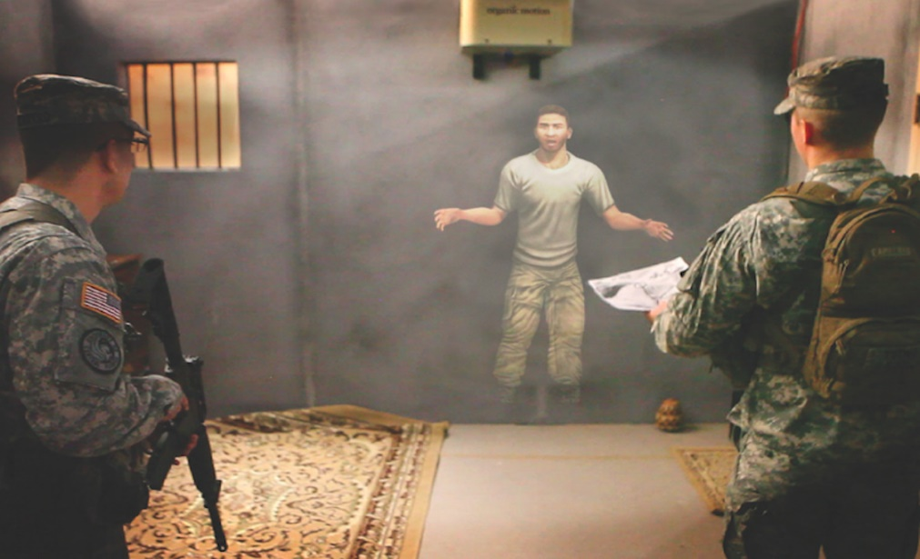
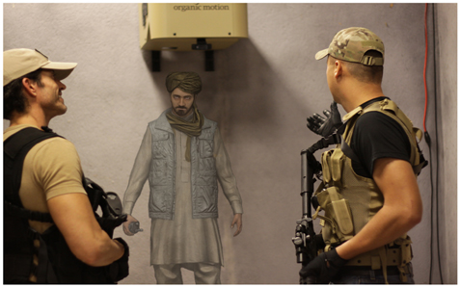
1.3 Applications
Military
Interaction with digitally animated characters in live training scenarios in a natural and intuitive way
Simulation of a combat and conflict-resolving situations
To improve the education and training of military forces or healthcare personnel by inserting live role-players

Slide 16
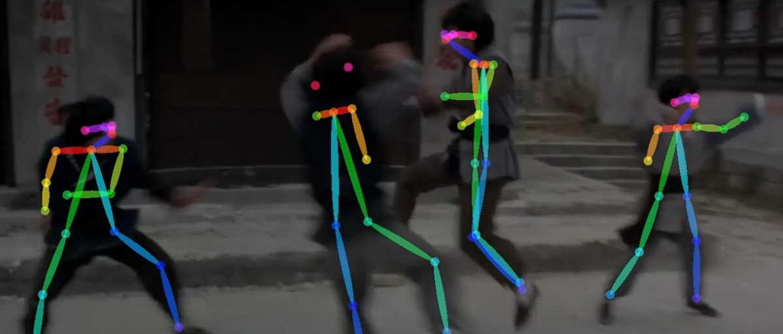
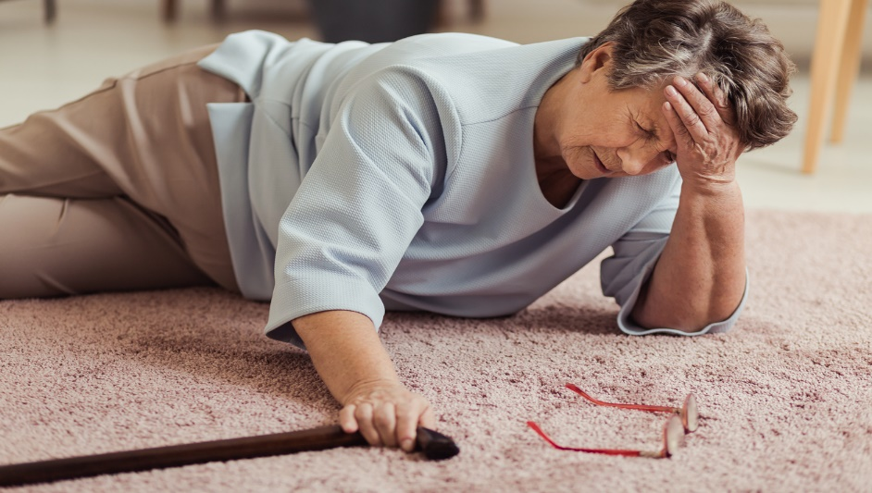
1.3 Applications
Other domains
Security – identification of persons based on their style of walking (~ gait recognition)
Smart-homes – detection of falls of elderly people
Construction-sites – identification of unsafe acts, e.g., speed limit violations of equipment or close distance between equipment and workers

Slide 17
2
Challenges in Motion Data Processing
2.1 Data Volume
2.2 Imprecise Data
2.3 Operations

Slide 18
2 The Big Data Corollaries
Shifts in thinking
From some to all – more scalability
From clean to messy – less determinism (ranked comparisons)
Loads on a sharp rise – usage on decline
Foundational concerns
Scalable and secure data analysis, organization, retrieval, and modeling
Technological obstacles
Heterogeneity, scale, timeliness, complexity, and privacy aspects

Slide 19
2 The Big Data Corollaries
The (3V) problem: Volume, Variety, Velocity
Issues:
Acquisition – what to keep and what to discard
Datafication – render into data aspects that do not exist in analog form
Unstructured data – structured only on storage and display
Inaccuracy – approximation, imprecision, noise

Slide 20
2 Challenges in Motion Data Processing
Computerized processing
Operations that process motion data automatically, without any need of user intervention
Challenges
Large volume of data
Inaccuracy of data
Variety of motion-analysis operations

Slide 21
2 Motion Data Specifics
Motion data specifics
Large volume of data
E.g., 31 joints ∙ 3D space ∙ 120 Hz => 11,160 float numbers/second generated => 1.5 TB/year needed to store the data
Inaccuracy of data – captured data can be:
Inconsistent (e.g., location of markers)
Imprecise (e.g., inaccurate information about positions of joints)
Incomplete (e.g., missing information about some joint positions)
Variety of motion-analysis operations
Designing operations, such as similarity comparison, searching, classification, semantic segmentation, clustering or outlier detection, with respect to the spatio-temporal nature of motion data

Slide 22
2.1 Data – Types of Motions
Motion data types
Short motions:
Semantically-indivisible motions ~ ACTIONS
Length – typically in order of seconds
Database – usually a large number of actions
Long motions:
Semantically-divisible motions ~ sequences of actions
Length – in order of minutes, hours, days, or even unlimited
Database – typically a single long motion processed either as a whole, or in the stream-based nature
Gait cycle
(0.6 s)
Cartwheel
(2.1 s)
…
…
Figure skating performance (3 mins)

Slide 23

2.3 Motion-Analysis Operations
Long semantically-divisible motion
Short semantically-indivisible motions
…
…
Figure skating performance (3 mins)
88%
96%
90%
Rittberger
jump (0.4 s)
Pirouette (1.1 s)
95%
Subsequence
search
Semantic segmentation
Search
Classification
Pirouette (97%)
Rittberger (92%)
…
Pirouette (95%)
Long motion
Short motion
What is inside?
Where is it?
What is it?

Slide 24
2.3 Operations
Motion-analysis operations
Search
Subsequence search
Classification
Semantic segmentation
Other operations:
Clustering
Outlier detection
Joins
Mining frequent movement patterns
Action prediction
…

Slide 25
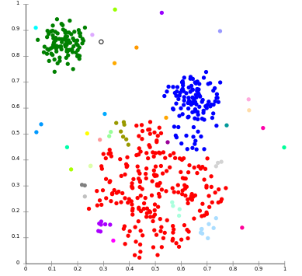
2.3 Other Operations – Clustering
Clustering
Suppose each motion as a point in n-dimensional space
Grouping motions in action collections
Motions in the same group (called a cluster) are more similar (in some sense) to each other than to those in other groups (clusters)
Useful for statistical data analysis

Slide 26

2.3 Other Operations – Outlier Detection
Outlier detection
Identifying motions which significantly deviate from other motion entities
Outliers

Slide 27
2.3 Other Operations – Similarity Join
Similarity join
Finding pairs of similar motions
Types:
Range joins – finding all the motion pairs at distance at most r
k-closest pair joins – finding the k closest motion pairs
Similar
pairs

Slide 28
2.3 Summary of Motion-Analysis Operations
Summary of operations
=> All the operations require the concept of motion similarity
OPERATION | OPERATION DATA (KNOWLEDGE BASE) | USER INPUT (QUERY) | OPERATION RESULT
Search | Actions | Action | Actions similar to the query action
Subsequence search | Long motions | Action | Positions of query-similar subsequences
Classification | Labelled (categorized) actions | Action | Class of the examined action
Semantic segmentation | Labelled (categorized) actions | Long motion | Positions of detected actions
Require annotated (labeled) data

Slide 29
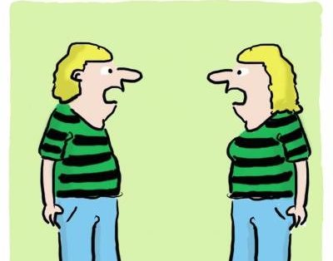
3
Similarity as a General Concept of Data Understanding
3.1 Social-Psychology View/Computer-Science View
3.2 Metric Space Model
3.3 Feature Learning
We are becoming very similar in a lot of ways…

Slide 30
3.1 Real-Life Motivation
Quotations from the social psychology literature
Any event in the history of organism is, in a sense, unique
Recognition, learning, and judgment presuppose an ability to categorize stimuli and classify situations by similarity
Similarity (proximity, resemblance, communality, representativeness, psychological distance, etc.) is fundamental to theories of perception, learning, judgment, etc.
Similarity is subjective and context-dependent

Slide 31
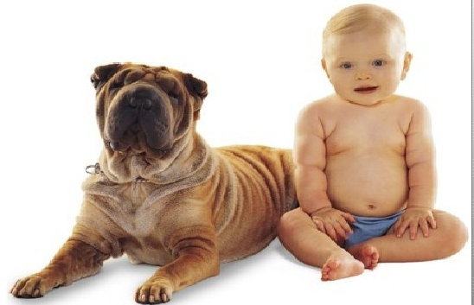
3.1 Real-Life Similarity
Are they similar?

Slide 32
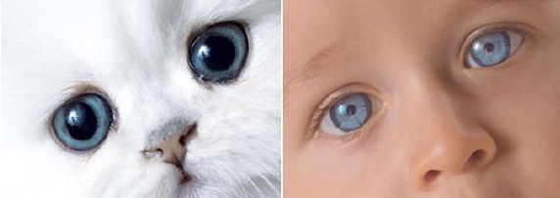
3.1 Real-Life Similarity
Are they similar?

Slide 33
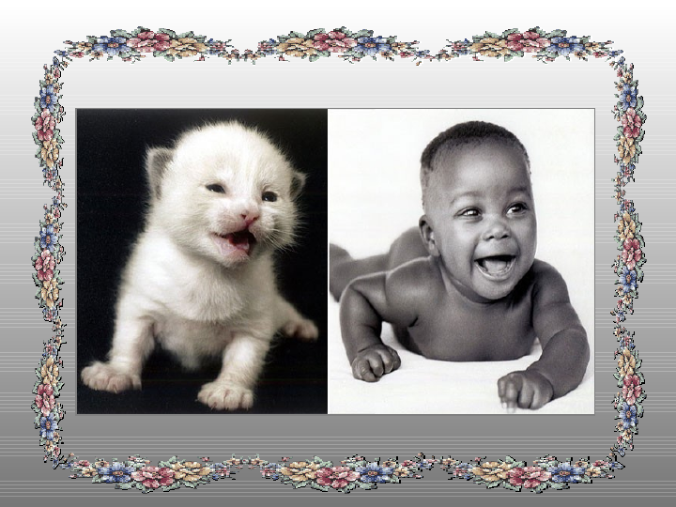
3.1 Real-Life Similarity
Are they similar?

Slide 34
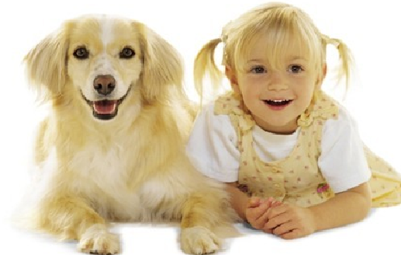
3.1 Real-Life Similarity
Are they similar?

Slide 35
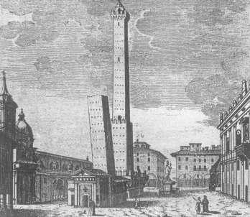
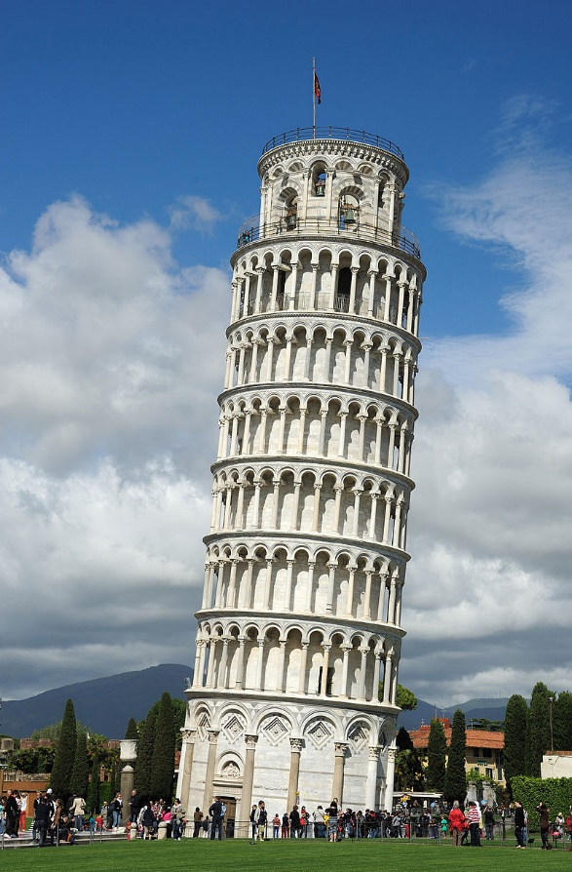
3.1 Real-Life Similarity
Prototypicality or centrality
Not symmetric

Slide 36
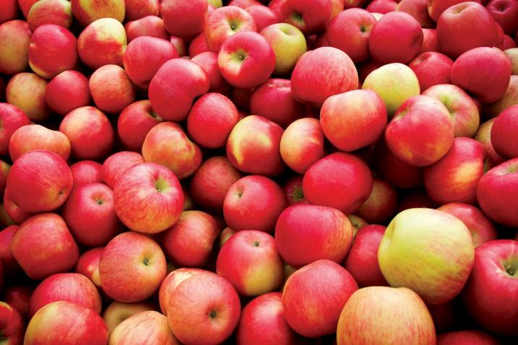
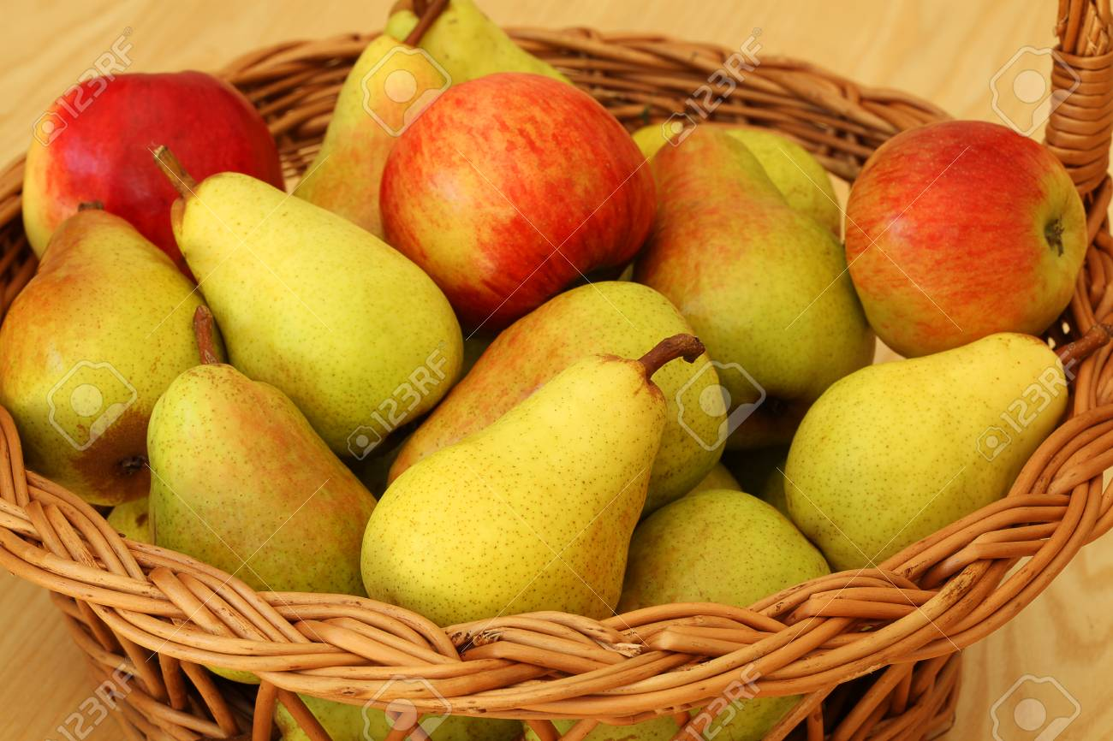
3.1 Real-Life Similarity
Context/Data/Environment dependent
Circumstances alter similarities

Slide 37
3.1 Similarity in Geometry
We learned from school
Two polygons are similar to each other, if:
Their corresponding angles are congruent
∠A = ∠E; ∠B = ∠F; ∠C = ∠G; ∠D = ∠H, and
The lengths of their corresponding sides are proportional
AB/EF = BC/FG = CD/GH = DA/HE
D
C
H
G
A
B
E
F

Slide 38
3.1 Similarity in Geometry
Similarity in geometry
If one polygon is similar to a second polygon, and the second polygon is similar to the third polygon, the first polygon is similar to the third polygon
In any case: two geometric figures are either similar, or they are not similar at all

Slide 39
3.1 Contemporary Networked Media
The digital data point of view
Almost everything that we see, read, hear, write, measure, or observe can be digital
Users autonomously contribute to production of global media and the growth is exponential
Sites like Flickr, YouTube, Facebook host user contributed content for a variety of events
The elements of networked media are related by numerous multi-facet links of similarity
Majority of current data is unstructured,
possibly only structured on display

Slide 40
3.1 Challenge
Challenge
Networked media database is getting close to the human “fact-bases”
The gap between physical and digital world has blurred
Similarity data management is needed to connect, search, filter, merge, relate, rank, cluster, classify, identify, or categorize objects across various collections
WHY?
It is the similarity which is in the world revealing

Slide 41
3.1 Iterative and Interactive Nature of Contemporary Searching
When we search, our next actions are reactions to the stimuli of previous search results
What we find is changing what we seek
In any case, search must be:
fast, simple, and relevant

Slide 42
3.2 Metric Space: A Geometric Model of Similarity
Metric space M = (D, d)
D – domain of objects
d(x, y) – distance function between objects x and y
∀ x, y, z ∈ D :
d(x, y) > 0 – non-negativity
d(x, y) = 0 ⇔ x = y – identity
d(x, y) = d(y, x) – symmetry
d(x, y) ≤ d(x, z) + d(z, y) – triangle inequality

Slide 43
3.2 Metric Space – Distance Functions
Example of distance functions
L_{p} Minkovski distance – for vectors
L₁ – city-block distance
L₂ – Euclidean distance
L∞ – infinity
Edit distance – for strings
Minimum number of insertions, deletions and substitutions
d(“application”, “applet”) = 6
Jaccard’s coefficient – for sets A, B

Slide 44

3.2 Metric Space – Distance Functions
Example of other distance functions
Mahalanobis distance
For vectors with correlated dimensions
Hausdorff distance
For sets with elements related by another distance
Earth-movers distance
Primarily for histograms (sets of weighted features)
and many others – see the book

Slide 45
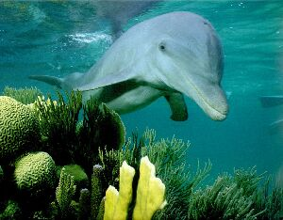
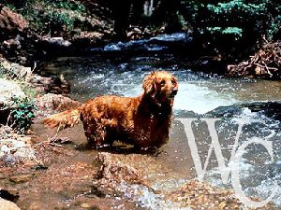
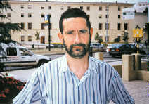
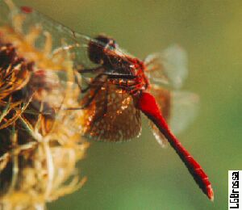
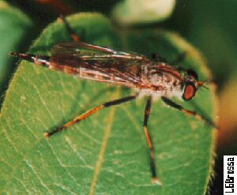
3.2 Content-Based Search
Content-based search in images
Image base
similar?

Slide 46
3.2 Extracting Features
Extracting features
Image level
B
Feature level
R
G

Slide 47

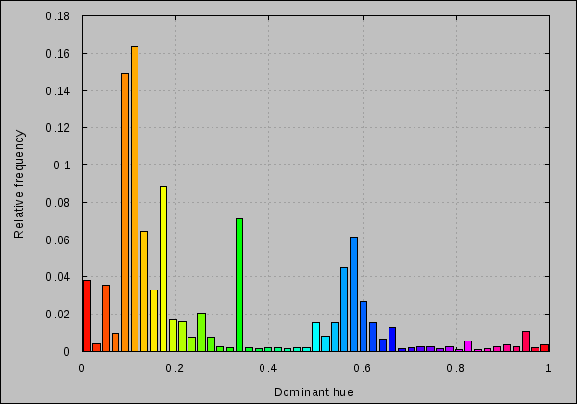
3.2 Visual Similarity
Examples of features – MPEG-7
MPEG-7 multimedia content descriptor standard ~ 2000
Global feature descriptors – color, shape, texture, etc.
One high-dimensional vector per image and feature
Minkovski distance used

Slide 48

3.2 Visual Similarity
Examples of features
Local feature descriptors – SIFT, SURF, etc.
Invariant to image scaling, small viewpoint change, rotation, noise, illumination

Slide 49

3.2 Visual Similarity
Finding correspondence

Slide 50

3.2 Visual Similarity – Biometrics
Fingerprints
Minutiae detection:
Detect ridges (endings and branching)
Represented as a sequence of minutiae
P=( (r₁, e₁, θ₁), …, (r_{m}, e_{m}, θ_{m}) )
Point in polar coordinates (r, e) and direction θ
Matching of two sequences:
Align input sequence with a database one
Compute a weighted edit distance
w_{ins, del} = 620
w_{repl} = [0; 26] – depending on similarity of two minutiae

Slide 51



3.2 Visual Similarity – Biometrics
Hand recognition
Hand image analysis
Contour extraction, global registration
Rotation, translation, normalization
Finger registration
Contour represented as a set of pixels F = {f₁, …, f_{NF}}
Matching: modified Hausdorff distance

Slide 52

3.2 Visual Similarity – Multiple Features
Multiple visual aspects

Slide 53

3.3 Feature Extraction
Current approaches in feature extraction
Technology of neural networks
Convolutional neural networks (CNN)
Recurrent neural networks (RNN)
Training data
Training (Fine-tuning)
Neural network model
Classified
dataset
Data split
Validation data
Validation

Slide 54

3.3 Feature Extraction – Convolutional Neural Networks
Convolutional neural network (CNN) – AlexNet
The last layer with 1,000 output categories
Output of any layer can be used as a feature
Notes:
It contains 5 convolutional layers and 3 fully connected layers. Relu is applied after very convolutional and fully connected layer. Dropout is applied before the first and the second fully connected year.
Convolutional layer is a feature detector that automatically learns to filter out not needed information from an input by using convolutional kernel.
Pooling layers compute the max or average value of a particular feature over a region of the input data (downsizing of input images) and also help to detect objects in some unusual places and reduce memory size.
The network has 62.3 million parameters (and 650,000 neurons), and needs 1.1 billion computation units in a forward pass. We can also see convolution layers, which accounts for 6% of all the parameters, consumes 95% of the computation. It takes five to six days to train on two GTX 580 3GB GPUs.
The network uses Relu instead of Tanh to add non-linearity. It accelerates the speed by 6 times at the same accuracy.

Slide 55

3.3 Feature Extraction – Recurrent Neural Networks
Recurrent neural networks (RNN)
Long-Short Term Memory (LSTM) networks:
Learn when data should be remembered and when they should be thrown away
Well-suited to learn from experience to classify, process and predict time series when there are very long time lags of unknown size between important events

Slide 56
3.3 Feature Extraction – Deep Learning Summary
Summary of deep learning
It is no magic! Just statistics in a black box, but exceptional effective at learning patterns
Powerful computational infrastructure can be applied, e.g., GPU cards
Deep learning can be used not only for classification but is also able to provide content preserving feature vectors
When calibrated by an L_{p} distance, good quality similarity estimates can be obtained

Slide 57
3.3 Demos
Similarity search demos – extensibility
20M images: http://disa.fi.muni.cz/demos/profiset-decaf/
Fashion: http://disa.fi.muni.cz/twenga/
Image annotation: http://disa.fi.muni.cz/annotation-ui/
Fingerprints: http://disa.fi.muni.cz/fingerprints/
Time series: http://disa.fi.muni.cz/subseq/

Slide 58




4
Similarity of Actions
4.1 Similarity in Motion Data
4.2 Feature Extraction Principles
4.3 LSTM-based Similarity Concept
4.4 Motion-Image Similarity Concept
4.5 Triple Loss Similarity Concept
Similar?

Slide 59



4.1 Similarity in Motion Data
Similarity of short motion sequences (~ actions)
Determining similarity is needed everywhere, e.g., for clustering, classification, searching, semantic segmentation
Similarity measure = features + distance function
How similar are
the motions?
M₁
M₂
Feature extraction process
<0, 0, 5.2, 8.1, 0, 2.3, -1.1, 0, …>
<0, 0.1, 6.2, 7.1, 0, 2.9, -2.1, 0, …>
$$F_{M_{1}}$$
$$F_{M_{2}}$$
$dist\left(F_{M_{1}},F_{M_{2}}\right)$ = 8.56

Slide 60
4.1 Challenges of Similarity Measures
Objective
To propose an effective and efficient similarity measure, i.e., content-preserving features + fast distance function
Problems
Similarity is application-dependent (e.g., recognizing daily actions vs. recognizing people based on their style of walking)
Subjects have different bodies (e.g., child vs. adult)
Spatial and temporal deformations – the same action (e.g., kick) can be performed at different:
Styles (e.g., frontal kick vs. side kick) and
Speeds (e.g., faster vs. slower)

Slide 61
4.2 Features and Distance Functions
Feature design
Data normalization – optional pre-processing step
Space-dependent/invariant motion data
Skeleton-size variability
Granularity of features
Pose features – a set of times series + alignment function
E.g., joint angle rotations, distances between joints
Motion features – a fixed-length vector + L_{p} metric
E.g., average velocity of individual joints, lengths of joint trajectories
Engineering
Hand-crafted features – manual feature engineering
Machine-learned features – learning features automatically
Notes:
Semantics of individual vector dimensions depends on the application and needn’t be easily interpretable.

Slide 62

4.2 Input Data Normalization
Normalization of:
Position
Orientation
Skeleton size
Normalizing each pose:
Independently
Conditionally
E.g., relatively to the first normalized pose

Slide 63

4.2 Hand-Crafted Features
Hand-crafted features
Very good knowledge of data domain is needed
Very specialized in what they express
Lower descriptive power compared to ML approaches
Usually extracted for individual poses ~ time series
E.g., time series of joint angle rotations + Dynamic Time Warping (DTW)

Slide 64
4.2 Hand-Crafted Features
Existing hand-crafted-based approaches
17D motion feature – 17 scalars describing gait velocity, stride length, step frequency, etc.
[Pradhan et al., Automated classification of neurological disorders of gait using spatio-temporal gait parameters, Journal of Electromyography and Kinesiology, 2015]
[classification of neurological disorders of gait]
6D pose features – pair-wise distances between joints
[Sedmidubsky et al., Gait Recognition Based on Normalized Walk Cycles, ISVC 2013]
[gait recognition]
28D pose features – 28 joint-angle rotations
[Sedmidubsky et al., A key-pose similarity algorithm for motion data retrieval, ACIVS 2013]
[action searching]
40D pose features – 40 relational frame-based characteristics
[Muller et al., Efficient and robust annotation of motion capture data, SCA 2009]
[action searching]

Slide 65


4.2 Machine-Learned Features
Machine-learned features
Learning features automatically
Requires a large amount of (labelled) training data
Successful approaches based on CNN, RNN, LSTM
Convolutional neural networks (CNN)
Recurrent neural networks (RNN)
Notes:
Feature learning
Goal – utilizing machine-learning techniques to automatically discover the representations needed for feature detection or classification from input data
Machine learning – a type of artificial intelligence that provides computers with the ability to learn without being explicitly programmed
Deep learning
Part of machine learning which derives meaning out of data by using a hierarchy of multiple layers that mimic the neural networks of our brain
Machine learning is a scientific discipline that explores the construction and study of algorithms that can learn from data. Such algorithms operate by building a model based on inputs and using that to make predictions or decisions, rather than following only explicitly programmed instructions.
In machine learning, feature learning or representation learning is a set of techniques that allows a system to automatically discover the representations needed for feature detection or classification from raw data. This replaces manual feature engineering and allows a machine to both learn the features and use them to perform a specific task.
Types of learning:
Supervised – training with a labeled training set (e.g., e-mail spam detector with training set of already labeled emails)
Unsupervised – discovering patterns in unlabeled data (e.g., cluster similar documents based on the text content)
Reinforcement – learning based on feedback or reward (e.g., learn to play chess by winning or losing)
Convolutional neural networks (CNN)
consist of a hierarchy of layers
each layer transforms the data into more abstract representations (e.g., edge -> nose -> face)
the output layer combines the features to make predictions

Slide 66
4.2 Machine-Learned Features
Existing ML approaches
16–256D float vectors compared by the Euclidean distance
[Coskun et al.: Human Motion Analysis with Deep Metric Learning. ECCV, 2018]
[action recognition] [gait recognition]
?D float vectors compared by the Euclidean distance
[Aristidou et al.: Deep Motifs and Motion Signatures, ACM Trans. Graph., 2018]
[action recognition] [action searching]
4,096D float vectors compared by the Euclidean distance
[Sedmidubsky et al.: Effective and efficient similarity searching in motion capture data. MTAP, 2018]
[action recognition] [action searching]
160D bit vectors compared by the Hamming distance
[Wang et al.: Deep signatures for indexing and retrieval in large motion databases. Motion in Games, 2015]
[action searching]
Notes:
Approaches
Coskun et al.: triplet-based deep metric learning (+ utilization of LSTM)
Aristidou et al.: triplet-based learning
Wang et al.: 4-layer deep autoencoder with the first layer being the gaussian RBM and the other 3 layers being normal RBMs (restricted Boltzmann machines)

Slide 67



4.2 Summary of Features
Advantages/disadvantages of features
 | HAND-CRAFTED | MACHINE-LEARNED
Accuracy (descriptive power)
Interpretability of dimensions
Prerequisites | Very good scenario knowledge | Many example categorized motions
Application | More-easily describable scenarios | Most scenarios with some categorization

Slide 68



4.3 Feature Learning Approaches
Machine-learning approaches in detail
LSTM-based Similarity Concept
1,024D feature + Manhattan distance
Motion-Image Similarity Concept
4,096D feature + Euclidean distance
Triple-Loss Similarity Concept
?D feature + Euclidean distance
Notes:
Combination of advantages of machine-learning techniques and distance-based methods

Slide 69

4.3 LSTM-based Similarity Concept
Recurrent Neural Networks (RNN)
Ideal to model sequences of poses
Output contents are influenced by the history of inputs
Long-Short Term Memory (LSTM) network:
A special kind of RNN, capable of learning long-term dependencies
It learns when data should be remembered and when they should be thrown away
Notes:
RNN:
“Whenever there is a sequence of data and that temporal dynamics that connects the data is more important than the spatial content of each individual frame.” – Lex Fridman (MIT)
Output state hi of the i-th cell is fed to the next (i+1)-th cell
Number of states/cells corresponds to the number of poses (t)
GRU (Gated Recurrent Unit) – similar to a LSTM unit; LSTM has 3 gates, GRU has 2 gates
Deep RNN – multiple RNNs where output of each cell of the first layer is the input for the cell in the second layer, etc.
Sources:
http://colah.github.io/posts/2015-08-Understanding-LSTMs/
https://towardsdatascience.com/understanding-lstm-and-its-quick-implementation-in-keras-for-sentiment-analysis-af410fd85b47
tanh = hyperbolic tangent function (activation function). It is used to overcome the vanishing gradient problem - we need a function whose second derivative can sustain for a long range before going to zero. tanh is a suitable function with this property.
In cases where the gap between the relevant information and the place that it’s needed is small, RNNs can learn to use the past information. Unfortunately, as that gap grows, RNNs become unable to learn to connect the information. These larger gaps can be solved by LSTM cells. LSTM outperforms the other models when we want our model to learn from long term dependencies. LSTM’s ability to forget, remember and update the information pushes it one step ahead of RNNs.
LSTM:
The key to LSTMs is the cell state, the horizontal line running through the top of the diagram.
Steps:
The first sigmoid layer outputs numbers between zero and one, describing how much of each component should be let through. A value of zero means “let nothing through,” while a value of one means “let everything through!”
The next step is to decide what new information we’re going to store in the cell state (a sigmoid layer called the “input gate layer” decides which values we’ll update. Next, a tanh layer creates a vector of new candidate values that could be added to the state).
Learning as in case of RNN
Learning for classification – projecting the hidden state output (e.g., 1,024D) into the classification output (e.g., 122D) and apply the softmax function to get a probability vector
The projection is a linear function f(x)=Wx+b, where W is learnt matrix (weights) and b is learnt vector (bias)

Slide 70
4.3 LSTM-based Similarity Concept
LSTM-based similarity measure (LSTM features)
Number of states/cells corresponds to the number of poses
The last state h_{t+1} can be used as a feature
Size of each state h_{i} is a user-defined parameter
Suitable state size of 512 / 1,024 / 2,048 dimensions
Features compared by the Manhattan/Euclidean distance
0.1
0.0
…
0.7
0.2
Projection + Softmax
# of classes
Result classification

Slide 71

4.3 LSTM-based Similarity Concept
LSTM-based similarity measure (LSTM features)
Standard LSTM architecture:
Bidirectional LSTM extension:

Slide 72

4.4 Motion-Image Similarity Concept
Motion-image similarity measures (CNN features)
[Sedmidubsky et al.: Effective and efficient similarity searching in motion capture data. Multimedia Tools and Appl., 2018]
Deep 4,096D features compared by the Euclidean distance
Suitable for motions in order of seconds (~ actions)

Slide 73
4.4 Feature Extraction
Feature extraction steps
Normalizing motion data (optional context-dependent step)
Transforming normalized data into a 2D motion image
Extracting a 4,096D feature from the image using a DCNN

Slide 74
4.4 Feature Extraction – Normalization
Feature extraction steps
Normalizing motion data
Optional step – its utilization depends on a target application
Normalizing each pose independently vs. conditionally
E.g., position, orientation, and skeleton-size normalization in each pose independently is suitable for classifying daily activities

Slide 75


4.4 Feature Extraction – Visualization
Feature extraction steps
Transforming data into a 2D motion image
Sizing an RGB cube to fit all possible poses of motion M
Fitting each motion pose into the center of the RGB cube to represent each joint position by a specific color
Building the motion image by composing joint-position colors
root
|M|
left leg
right leg
torso
left hand
right hand
Time

Slide 76

4.4 Feature Extraction
Feature extraction steps
Extracting a 4,096D feature from the image using a CNN
CNN = AlexNet pretrained on 1M ImageNet photos categorized in 1,000 classes (e.g., green mamba, espresso, projector)
Optionally fine-tuned on the domain of motion images
4,096D feature = output of the last hidden CNN layer
Notes:
AlexNet:
It contains 5 convolutional layers and 3 fully connected layers. Relu is applied after very convolutional and fully connected layer. Dropout is applied before the first and the second fully connected year.
Convolutional layer is a feature detector that automatically learns to filter out not needed information from an input by using convolutional kernel.
Pooling layers compute the max or average value of a particular feature over a region of the input data (downsizing of input images) and also help to detect objects in some unusual places and reduce memory size.
The network has 62.3 million parameters (and 650,000 neurons), and needs 1.1 billion computation units in a forward pass. We can also see convolution layers, which accounts for 6% of all the parameters, consumes 95% of the computation. It takes five to six days to train on two GTX 580 3GB GPUs.
The network uses Relu instead of Tanh to add non-linearity. It accelerates the speed by 6 times at the same accuracy.
Dropout:
Dropout is a regularization technique patented by Google for reducing overfitting in neural networks by preventing complex co-adaptations on training data. It is a very efficient way of performing model averaging with neural networks. The term "dropout" refers to dropping out units (both hidden and visible) in a neural network

Slide 77


4.4 Increasing Accuracy of Features
Fine-tuning the CNN ~ transferred learning
Increases a descriptive power of the extracted features
Utilizes a pre-trained CNN model, not-necessary originally trained on the same domain of images
Requires additional domain-specific training images classified into categories (only last CNN layer is changed)

Slide 78
4.4 Elasticity Property
Elasticity property
Motion-image similarity concept exhibits elasticity property
Classification accuracy decreases only slightly when up to 20% of motion content is misaligned (i.e., shifted)
Evaluated on the action recognition scenario using the 1NN classifier on a dataset of 1,464 HDM05 motions divided into 15 categories
20% 20%
20% misalignment w.r.t. segment size

Slide 79
4.4 Summary
Summary of the motion-image similarity concept
Suitable for motions in order of seconds (e.g., gait cycles)
Each motion image resized to 227x227 pixels for the CNN
227 pixels in time dimension correspond to the motion of ~2 seconds, when considering the frame rate of 120Hz
Feature extraction time of ~25ms using a GPU impl.
Advantages:
Utilizing a pre-trained CNN does not require large amounts of training data and training time
Even motions of categories that have not been available during the training phase are well clustered

Slide 80
4.5 Triple Loss Similarity Concept
Triple loss similarity concept
[Aristidou et al.: Deep Motifs and Motion Signatures, ACM Transactions on Graphics, 2018]
Learning features in an unsupervised way, i.e., without labelled training data
Requirements:
A granular similarity concept to determine very similar and very dissimilar motions
A large amount of “triples” of training data
Triplet = anchor + its similar (positive) motion + its dissimilar (negative) motion

Slide 81
4.5 Triple Loss Similarity Concept
Triple loss similarity concept
Triplets generated from long motion sequences by a synthetic segmentation technique
Segments of about 0.7s with a shift of about 0.15s
Triplets:
Anchor – randomly selected segment
Positive examples – segments temporarily close to the anchor with no overlap or matched using DTW on joint-angle rotations
Negative examples – segments temporally far away from the anchor or taken from another motion sequence
Long data sequence
Notes:
Positive examples:
Z=4 temporally closest segments with no overlap
K=5 similar using DTW on joint-angle rotations

Slide 82

4.5 Triple Loss Similarity Concept
Triple loss similarity concept
Three CNNs sharing the same parameters
Inputs in form of motion images
Loss function:
Architecture:
Notes:
Network strives for an embedding function f (x) that minimizes the distance between an anchor motion word xa and a positive xp sample, that is semantically close to xa, and maximizes the distance between xa and a negative xn sample that is semantically different.

Slide 83


4.5 Summary
Advantages/disadvantages of the similarity concepts
 | LSTM-based | CNN-based | Triple-loss-based
Accuracy (descriptive power of features)
Volume of training data
Input data preprocessing
Length of motions
Feature-size flexibility
Labelled data needed

Slide 84
5
Metric Searching as a Data-Access Paradigm
5.1 Similarity Queries & Partitioning Principles
5.2 Indexing Structures (M-Tree, D-Index, Sketches)
5.3 Summary & Live Demo

Slide 85
5.1 Metric Space – Search Problem
Similarity search problem in metric spaces
For X ⊆ D in metric space M , pre-process X so that the similarity queries are executed efficiently
Implementation problems:
How to partition the data to reduce search space
How to ask questions – definition of queries
How to execute queries – to achieve performance
The challenge: in metric spaces, no total ordering exists!

Slide 86
5.1 Metric Space – Partitioning Principles
Basic partitioning principles
Given a set X ⊆ D in metric space M = (D, d), basic partitioning principles have been defined:
Ball partitioning
Generalized hyper-plane partitioning
Note:
Some special cases, such as Euclidian or Supermetric spaces are more tractable

Slide 87
5.1 Metric Space – Partitioning Principles
Basic partitioning principles
For X ⊆ D in metric space M = (D, d)
Generalized hyper-
Ball partitioning plane partitioning
Inner set: { x ∈ X | d(p, x) ≤ d_{m} } { x ∈ X | d(p₁, x) ≤ d(p₂, x) }
Outer set: { x ∈ X | d(p, x) > d_{m} } { x ∈ X | d(p₁, x) > d(p₂, x) }
p₂
d_{m}
p
p₁

Slide 88
5.1 Metric Space – Similarity Queries
Range query Nearest neighbor query
R(q, r) = {x ∈ X | d(q, x) ≤ r} NN(q) = {x ∈ X | ∀y ∈ X, d(q,x) ≤ d(q,y)}
k-nearest neighbor query
k-NN(q, k) = A
A ⊆ X, |A| = k
∀x ∈ A, y ∈ X – A, d(q, x) ≤ d(q, y)
“all museums up to 2km “five closest museums to my hotel q”
from my hotel q”
k=5
r
q
q

Slide 89
5.1 Metric Space – Similarity Queries
Reverse nearest neighbor query
“all hotels with a specific museum as
a nearest cultural heritage cite”
Example of 2-RNN: objects o₄, o₅, and o₆ have q between their two nearest neighbors
k-RNN(q, k) = {R ⊆ X,
∀x ∈ R: q ∈ k-NN(x, k) ∧
∀x ∈ X – R: q ∈ k-NN(x, k)
o₄
o₁
o₂
q
o₅
o₃
o₆

Slide 90
5.1 Metric Space – Similarity Joins
Similarity joins
Similarity join of two data sets
Similarity self join ⬄ X = Y
“pairs of hotels and museums
which are five minutes walk apart”
μ

Slide 91
5.1 Metric Space – Pivot Filtering
Pivot filtering
Idea: Given R(q, r), use triangle inequality for pruning
All distances between objects and a pivot p are known
Prune object o ∈ X if any holds:
d(p,o) < d(p,q) – r
d(p,o) > d(p,q) + r
r
p
q

Slide 92
5.1 Metric Space – Pivot Filtering
Pivot filtering
Filtering with two pivots:
Only objects in the dark blue region have to be checked
Effectiveness is improved using more pivots
o₂
r
p₁
q
o₃
p₂
o₁

Slide 93
5.1 Metric Space – Pivot Filtering
Pivot filtering summary
Given a metric space M = (D, d) and a set of pivots P = {p₁, p₂, p₃,…, p_{n}}, define a mapping functionΨ: Ψ: (D, d) → (R^{n}, L∞) as:
Ψ(o) = (d(o, p₁), …, d(o, p_{n}))
Then, we can bound the distance d(q, o) from:
L∞(Ψ(o), Ψ(q)) ≤ d(q, o)

Slide 94
5.2 M-Tree
M-tree
[Ciaccia P., Patella M., and Zezula P.: M-tree: An Efficient Access Method for Similarity Search in Metric Spaces. VLDB, 1997]
Paged organization
Dynamic
Suitable for arbitrary metric spaces
I/O and CPU optimization – computing d can be time-consuming

Slide 95
5.2 M-Tree
Metric: L₂ (Euclidean)
The M-tree idea
Depending on the metric, the “shape” of index regions changes
C
A B
A
E
B
C D E F
F
D
L₁ (city-block)
L∞ (max-metric)
weighted-Euclidean
quadratic form

Slide 96
5.2 M-Tree
M-tree example
o₅
o₁₀
o₁₁
o₂
o₃
o₇
o₈
o₁
Covering radius
o₆
o₄
o₉
Distance to parent
Distance to parent
Distance to parent
o₁
4.5
-.-
o₂
6.9
-.-
o₁
1.4
0.0
o₁₀
1.2
3.3
o₇
1.3
3.8
o₂
2.9
0.0
o₄
1.6
5.3
o₁
0.0
o₆
1.4
o₁₀
0.0
o₃
1.2
o₂
0.0
o₈
2.9
Distance to parent
o₇
0.0
o₅
1.3
o₁₁
1.0
o₄
0.0
o₉
1.6
Leaf entries

Slide 97
5.2 M-Tree – Range Search
M-Tree – range search
Given R(q, r):
Traverse the tree in a depth-first manner
In an internal node, for each entry ⟨p, r^{c}, d(p, p^{p}), ptr⟩:
Prune the subtree if |d(q, p^{p}) – d(p, p^{p})| – r^{c} > r
Application of the pivot-pivot constraint
r
p^{p}
q
p^{p}
p
r^{c}
p
r
r^{c}
q

Slide 98
5.2 M-Tree – Range Search
M-Tree – range search
If not discarded, compute d(q, p) and
Prune the subtree if d(q, p) – r^{c} > r
Application of the range-pivot constraint
All non-pruned entries are searched recursively
r^{c}
r
q
p

Slide 99
5.2 D-Index
D-Index
[Dohnal V., Gennaro C., Pasquale S., Zezula P.: D-Index: Distance Searching Index for Metric Data Sets. Multimedia Tools and Applications, 2003]
4 separable buckets at the first level
2 separable buckets at the second level
exclusion bucket of the whole structure

Slide 100
5.2 D-Index
D-Index – insertion

Slide 101
5.2 D-Index
D-Index – range search
r
r
q
q
r
r
q
q
r
q
r
q

Slide 102
5.2 Pivot Permutation Approach
Pivot Permutation Approach
Assume a set of n pivots {p₁, p₂, ..., p_{n}}
Given object x in X, order the pivots according to d(x, p_{i})
Let ∏_{x} be a permutation on the set of pivot indexes {1, …, n} such that ∏_{x}(j) is index of the j-th closest pivot from x
E.g., ∏_{x}(1) is the index of the closest pivot to x
p_{∏x(j)} is the j-th closest pivot from x
∏_{x} is denoted as Pivot Permutation (PP) with respect to x

Slide 103

5.2 Pivot Permutation Approach
Pivot Permutation Approach
Can be seen as a recursive Voronoi partitioning to level l
Cell C_{<i1, … il>} contains objects x for which:
∏_{x}(1) = i₁, ∏_{x}(2) = i₂, …, ∏_{x}(l)=i_{l}

Slide 104
5.2 Metric Sketches
Metric sketches for fast searching and filtering
Transformation of any metric space (D, d) to the Hamming space:
Each descriptor o is transformed into a bit-string sketch of length λ
Hamming distance evaluates the number of different bits – very efficient (using a hardware instruction)
Sketches compared by the Hamming distance should approximate similarity relationships of the original metric
Typical sketch length is 32–320 bits

Slide 105


5.2 Metric Sketches
Sketching transformation
GHP to set one bit of sk(o) Two GHPs to set two bits μ and v of all sketches sk(o)
μ:
v:

Slide 106

5.2 Metric Sketches
Properties and application
Good sketches (choosing pivots):
Balanced split
Low correlation
Application – even better for filtering than searching

Slide 107


5.3 Similarity Search Textbooks
Major textbooks on metric searching technologies
H. Samet
Foundation of Multidimensional and Metric Data Structures
Morgan Kaufmann, 1,024 pages, 2006
P. Zezula, G. Amato, V. Dohnal, and M. Batko
Similarity Search: The Metric Space Approach
Springer, 220 pages, 2005
Teaching materials:
http://www.nmis.isti.cnr.it/amato/similarity-search-book/

Slide 108






5.3 MESSIF– Infrastructure Independence
MESSIF (Metric Similarity Search Implementation Framework)
Performance statistics
Distributed index structures
Centralized index structures
Metric space (D,d)
Operations
Storage
Communication
Net
Vectors
L_{p} and quadratic form
Strings
(weighted) edit and protein sequence
Insert, delete,
range query,
k-NN query,
Incremental k-NN
Volatile memory
Persistent memory

Slide 109

5.3 Demos
Similarity search demos – scalability
20M images: http://disa.fi.muni.cz/demos/profiset-decaf/

Slide 110
6
Action Recognition
6.1 Action Recognition
6.2 kNN Classification
6.3 Live Demo

Slide 111
6.1 Action Classification
Action classification – the problem of identifying a single class (category) to which a query movement action belongs, on the basis of a training set of already categorized motions
Sometimes referred to as action recognition
exercise
cartwheel
sit down
jump
?
HANDSTAND
stretch
kick
punch
wave

Slide 112
6.1 Action Classification
Short semantically-indivisible motions
Knowledge base
Collection of labeled short actions ~ training data
Input
Unlabeled short action ~ query action
Output
Estimated class of the query
Probability of the query action being a member of each of the possible classes
Rittberger
jump (0.4 s)
Pirouette (1.1 s)
Classification
Pirouette (95%)
Short motion
What is it?

Slide 113

6.1 Existing Approaches
Action recognition approaches
k-nearest-neighbor (kNN) classifiers
Require an effective similarity model (features + distance function)
Search for the k most similar actions with respect to the query
Rank the retrieved actions to estimate the query class (probability)
Machine-learning (ML) classifiers
Learn the representation of classes from the provided training data
Query action is directly classified (usually in constant time)
Many approaches – support vector machines, decision trees, Bayesian networks, artificial neural networks

Slide 114
6.1 ML-Based Classification
Neural network classifiers
Suitable architectures:
CNN or LSTM neural networks
Training a network with labelled (categorized) actions
(Re)Training is time-consuming
Classification only into known classes provided within the training process
4kD CNN
1kD LSTM
4,096
1,024

Slide 115









6.2 1NN Classification
1NN classification
Searching for the nearest neighbor based on similarity of features
Class of the nearest neighbor considered as class of the query
JUMP class feature vectors
<…, 0.53, 10.8, 4.64, …>
<…, 0.12, 8.60, 1.99, …>
8.7 KICK
9.1 JUMP
10.2 JUMP
14.3 KICK
KICK (100%)
Query action
feature vector
<…, 0.93, 10.1, 2.43, …>
KICK class feature vectors
<…, 8.93, 10.1, 2.43, …>
<…, 7.42, 7.14, 2.27, …>
<…, 3.93, 6.26, 3.41, …>

Slide 116
6.2 kNN Classification
1NN classification
Problems – relying on the nearest neighbor only
kNN classification
Possible design – considering the output class as the class with the highest number of occurrences within k results
If more candidates exist, take that with the minimum distance
Problems:
When k is higher than the count of relevant class samples
Similarities of neighbors are not considered
Example: query action of the jump class
8.7 KICK
9.1 JUMP
10.2 JUMP
14.3 KICK
JUMP (50%)
KICK (50%)
k=4:

Slide 117
6.2 kNN Classification
Weighted-distance kNN classifier (kNN_WD)
Considering not only the number of votes but also the similarity of neighbors
Normalizing the neighbor distance with respect to the k-th neighbor
Effective when distances of nearest neighbors vary across classes
Computing class relevance by summing relevance of class neighbors (1 – normalized distance)
Example scenario – query action belonging to the jump class
Original
distances
8.7 KICK
9.1 JUMP
10.2 JUMP
14.3 KICK
Normalized
distances
0.55 KICK
0.58 JUMP
0.65 JUMP
0.91 KICK
Relevance
of neighbors
0.45 KICK
0.42 JUMP
0.35 JUMP
0.09 KICK
Relevance
of classes
0.54 KICK
0.77 JUMP
KICK (41%)
JUMP (59%)

Slide 118
6.2 Classification Dataset
HDM05 dataset
Acquired by Vicon (120 Hz sampling, 31 body joints)
5 actors, 102 long motion sequences, 68 minutes in total
Ground truth – 2,328/2,345 short actions in 122/130 classes
Shortest and longest samples: 13 frames (0.1s) and 900 frames (7.5s)
Action classes corresponding to daily/exercising activities:
Clap with hands 5 times
Walk two steps, starting with left leg
Turn left
Frontal kick by left leg two times
Cartwheel, starting with left hand
…

Slide 119
6.2 Comparison of Classification Methods
HDM05 dataset 2,328/2,345 samples in 122/130 classes
2-fold cross validation (50% of training data)
Only about 10 action samples per class for training on average
 | Accuracy (%)
 | HDM-122 | HDM-130
LieNet-2Blocks (Huang et al., CVPR 2017) | N/A | 75.78
CNN on motion images (Laraba et al., CAVW 2017) | N/A | 83.33
Multi-scale filtering version of STGC (Li et al., AAAI 2018) | N/A | 86.17
4kD CNN motion-image features + 1NN (Sed., MTaP 2018) | 87.24 | 86.79
4kD CNN & handcrafted features + kNN (Sed., DEXA 2018) | 89.09 | 88.78
1kD LSTM features + 1NN (2019) | 91.41 | 90.74
1kD LSTM features + augmented training data + kNN (2019) | 94.33 | 93.64
Notes:
STGC – spatio-temporal graph convolution

Slide 120
6.3 Summary & Live Demo
Advantages/disadvantages of the kNN and ML classifiers
Live Demo: http://disa.fi.muni.cz/mocap-action-recognition/
[Sedmidubsky et al.: Recognizing User-Defined Subsequences in Human Motion Data. ICMR, 2019]
 | kNN-BASED | ML-BASED
Accuracy
Training time
Adaptability to a changing knowledge base
Classification efficiency

Slide 121
7
Indexing and Searching in Long Motion Sequences
7.1 Processing Long Motions
7.2 Subsequence Search
7.3 Sequence Annotation

Slide 122
7.1 Long Motions
Long motions
Semantically-divisible motions ~ sequence of actions
Length – in order of minutes, hours, days, or even unlimited
Database – typically a single long motion either pre-processed as a whole, or evaluated in the stream-based manner
…
…
Figure skating performance (3 mins)

Slide 123
7.1 Processing Long Motions
Long semantically-divisible motion
Short semantically-indivisible motions
…
…
88%
96%
Rittberger
jump (0.4 s)
Pirouette (1.1 s)
Subsequence
similarity search
Semantic segmentation
Pirouette (97%)
Rittberger (92%)
…
Long motion
Short motion
What is inside?
Where is it?

Slide 124
7.1 Processing Long Motions
Operations
Subsequence similarity search
Semantic segmentation
Offline sequence annotation
Real-time event detection
Other operations:
Mining frequent movement patterns
Prediction of actions

Slide 125
7.1 Processing Long Motions
Long-motion processing
File-based processing:
The long motion is known in advance and can be stored and pre-processed offline as a whole
E.g., offline sequence annotation
Stream-based processing:
A limited part of the long motion is accessible at a given time
E.g., real-time event detection in data from surveillance cameras
…
…
PAST ◀
SLIDING WINDOW
▶ FUTURE

Slide 126




7.2 Subsequence Search
Subsequence search
An efficient mechanism for searching a long motion and localizing its parts that are similar to a short query sequence
Query
Query-similar subsequences
2 seconds
> 1 hour
…
…
Long motion

Slide 127
7.2 Search Challenges
Problems
Query can be potentially any motion sequence, usually limited in its length
E.g., semantic action such as kick or jump, its part or a transition in between any of these, but also any non-categorized motion
Query-similar subsequences can potentially occur anywhere in a long sequence
Length of query-similar subsequences needn’t be exactly the same with respect to the query motion
=> efficient subsequence matching algorithm

Slide 128


7.2 Subsequence Search in Time Series
Subsequence matching in time series
Motion data can be perceived as a set of synchronized time series ~ a single multi-dimensional time series
E.g., a single time series for each joint and axis (x/y/z)
=> 31 joints ∙ 3 = 93 time series
Subsequence matching in time series data is a well-known problem for 1-dimensional time series
[Esling et al.: Time-series data mining. ACM Computing Surveys, 2012]
[Rakthanmanon et al.: Searching and Mining Trillions of Time Series Subsequences under Dynamic Time Warping. KDD, 2012]

Slide 129
7.2 Subsequence Search in Time Series
Subsequence matching in time series
Subsequence matching in time series data also applied to multi-dimensional time series
[Hu et al.: Time Series Classification under More Realistic Assumptions. ICDM, 2013.]
[Gong et al.: Fast Similarity Search of Multi-Dimensional Time Series via Segment Rotation. DASFAA, 2015.]
Efficient algorithms are based on distance functions that compare frame-based features
Traditional time-series algorithms hardly applicable to motion-data domain due to the absence of distance functions working effectively on frame-based features
There is a need for an effective distance function

Slide 130
7.2 Subsequence Search in Motion Data
Subsequence matching in motion data
Effective motion-based features are extracted from short motions => segmentation
Partitioning the query and long motion sequence into parts – segments – to be meaningfully comparable
Types of segmentation:
Overlapping/disjoint segments
Segments of a fixed/variable length
Unsupervised/supervised (semantic) segmentation
Query
Long data sequence

Slide 131
7.2 Subsequence Search in Motion Data
Subsequence matching in motion data
Subsequence search = segmentation + retrieval algorithm
Retrieval algorithm – searching for consecutive data segments that are similar to consecutive query segments
Query-similar subsequence
Query
Query segments
Long data sequence
Data segments

Slide 132
7.2 Alignment Problem
Alignment problem in subsequence matching
Detecting only “selected” segments => alignment problem
Solving the alignment problem by overlapping segments
Considering every possible segment is extremely expensive
Query-similar subsequence
Query
Query segments
Long data sequence
Overlapping segments
Disjoint segments
Disjoint segments
Overlapping segments

Slide 133
7.2 Overlapping Segmentation
Partitioning both the query and data sequence
☺ Overlapping segments solve the alignment problem
☹ Longer queries have more query segments and are more expensive to evaluate
☹ Grouping relevant segments w.r.t. temporal information
Query-similar subsequence
Query
Long data sequence
Overlapping segments
Disjoint segments
Disjoint segments
Overlapping segments

Slide 134
7.2 Overlapping Data Segmentation & Query as a Single Segment
Partitioning only the data sequence
Solving the alignment problem by:
Considering a query as a single segment
Organizing overlapping data segments in multiple levels for different segment lengths
☺ Much easier retrieval – one query, no complex post-processing
☹ Segment level for each query length – a big number of data segments
[Sedmidubsky et al.: Similarity Searching in Long Sequences of Motion Capture Data. SISAP, 2016]
Query
Single segment
Query-similar subsequence
Long data sequence
Overlapping segments for all possible lengths of queries
…
Level #5
…
Level #14
…

Slide 135
7.2 Elasticity Property
Reducing the number of levels and segments
Motion-image similarity concept exhibits elasticity property
Search accuracy decreases only slightly when up to 20% of segment content is misaligned (i.e., shifted)
20% 20%
20% misalignment w.r.t. segment size
Overlapping segments can be shifted by 5–25 % of their length (and not only by a single frame)
Levels can be generated only for the specific lengths of queries (and not for all the possible ones)
☺ The big number of segments can be dramatically reduced

Slide 136

7.2 Decreasing Number of Segments
Reducing the number of levels and segments
Segment lengths and number of levels depend on
Query length limits (l^{min}, l^{max})
Elasticity of the similarity measure (quantified by $cf∈[0, 1]$)
Segmentation example for elasticity cf = 0.2 ~ 20%:
Query length limits [100, 500]
l^{min} = 100
l^{max} = 500
Long data sequence
Segment levels
#1 (l₁ = 125 frames)
100–150
#2 (l₂ = 187 frames)
150–224
#3 (l₃ = 280 frames)
224–336
#4 (l₄ = 420 frames)
336–504
Level shift: l_{n} = l_{n-1} * (1 + cf)/(1 – cf)
Segment shift: l_{n} * cf

Slide 137


7.2 Query Evaluation
Searching within a multi-level segmentation
Only a single query-relevant level considered for search
For arbitrary data subsequence of l^{min} < length < l^{max}, there exists a single segment that overlaps for at most 100 ∙ (1 – cf) [%]
The k most similar segments presented as the query result
Query-similar subsequence
Query
Single segment
Long data sequence
Overlapping segments for all possible lengths of queries
…
Level #2
…
…
Level #4
…

Slide 138
7.2 Query Evaluation Costs
Example:
Data sequence of length 400,000 frames (120 Hz ~ 1 hour)
Query length limits: l^{min} = 100 and l^{max} = 500 frames
Example query length: 300 frames (120 Hz ~ 3 seconds)
 | Total # of data segments | Data replication | Max # of comparisons
Baseline – overlap on query | 4,000 | 1 | 800,000
Baseline – overlap on data | 400,000 | 100 | 1,200,000
Multi-level segmentation – naïve | 160,000,000 | 120,000 | 400,000
Multi-level segmentation | 7,720 | 20 | 1,430

Slide 139
7.2 Dataset
HDM05 – long motions
102 long sequences ~ 68 minutes in total
Ground truth – 1,464 short subsequences in 15 categories (~queries)
Shortest and longest samples: 41 frames (0.3s) and 2,063 frames (17.2s)
Action classes corresponding to exercising activities:
Cartwheel
Exercise
Jump
Kick
…

Slide 140

7.2 Experimental Evaluation
Subsequence search evaluation
Subsequence retrieval using kNN queries:
1,464 ground-truth subsequences used as query objects
Retrieved subsequence is relevant if it overlaps with some ground-truth subsequence of the same class
l^{min} = 41 frames (0.3s), l^{max} = 2,063 frames (17.2s)
Different settings of elasticity cf = {10%, 20%, 30%, 40%, 50%}
cf [%] | # of levels | Sequential scan [ms]
10 | 18 | 447
20 | 9 | 205
30 | 6 | 126
40 | 5 | 88
50 | 4 | 66

Slide 141
7.2 Subsequence Search Summary
Summary
Advanced subsequence matching in mocap data:
Query always considered as a single segment
The elasticity property of the motion-image similarity concept dramatically reduces the number of data segments
Efficiency:
Searching the 68-minute sequence sequentially takes 205ms
Search times can further be decreased by roughly two orders of magnitude by indexing data segments at each level
Approximate search within a 121-day long data sequence in 1 second
Live demo: http://disa.fi.muni.cz/mocap-demo/

Slide 142
7.3 Semantic Segmentation
Short semantically-indivisible motions
Rittberger
jump (0.4 s)
Pirouette (1.1 s)
Semantic segmentation
Pirouette (97%)
Rittberger (92%)
…
Long motion
What is inside?

Slide 143
7.3 Semantic Segmentation
Semantic segmentation
An efficient mechanism for discovering actions within a long motion, based on a user-provided categorization
Processing:
File-based processing ~ offline sequence annotation
Stream-based processing ~ online event detection
User-provided instances of the
KICK class
> 1 hour
…
…
Long motion

Slide 144
7.3 Semantic Segmentation
Challenges
Beginnings and endings of actions are unknown
A more difficult problem than action classification
In case of stream-based processing, only a small part of data is accessible and has to be processed in real time
Approaches
Segment-based event detection
[Elias et al.: A Real-Time Annotation of Motion Data Streams. ISM, 2017]
Frame-based semantic segmentation using a LSTM network
[Carrara et al.: LSTM-Based Real-Time Action Detection and Prediction in Human Motion Streams. Multimedia Tools and Applications, 2019]
Offline-LSTM – offline sequence annotation
Online-LSTM – online event detection

Slide 145
7.3 Segment-Based Event Detection
Segment-based matching
Multi-level segmentation structure as in subsequence search
Segments detected in a stream-based manner
Each segment is matched against each action in each class
Matching based on motion-image similarity concept
If similarity between the segment and action is under a class-based threshold, the segment is assigned the action class
All the assigned segments are merged to obtain the overall semantic segmentation

Slide 146


7.3 Segment-Based Event Detection
PAST ◀
SLIDING WINDOW
▶ FUTURE
For each class, search for 1NN and match its distance with the class-based threshold
WALK
CARTWHEEL
Actions
Each class is represented by action samples
KICK
CARTWHEEL
WALK
threshold = 5
threshold = 7
threshold = 2

Slide 147
7.3 Segment-Based Event Detection
Segmentation
Multi-level segmentation structure as in subsequence search
Versatility – the density of the segments is controlled by a user-specified parameter cf
The parameter denotes the number of levels and the size of shift (overlap) between consecutive segments
Segmentation density impacts efficiency and effectiveness
Dense segmentation
Produces more segments resulting in a more precise annotation but requires
more processing power.
Sparse segmentation
Produces less segments but requires a more elastic similarity measure.

Slide 148

7.3 Frame-Based Semantic Segmentation
LSTM-based semantic segmentation
Learning a class assignment for each frame on training data
Sequences with their annotated parts are provided in advance
No similarity concept needed
Online-LSTM model:
h_{i} – 1kD feature (1x1,024)
Sequence of n poses
m classes

Slide 149

7.3 Frame-Based Semantic Segmentation
Output of Online-LSTM

Slide 150

7.3 Frame-Based Semantic Segmentation
Offline-LSTM model
A bidirectional LSTM architecture to enhance the estimation of beginnings and endings of actions
1kD feature (2x512)
h’_{i} – 512D feature
h_{i} – 512D feature

Slide 151
7.3 Dataset
HDM05 – long motions
102 long sequences ~ 68 minutes in total
Ground truth – 1,464 short subsequences in 15 categories
Shortest and longest samples: 41 frames (0.3s) and 2,063 frames (17.2s)
Action classes corresponding to exercising activities:
Cartwheel
Exercise
Jump
Kick
Event detection scenario:
Actions in sequences of 17 mins used as representatives of classes
Sequences of 51mins used for online event detection
…

Slide 152

7.3 Comparison of Methods
Accuracy measure
F₁ score – a harmonic mean of recall and precision measured on the level of individual frames $F_{1}=\frac{\text{2} ∙ \text{Precision} ∙ \text{Recall}}{\text{Precision}\text{ + }\text{Recall}}$
Precision – the ratio of correctly annotated frames and all the algorithm-annotated frames
Recall – the ratio of correctly annotated frames and all the ground-truth annotated frames
 | Training data | Test data | Training time | Per-frame efficiency |  |  | F₁ accuracy
 |  |  |  | Extr. | Annot. | Total
Muller et al. (2009) | 24 min | 60 min | N/A | 1.9 ms | 2.3 ms | 4.2 ms | 61.00 %
Muller + keyframes (2009) | 24 min | 60 min | N/A | 1.9 ms | 0.2 ms | 2.1 ms | 75.00 %
Segment-based ann. (2017) | 17 min | 51 min | 2 h | 7.1 ms | 0.5 ms | 7.6 ms | 68.65 %
Online-LSTM (2019) | 17 min | 51 min | 5 h | - | 0.1 ms | 0.1 ms | 74.95 %
Offline-LSTM (2019) | 17 min | 51 min | 3.5 h | - | 0.1 ms | 0.1 ms | 78.78 %

Slide 153
8
Conclusions

Slide 154
8 Conclusions
Tutorial objectives:
To present challenges and existing principles for searching in mocap capture data
Presented operations – similarity comparison, subsequence search, action recognition, semantic segmentation
To focus not only on effectiveness but also on efficiency and exploit similarity search
To apply modern machine-learning principles to automatically learn content-preserving movement features
Presented approaches possibly applicable:
To any application field that processes motion data, e.g., medicine
To any spatio-temporal data ~ ground-reaction force (GRF) data

Slide 155


8 Demos
Subsequence search demo
http://disa.fi.muni.cz/mocap-demo/
Action recognition demo
http://disa.fi.muni.cz/mocap-action-recognition/
Gait recognition demo
http://disa.fi.muni.cz/mmpi

Slide 156



8 DISA at Masaryk University
Laboratory of Data Intensive Systems and Applications
http://disa.fi.muni.cz

Slide 157












8 SISAP Conference
SISAP (Similarity Search and Applications)
International conference series (http://sisap.org/)
2009
Prague
Czechia
2011
Lipari
Italy
2013
A Coruña
Spain
2015
Glasgow
UK
2017
Munich
Germany
2019
Newark NJ
USA
2008
Cancun
Mexico
2010
Instanbul
Turkey
2012
Toronto
Canada
2014
Los Cabos
Mexico
2016
Tokyo
Japan
2018
Lima
Peru

Slide 158
Resources
Similarity Measures & Motion Features
[Mathieu Barnachon, Saïda Bouakaz, Boubakeur Boufama, and Erwan Guillou. Ongoing human action recognition with motion capture. Pattern Recognition, 2014.]
[Yong Du, Wei Wang, and Liang Wang. Hierarchical Recurrent Neural Network for Skeleton Based Action Recognition. CVPR, 2015.]
[Georgios Evangelidis, Gurkirt Singh, and Radu Horaud. Skeletal Quads: Human Action Recognition Using Joint Quadruples. ICPR, 2014.]
[Harshad Kadu and C.-C. Jay Kuo. Automatic Human Mocap Data Classification. IEEE Transactions on Multimedia, 2014.]
[Meinard Müller, Andreas Baak, and Hans-Peter Seidel. Efficient and Robust Annotation of Motion Capture Data. SCA, 2009.]
[Jan Sedmidubsky, Petr Elias, and Pavel Zezula. Effective and Efficient Similarity Searching in Motion Capture Data. Multimedia Tools and Applications, 2018.]
[Jan Sedmidubsky, Petr Elias, and Pavel Zezula. Enhancing Effectiveness of Descriptors for Searching and Recognition in Motion Capture Data, ISM 2017.]
[Jan Sedmidubsky and Pavel Zezula. Probabilistic Classification of Skeleton Sequences. DEXA, 2018.]
[Roshan Singh, Jagwinder Kaur Dhillon, Alok Kumar Singh Kushwaha, and Rajeev Srivastava. Depth based enlarged temporal dimension of 3D deep convolutional network for activity recognition. Multimedia Tools and Applications, 2018.]
[Bin Sun, Dehui Kong, Shaofan Wang, Lichun Wang, Yuping Wang, and Baocai Yin. Effective human action recognition using global and local offsets of skeleton joints. Multimedia Tools and Applications, 2018.]
[Chang Tang, Wanqing Li, Pichao Wang, and Lizhe Wang. Online human action recognition based on incremental learning of weighted covariance descriptors. Information Sciences, 2018.]
[Yingying Wang and Michael Neff. Deep signatures for indexing and retrieval in large motion databases. Motion in Games, 2015.]

Slide 159
Resources
Similarity Measures & Motion Features
[D. Wu and L. Shao. Leveraging Hierarchical Parametric Networks for Skeletal Joints Based Action Segmentation and Recognition. CVPR, 2014.]
[Pavel Zezula, Giuseppe Amato, Vlastislav Dohnal, and Michal Batko. Similarity Search: The Metric Space Approach. Advances in Database Systems, Vol. 32., Springer-Verlag. 220 pages.]
[Huseyin Coskun, David Joseph Tan, Sailesh Conjeti, Nassir Navab, and Federico Tombari. Human Motion Analysis with Deep Metric Learning. ECCV, 2018.]
[Andreas Aristidou, Daniel Cohen-Or, Jessica K. Hodgins, Yiorgos Chrysanthou, and Ariel Shamir. Deep Motifs and Motion Signatures. ACM Transactions on Graphics, 2018.]

Slide 160
Resources
Similarity Searching
[Zhigang Deng, Qin Gu, and Qing Li. Perceptually Consistent Examplebased Human Motion Retrieval. I3D, 2009.]
[Y. Fang, K. Sugano, K. Oku, H. H. Huang, and K. Kawagoe. Searching human actions based on a multi-dimensional time series similarity calculation method. ICIS, 2015.]
[Mubbasir Kapadia, I-kao Chiang, Tiju Thomas, Norman I Badler, and Joseph T Kider Jr. Efficient Motion Retrieval in Large Motion Databases. I3D, 2013.]
[Björn Krüger, Anna Vögele, Tobias Willig, Angela Yao, Reinhard Klein, and Andreas Weber. Efficient Unsupervised Temporal Segmentation of Motion Data. IEEE Transactions on Multimedia, 2017.]
[Jan Sedmidubsky, Petr Elias, and Pavel Zezula. Effective and Efficient Similarity Searching in Motion Capture Data. Multimedia Tools and Applications, 2018.]
[Jan Sedmidubsky, Petr Elias, and Pavel Zezula. Searching for variable-speed motions in long sequences of motion capture data. Information Systems, 2018.]
[Jan Sedmidubsky, Jakub Valcik, and Pavel Zezula. A Key-Pose Similarity Algorithm for Motion Data Retrieval. ACIVS, 2013.]
[Jan Sedmidubsky, Pavel Zezula, and Jan Svec. Fast Subsequence Matching in Motion Capture Data. ADBIS, 2017.]
[Pavel Zezula. Similarity Searching for the Big Data. Mob. Netw. Appl., 2015.]
[Pavel Zezula. Similarity Searching for Database Applications. ADBIS, 2016.]
[Pavel Zezula, Giuseppe Amato, Vlastislav Dohnal, and Michal Batko. Similarity Search: The Metric Space Approach. Advances in Database Systems, Vol. 32., Springer-Verlag. 220 pages.]
[Andreas Aristidou, Daniel Cohen-Or, Jessica K. Hodgins, Yiorgos Chrysanthou, and Ariel Shamir. Deep Motifs and Motion Signatures. ACM Transactions on Graphics, 2018.]

Slide 161
Resources
Classification
[Fabien Baradel, Christian Wolf, and Julien Mille. Human Action Recognition: Pose-based Attention draws focus to Hands. ICCV Workshop on Hands in Action, 2017.]
[Mathieu Barnachon, Saïda Bouakaz, Boubakeur Boufama, and Erwan Guillou. Ongoing human action recognition with motion capture. Pattern Recognition, 2014.]
[Judith Butepage, Michael J. Black, Danica Kragic, and Hedvig Kjellstrom. Deep Representation Learning for Human Motion Prediction and Classification. CVPR, 2017.]
[Yong Du, Wei Wang, and Liang Wang. Hierarchical Recurrent Neural Network for Skeleton Based Action Recognition. CVPR, 2015.]
[Georgios Evangelidis, Gurkirt Singh, and Radu Horaud. Skeletal Quads: Human Action Recognition Using Joint Quadruples. ICPR, 2014.]
[Harshad Kadu and C.-C. Jay Kuo. Automatic Human Mocap Data Classification. IEEE Transactions on Multimedia, 2014.]
[Sohaib Laraba, Mohammed Brahimi, Joelle Tilmanne, and Thierry Dutoit. 3D skeleton-based action recognition by representing motion capture sequences as 2D-RGB images. Computer Animation and Virtual Worlds, 2017.]
[Chaolong Li, Zhen Cui, Wenming Zheng, Chunyan Xu, and Jian Yang. Spatio-Temporal Graph Convolution for Skeleton Based Action Recognition. AAAI, 2018.]
[Jun Liu, Amir Shahroudy, Dong Xu, and GangWang. Spatio-Temporal LSTM with Trust Gates for 3D Human Action Recognition. ECCV, 2016.]
[Jun Liu, Gang Wang, Ling-Yu Duan, Ping Hu, and Alex C. Kot. Skeleton Based Human Action Recognition with Global Context-Aware Attention LSTM Networks. IEEE Transactions on Image Processing, 2018.]
[Juan C. Nunez, Raul Cabido, Juan J. Pantrigo, Antonio S. Montemayor, and Jose F. Velez. Convolutional Neural Networks and Long Short-Term Memory for skeleton-based human activity and hand gesture recognition. Pattern Recognition, 2018.]

Slide 162
Resources
Classification
[Jan Sedmidubsky and Pavel Zezula. Probabilistic Classification of Skeleton Sequences. DEXA, 2018.]
[Roshan Singh, Jagwinder Kaur Dhillon, Alok Kumar Singh Kushwaha, and Rajeev Srivastava. Depth based enlarged temporal dimension of 3D deep convolutional network for activity recognition. Multimedia Tools and Applications, 2018.]
[Sijie Song, Cuiling Lan, Junliang Xing, Wenjun Zeng, and Jiaying Liu. An End-to-End Spatio-Temporal Attention Model for Human Action Recognition from Skeleton Data. CoRR abs/1611.06067, 2016.]
[Bin Sun, Dehui Kong, Shaofan Wang, Lichun Wang, Yuping Wang, and Baocai Yin. Effective human action recognition using global and local offsets of skeleton joints. Multimedia Tools and Applications, 2018.]
[Wentao Zhu, Cuiling Lan, Junliang Xing, Wenjun Zeng, Yanghao Li, Li Shen, and Xiaohui Xie. Co-occurrence Feature Learning for Skeleton Based Action Recognition Using Regularized Deep LSTM Networks. AAAI, 2016.]
[Pattreeya Tanisaro and Gunther Heidemann. An Empirical Study on Bidirectional Recurrent Neural Networks for Human Motion Recognition. TIME, 2018.]
[Zhiwu Huang, Chengde Wan, Thomas Probst, and Luc Van Gool. Deep Learning on Lie Groups for Skeleton-Based Action Recognition. CVPR, 2017.]
[Qiuhong Ke, Mohammed Bennamoun, Senjian An, Ferdous Ahmed Sohel, and Farid Boussaïd. A New Representation of Skeleton Sequences for 3D Action Recognition. CVPR, 2017.]
[Chaolong Li, Zhen Cui, Wenming Zheng, Chunyan Xu, and Jian Yang. Spatio-Temporal Graph Convolution for Skeleton Based Action Recognition. AAAI, 2018.]
[Jun Liu, Gang Wang, Ling-Yu Duan, Ping Hu, and Alex C. Kot. Skeleton Based Human Action Recognition with Global Context-Aware Attention LSTM Networks. IEEE Transactions on Image Processing, 2018.]

Slide 163
Resources
Semantic Segmentation
[Said Yacine Boulahia, Eric Anquetil, Franck Multon, and Richard Kulpa. CuDi3D: Curvilinear displacement based approach for online 3D action detection. Computer Vision and Image Understanding, 2018.]
[Judith Butepage, Michael J. Black, Danica Kragic, and Hedvig Kjellstrom. Deep Representation Learning for Human Motion Prediction and Classification. CVPR, 2017.]
[Petr Elias, Jan Sedmidubsky, and Pavel Zezula. A Real-Time Annotation of Motion Data Streams. ISM, 2017.]
[Sheng Li, Kang Li, and Yun Fu. Early Recognition of 3D Human Actions. ACM Trans. Multimedia Comput. Commun. Appl., 2018.]
[Shugao Ma, Leonid Sigal, and Stan Sclaroff. Learning Activity Progression in LSTMs for Activity Detection and Early Detection. CVPR, 2016.]
[Meinard Müller, Andreas Baak, and Hans-Peter Seidel. Efficient and Robust Annotation of Motion Capture Data. SCA, 2009.]
[Sijie Song, Cuiling Lan, Junliang Xing, Wenjun Zeng, and Jiaying Liu. Spatio-Temporal Attention-Based LSTM Networks for 3D Action Recognition and Detection. IEEE Transactions on Image Processing, 2018.]
[Chang Tang, Wanqing Li, Pichao Wang, and Lizhe Wang. Online human action recognition based on incremental learning of weighted covariance descriptors. Information Sciences, 2018.]
[D. Wu and L. Shao. Leveraging Hierarchical Parametric Networks for Skeletal Joints Based Action Segmentation and Recognition. CVPR, 2014.]
[Yan Xu, Zhengyang Shen, Xin Zhang, Yifan Gao, Shujian Deng, YipeiWang, Yubo Fan, and EricI-Chao Chang. Learning multi-level features for sensor-based human action recognition. Pervasive and Mobile Computing, 2017.]
[Xin Zhao, Xue Li, Chaoyi Pang, Quan Z. Sheng, Sen Wang, and Mao Ye. Structured Streaming Skeleton – A New Feature for Online Human Gesture Recognition. ACM Trans. Multimedia Comput. Commun. Appl., 2014.]

Slide 164
Resources
Presentations
[Lukas Masuch: Deep Learning – The Past, Present and Future of Artificial Intelligence, 2015]
Funding
Supported by the Czech Science Foundation project No. GA19-02033S.

Slide 165
6.2 Experimental Evaluation
Subsequence search evaluation
Subsequence retrieval using kNN queries:
1,464 ground-truth subsequences used as query objects
Retrieved subsequence is relevant if it overlaps with some ground-truth subsequence of the same class
l^{min} = 41 frames (0.3s), l^{max} = 2,063 frames (17.2s)
Different settings of elasticity cf = {10%, 20%, 30%, 40%, 50%}
cf [%] | # of levels | # of levels |  | Feature extract. time [min] | Sequential scan [ms] | Precision
 |  | total | 1st level |  |  | k = 1 | k = 5
10 | 18 | 631,746 | 111,774 | 263.2 | 447 | 87.30 | 84.37
20 | 9 | 150,971 | 51,230 | 62.9 | 205 | 86.75 | 84.13
30 | 6 | 66,972 | 31,526 | 27.9 | 126 | 86.89 | 82.98
40 | 5 | 37,345 | 21,955 | 15.6 | 88 | 85.79 | 82.65
50 | 4 | 23,669 | 16,393 | 9.9 | 66 | 84.43 | 81.99

Slide 166

Deep learning – problem types

Slide 167

Deep learning – classification

Slide 168



Online-LSTM
Each pose Pi ∈ R93 embedded into a 64-dimensional space with a linear projection (with parameters WE ∈ R93×64 and bE ∈ R64) followed by a ReLU activation
The obtained embedded poses P′i ∈ R64 are then fed to a unidirectional LSTM cell, which produces a hidden state vector hi ∈ R1,024
We optimize the parameters (WE , bE , WC, bC, and LSTM parameters) by minimizing the binary cross-entropy between the pose-level predictions and the targets. The loss function is defined as:

