Slide 1
Motion Words: Efficient and Effective
Representation of Motion Capture Data
Petra Budíková, Vlastislav Dohnal, Jan Sedmidubský, Pavel Zezula

Slide 2
Outline
WHY motion words?
  Challenges of motion data processing
  Limitations of existing approaches
  Inspiration from related fields
HOW can motions be represented by motion words?
  Overview of our approach
  Discussion of individual steps
  Preliminary results

Slide 3
WHY motion words?

Slide 4
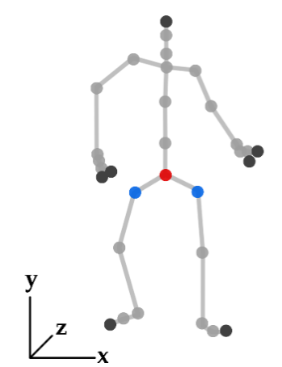








Motion capture (MoCap) data
Continuous spatio-temporal characteristics of a human motion simplified into a discrete sequence of 3D skeletons
Many application domains: computer animation, medicine, sports, …
Standard motion analysis operations: classification, subsequence search, semantic annotation
  Common task: determining similarity of two motion sequences

Slide 5
Evaluating motion similarity
State-of-the-art: features trained for whole actions
  Advantages:
    High-precision neural networks can be trained
    Suitable for action recognition
  Disadvantages:
    Limited applicability e.g. for subsequence search
      Typically works for a limited range of segment sizes
      High memory requirements (data replication) and retrieval costs
<0, 0, 5.2, 8.1, 0, 2.3, -1.1, 0, …>, ….
raw MoCap data
Action-sized segments
High-dimensional segment features
  similarity of two motion sequences = similarity of the respective two features

Slide 6
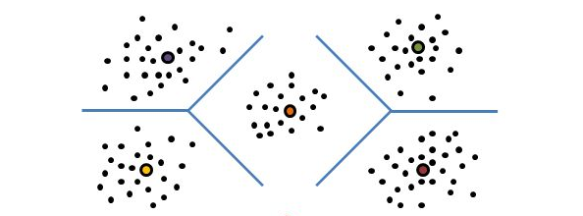
Evaluating motion similarity (cont.)
Alternative: motion word approach
  Expected advantages:
    Applicable to a wide range of MoCap processing tasks
    Applicable for comparing motion sequences of any size
    Compact motion representation, lower memory requirements
    Efficient text-processing methods can be applied for indexing and retrieval
<4.3,…>, <0.5,…>; …
ABC MOP …
raw MoCap data
Short segments
High-dimensional
segment features
Low-dimensional
motion words
  similarity of two motion sequences = similarity of the sequences of motion words

Slide 7
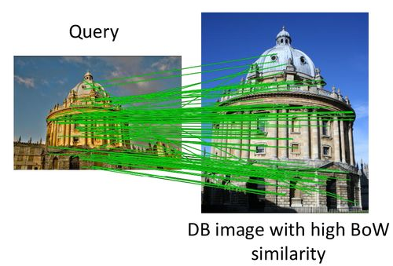
Inspiration: visual words
Around 2000, local image descriptors were very popular for image retrieval
  Effective, but not efficient: a high number (500-3000) of high-dimensional (128 for SIFT) features per single image!
Josef Sivic, Andrew Zisserman: Video Google: A Text Retrieval Approach to Object Matching in Videos. ICCV 2003.
  Use clustering to quantize feature descriptors into visual words
  Apply text-processing techniques
Many following works:
  Feature quantization:
    Trying to overcome efficiency problems:
      hierarchical k-means, approximate k-means, randomized methods
    Trying to minimize “border problems”:
      Fuzzy clustering (weighted combination of several visual words for each feature)
      Consensus clustering (multiple visual vocabularies, different levels of consensus)
  Spatial verification of candidates
p₃
p₁
a
b
p₂

Slide 8
Similar ideas in motion processing
Rongyi Lan, Huaijiang Sun: Automated human motion segmentation via motion regularities. The Visual Computer 31(1): 35-53 (2015)
  Cluster individual poses into motion words
    Agglomerative hierarchical clustering
  Apply probabilistic modeling to discover motion topics
Aristidou, A., Cohen-Or, D., Hodgins, J. K., Chrysanthou, Y., & Shamir, A. (2018). Deep Motifs and Motion Signatures. In SIGGRAPH Asia 2018
  Break motion sequences to short-term movements called motion words
  Cluster the motion words into motion motifs
    K-means clustering algorithm, mutually exclusive clusters
  The signature of a motion sequence S is defined as the normalized histogram of its words in all K clusters.
    For comparisons, use tf-idf weighting and Earth Mover’s Distance

Slide 9
Motion words – HOW?

Slide 10




Processing with MWs: overview
Similar?
…
…
…
…
segmentation
segmentation
raw MoCap data
raw MoCap data
feature extraction
feature extraction
<4.3,…>; <0.5,…>; <7.2,…>; <1.1,…>
<4.5,…>; <5.8,…>; <7.2,…>; <3.6,…>
Similar?
transformation to MWs
transformation to MWs
Match?
ABC
MOP
BBD
XVA
ABD
RRT
BBD
FGD
STEP 1: MW creation and matching
Similar?
STEP 2: similarity of MW sequences
STEP 3: complete motion processing

Slide 11
Our objectives
Demonstrate the viability of the MW approach
  Propose solutions for all phases
  Show that together they work in a real-world scenario
    With reasonable quality
    With high efficiency and scalability (at least in theory)
Identify problems, provide insight into individual steps using real data
  There are multiple phases where we can lose information
    Segmentation, feature extraction, quantization, matching
  We want to understand the influence of individual techniques, therefore we would like to evaluate each step independently

Slide 12
Step 1: MW creation and matching
Input: segment features and distance function
Output: motion words and MW matching function
What do we want?
  segments similar in the original feature space will be matched in the MW representation
  dissimilar segments will not be matched
<4.3,…>; <0.5,…>; <7.2,…>; <1.1,…>
<4.5,…>; <5.8,…>; <7.2,…>; <3.6,…>
Similar?
transformation to MWs
transformation to MWs
Match?
ABC
MOP
BBD
XVA
ABD
RRT
BBD
FGD
STEP 1: MW creation and matching

Slide 13
Towards formalization of MWs
Motion word (basic version)
  One-dimensional representation of MoCap data segment
  Obtained by disjoint quantization of the original MoCap data (features and distance measure)
    Each motion segment is associated with one MW
  Coarse approximation of the original MoCap similarity function by trivial MW matching function:
    segments that are mapped on the same MW have similarity 1
    segments that are mapped different MWs have similarity 0
Motion word vocabulary
  Set of available MWs defined by a particular quantization technique
  Can be seen as a set of equivalence classes over the original feature space
Problems:
  Assumes one optimal clustering – difficult to find
  Border problems are very likely to occur
p₃
p₁
a
b
p₂

Slide 14
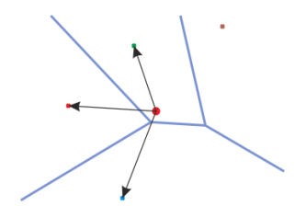
Towards formalization of MWs (cont.)
Motion word (generalized version)
  One-dimensional representation of MoCap data segment
  Obtained by soft (fuzzy, overlapping) quantization of the original MoCap data (features and distance measure)
    Each motion segment is associated with one or several motion words, potentially with confidences
      Segment s1 -> motion words {A,B,C}
      Segment s2 -> motion words {B,C,X}
      Segment s3 -> motion words {C,X,Y}
  Non-trivial MW matching function
    Motion segments are considered similar if all/some/at least k of their MWs match
      Not transitive, does not define equivalence classes
      Should provide better approximation of the original similarity between motion segments
Motion word vocabulary
  Set of available MWs defined by a particular quantization technique
  Motion words may not be equivalence classes over the original feature space
    Motion word A: {s1}
    Motion word B: {s1,s2}
    Motion word C: {s1,s2,s3}

Slide 15
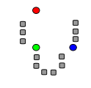
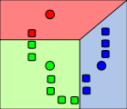
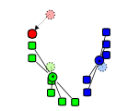
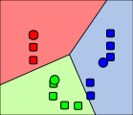
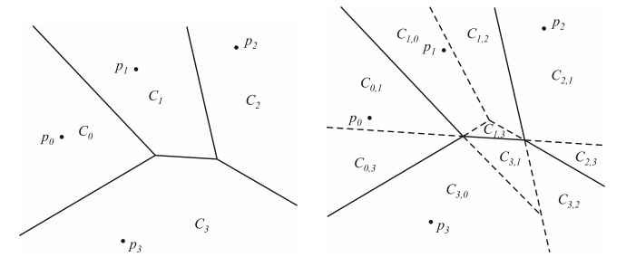
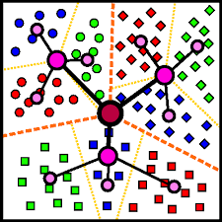
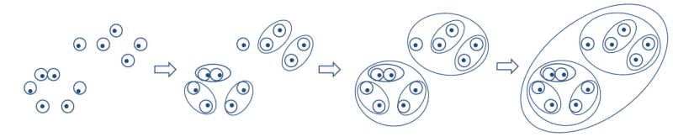
Quantizing features into MWs
Hard clustering
  Flat partitional clustering
    k-means clustering
  Hierarchical clustering
    Divisive
      Hierarchical k-means
      M-index
    Agglomerative
Soft clustering
  Fuzzy assignment to clusters
    k nearest clusters
    All clusters with close borders
  Consensus clustering
Things to consider:
  Vocabulary size = number of clusters
    Text retrieval: hundreds of thousands for full language dictionary
    Visual retrieval: hundreds of thousands or millions
    Motion retrieval: ???
      In Deep Motifs and Motion Signatures they use 100 motifs

Slide 16
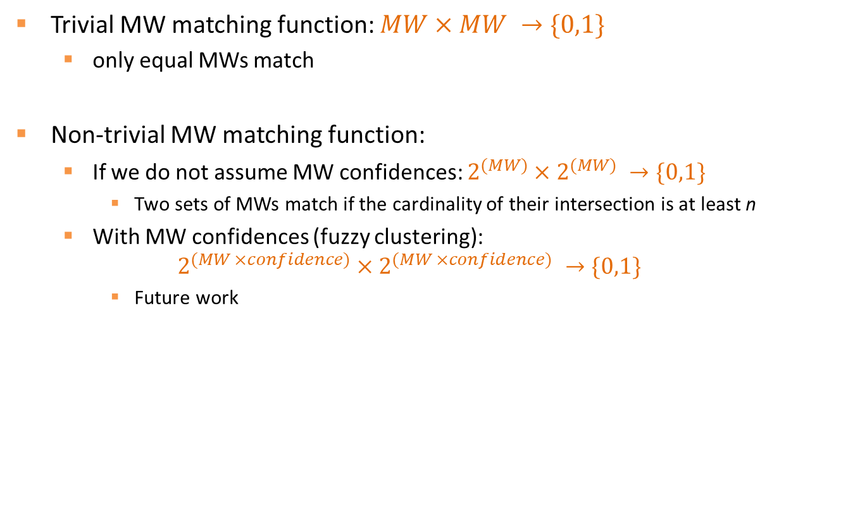
MW matching
Trivial MW matching function: $MW×MW →\{0,1\}$
  only equal MWs match
Non-trivial MW matching function:
  If we do not assume MW confidences: $2^{(MW)}×2^{(MW)} →\{0,1\}$
    Two sets of MWs match if the cardinality of their intersection is at least n
  With MW confidences (fuzzy clustering):
  $$2^{(MW ×confidence)}×2^{(MW ×confidence)} →\{0,1\}$$
    Future work

Slide 17
Evaluation of MW matching
Standard cluster evaluation
  External – compares given clustering C to GT clustering C_{GT}
    Rand index: probability that C and C_{GT} will agree on a random pair of objects
  Internal – no GT, uses intra- and inter-cluster distances
    Silhouette coefficient: measure of how similar an object is to its own cluster (cohesion) compared to the neighbor cluster (separation)
Unfortunately, there is no external GT for segment matching
  However, we can use the distribution of distances in the original feature space to define a partial approximate GT clustering C_{GT-approx}
    If dist(o₁,o₂) <= dist_{SIMILAR}, then o₁ and o₂ belong to the same cluster in C_{GT-approx}
    If dist(o₁,o₂) > dist_{DISSIMILAR}, then o₁ and o₂ belong to different clusters in C_{GT-approx}
  Using C_{GT-approx}, we can define “semi-external” evaluation measures
    E.g. Unsupervised Rand index

Slide 18
Step 2: similarity of MW sequences
Input: MW sequence and MW matching function
Output: MW sequence distance function
What do we want?
  Depends on application
    Find very similar motions different only in speed
    Find similar motions with gaps
    Detect longer sequences with similar subsequences
    …
  Common requirement: reasonable distribution of distances in the dataset
<4.3,…>; <0.5,…>; <7.2,…>; <1.1,…>
<4.5,…>; <5.8,…>; <7.2,…>; <3.6,…>
transformation to MWs
transformation to MWs
ABC
MOP
BBD
XVA
ABD
RRT
BBD
FGD
Similar?
STEP 2: similarity of MW sequences

Slide 19
Sequence similarity
Possible approaches:
  Set of words
    Jaccard similarity
  Bag of words (histograms, vectors)
    Euclidean distance
    Cosine distance
    Earth movers distance
  Sequence matching
    Edit distance
    DTW
    Sequence alignment
    Longest common subsequence
    Shingles + Jaccard similarity

Slide 20
Sequence similarity (cont.)
Things to consider:
  Word weighting
  Stop words
  Efficient indexing!
Evaluation
  Look at distance distribution of MW sequences

Slide 21
Step 3: complete motion processing with MWs
Similar?
…
…
…
…
segmentation
segmentation
raw MoCap data
raw MoCap data
feature extraction
feature extraction
<4.3,…>; <0.5,…>; <7.2,…>; <1.1,…>
<4.5,…>; <5.8,…>; <7.2,…>; <3.6,…>
Similar?
transformation to MWs
transformation to MWs
Match?
ABC
MOP
BBD
XVA
ABD
RRT
BBD
FGD
STEP 1: MW creation and matching
Similar?
STEP 2: similarity of MW sequences
STEP 3: complete motion processing

Slide 22
Complete motion processing with MWs
With respect to a given application, choose suitable segmentation, features, quantization, matching, sequence similarity
Segmentation
  Static or semantic?
    Now: static
    Future work: try semantic segmentation
  What is reasonable segment length?
  Disjoint or overlapping segments?
Segment features
  Now: original 3D data + DTW
  Future work: better segment features
    Train NN?

Slide 23
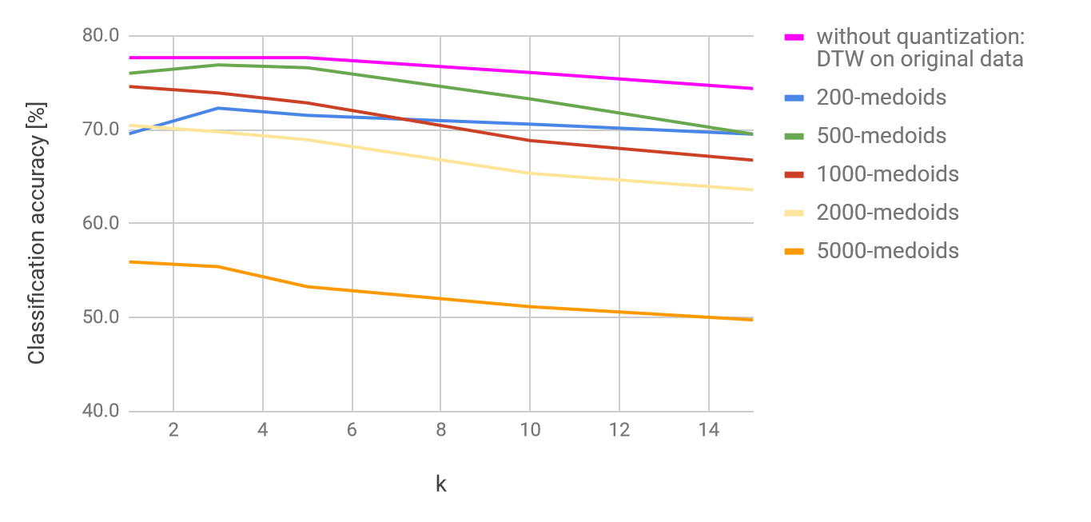
Preliminary results
Application: action recognition
  130 classes, 2345 actions
  kNN classifier
Settings:
  Static segmentation, segment length 80 frames, shift 16 frames
  Segment features: original 3D data + DTW
  Feature quantization: flat k-medoids
  Similarity evaluation: trivial MW matching, DTW for MW sequence similarity

Slide 24
The final slide (recap)
To make the MW idea work, we need to solve:
  Step 1: MW creation and matching
  Step 2: similarity of MW sequences
  Step 3: complete motion processing with MWs
What we have:
  First simple solution that provides not-so-bad results
  A lot of avenues to explore:
    Soft clustering methods
    MW sequence similarity measures
    Different segmentation strategies

