Slide 1
Efficient Processing of 3D Human Motions
Petra Budíková

Slide 2
Outline
Motivation
What are human motion data
Limitations of existing approaches to motion data management
Motion words
Principle
Soft MWs
Naïve application & evaluation
Efficient & scalable processing of soft-MW documents
Bag-of-words model
Indexing soft MWs by inverted files
Scalable processing of soft-MW posting lists
Conclusions

Slide 3
Motivation

Slide 4
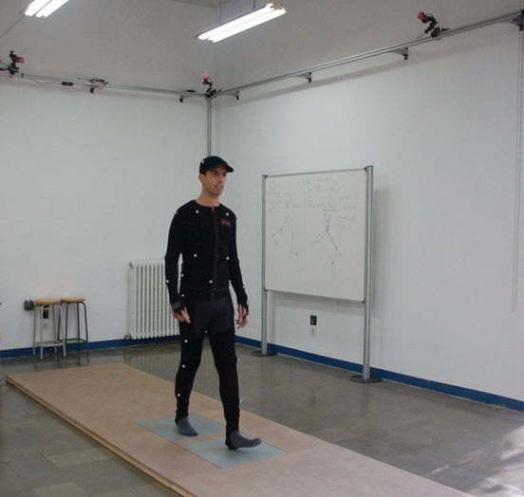
Digitization of Human Motion
Human motion can be described by a sequence of skeleton poses
Pose = 3D coordinates of important body joints in a specific time moment
Recorded by specialized motion capture devices or extracted from common video by 3D pose-estimation methods
Many application domains: computer animation, medicine, sports, …
Synchronized
cameras
Pose captured in a given
time moment

Slide 5
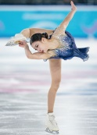
Types of Motion Data
Actions
Short motions (~seconds)
Application-dependent semantic primitive
Typical tasks: action search, classification
Long Motions
Long motion (~hours)
No clear semantics
Typical tasks: subsequence search
Motion Episodes
Medium-length motion (~minutes)
Complex semantic object
Possible tasks: retrieval of similar episodes
Figure-skating spin (10 seconds)
Figure-skating competion (3 hours)
Single skater’s performance (4 minutes)

Slide 6
Processing Motion Data
Skeleton data are voluminous
31 joints x 3 coordinates = 93 floats per pose
120 poses per second
A 10-second action is captured by 1,200 93-dimensional vectors
Methods of comparing skeleton sequences
Naïve: Dynamic Time Warping (DTW) on poses
Feature-based:
Each action represented by a fixed-size feature
L1/L2 distance on features
???
Expensive, Non-indexable
A₁
Efficient, indexable
Curse of dimensionality
A₂
Preprocessing: classification model training
1024-dim. feature from the last hidden layer
Efficient, compact, indexable
Query processing: action similarity evaluation
Action class 1
A₁
Bi-LSTM NN
(0.5; 0.221; ...)
…
Euclidean distance
A₂
Action class N
(0.7; 0.143; ...)

Slide 7
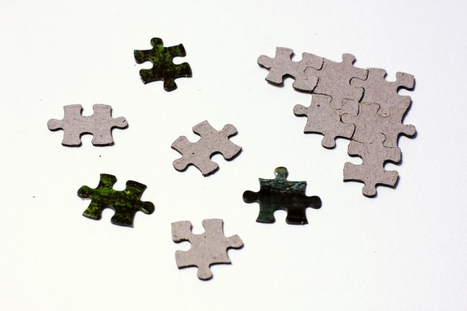
Towards Efficient Processing Motion Data
Idea: Let’s transform the motion search problem into a different problem for which good solutions already exist
Promising candidate: text retrieval!
Challenges to solve:
Transformation of motion data into text-like representations
J. Sedmidubsky, P. Budikova, V. Dohnal, and P. Zezula. Motion words: A text-like representation of 3D skeleton sequences. In 42nd European Conference on Information Retrieval (ECIR). Springer, 2020, pp. 527– 541.
Adaptation of text-processing techniques

Slide 8
Motion Words

Slide 9
Motion Words: Principle
Representing motions by MWs:
Cut motion into short, overlapping segments
Quantize the segment space
Represent original sequence by identifiers
of quantized segments
…
…
…
…
… A, A, B, O, M, M, P, D, …
A
C
D
F
G
B
E
¹

Slide 10
Motion Words: Principle (cont.)
Two main components of the MW model
MW vocabulary – produced by quantization
MW matching function – defines semantic relationship between MWs
$${match}^{MW}: MW×MW →\left\{0,1\right\}$$
Goal: similarity-preserving quantization: with high probability,
similar segment pairs are mapped to matching MWs
dissimilar segment pairs are mapped to non-matching MWs
Simple solution: hard MWs
Generalized solutions:
soft MWs
multi-overlay MWs

Slide 11
Hard MWs
Hard quantization
Segment space divided into non-overlapping partitions
Partition identifiers become the hard MWs
Each motion segment is associated with exactly one hard MW
Trivial MW matching: only identical MWs match
Properties:
Hard MWs can be readily processed by text-retrieval tools
Border problem
☺
☹
A
D
s₁ → A s₂ → C s₃ → C
trivial match^{MW}: s₁ ≈ s₂, s₁ ≈ s_{3,} s₂ ≈ s₃
s₁
B
s₂
s₃
C

Slide 12
Soft MWs
The border problem occurs when a segment lies near partition border
How can we put the divided segments back together?
Soft quantization:
Partition identifiers become MW elements
Soft MW for s₁ is an ordered set of one or more MW elements
Base element – identifies the partition containing s₁
Expanded elements – additional partitions that have borders near to s₁
Soft-base MW matching: two MWs match if their intersection contains at least one base element
element A
base, expanded
element D
s₁ → (A,{D}) s₂ → (C,{A,B}) s₃ → (C,{D})
soft-base match^{MW}: s₁ ≈ s₂, s₁ ≈ s_{3,} s₂ ≈ s₃
base
element B
expanded
s₁
s₂
s₃
element C

Slide 13
MW Quality Evaluation
Data: PKU-MMD dataset
Almost 20 K actions
43 classes of daily activities (e.g., “drink”, “wave hand”, “stand-up”)
Task: 20-NN search
129 query documents (3 random queries from each class)
Quality measures:
Average precision
Result is considered correct when it belongs to the same class as the query
Average query processing time
MW settings:
Segment length 0.66s, overlap 80 %
25 MWs per action on average
1,500 partitions (k-medoid clustering)
Soft MWs consist of up to 20 MW elements
372K unique soft MWs in total

Slide 14
MW Quality Evaluation (cont.)
ECIR20 approach: DTW alignment of MW sequences
Findings:
Soft MWs provide compact motion representation
Soft MWs are sufficiently precise
The border problem is suppressed
Soft MWs are more expensive to process
Due to the non-trivial MW matching
Method | Precision | Costs [ms]
DTW on skeletons | 54.19 % | 92,589
DTW on hard MWs | 51.82 % | 415
DTW on soft MWs | 60.60 % | 648

Slide 15
Current challenge: Efficient & scalable processing of soft-MW documents

Slide 16
What can we do with soft MWs?
DTW
Good precision
Expensive, not scalable
Text-like processing
Vision:
Adopt mature text-retrieval techniques
Achieve efficient and scalable retrieval
To do:
Is bag-of-words model applicable?
Can we find a suitable indexing scheme and a scalable retrieval algorithm?

Slide 17
The Bag-of-Words Model
Basics of text retrieval
Treat documents as bags of words
Represent the bags by (typically weighted) vectors
TF-IDF
Measure the similarity of Q and D using Cosine
The (weighted and normalized) number of words that appear in both Q and D
Soft-MWs in the bag-of-words model
Motions can be easily represented by bags of soft MWs
Cosine computation more problematic
The soft-MW matching needs to be taken into account
A single MW from Q can match multiple MWs in D and vice versa
Our solution: only consider the number of matched query MWs
TF-IDF weighting applicable with slight adjustments

Slide 18
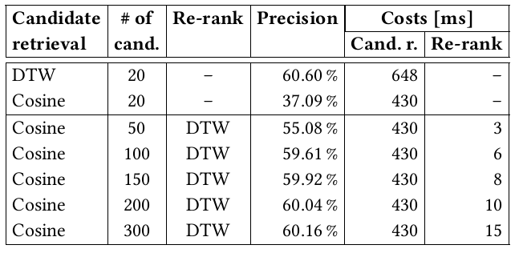
The Bag-of-Words Model: Evaluation
BoW with Cosine not sufficient
Solution: two-phase retrieval
BoW+Cosine for candidate retrieval
MW sequences+DTW for re-ranking
Weighting: TF-IDF does not work => no weights for now

Slide 19
Indexing Soft MWs Using Inverted Files
dog
cat
bear
whale
Inverted files in text retrieval:
For each word q, keep a posting list PL(q)
of all documents containing q
Given a query Q = (q₁, q₂, q₃), merge PL(q₁), PL(q₂), PL(q₃)
to get all candidate documents, compute their Cosine scores
Inverted files for MWs:
Let PL(q) be the standard posting list of documents containing MW q
Given a query Q = (q₁, q₂, q₃), merging PL(q₁), PL(q₂), PL(q₃) will only return a small subset of all relevant results
It only considers exact matches of the query MWs, not the soft-matching
Reminder: two MWs match whenever their intersection contains at least one base element
(A, {D}) and (C, {A, B}) are two different but matching MWs
Expanded posting lists: PL⁺(q) consists of the IDs of all data documents that contain q or any of its matching words
Merging PL⁺(q₁), PL⁺(q₂), PL⁺(q₃) will provide correct result for query Q
D₁
D₄
D₇
D₁
D₃
D₅
D₃
D₄
D₈
D₁
D₂
D₈
Q = (dog, cat)

Slide 20
Construction of Expanded Posting Lists
Possible approaches to PL⁺ construction
During data indexing
Does not require any changes of the query processing
Need to store large PL⁺, expensive updates
During query evaluation
Store only short basic posting lists
Additional computational costs during retrieval
Can be upper-bounded by approximate search strategies
(A,{B,C}) matches: (A,{B,C}), (A,{C,D}), (B,{C,D}), (G,{A,F})
D₁
D₄
D₇
D₁
D₃
D₅
D₃
D₄
D₈
D₁
D₂
D₈
Basic PLs
Expanded PL for (A,{B,C})
D₁ D₂ D₃ D₄ D₅ D₇ D₈
☺
☹
☺
☹
☺

Slide 21
Construction of Expanded Posting Lists (cont.)
To construct PL⁺ during query evaluation, we need
Basic PLs for all MWs
Plus auxiliary translation tables between full MWs and their IDs
Efficient way of finding all matches of a given MW
(A,{B,C}) has two types of matches:
MWs with B or C as their base elements
MWs with A anywhere
MW-matching index: for each element E, keep two lists
Base list of MWs having E as their base element
Expansion list of MWs having E among their expansion elements

Slide 22
Construction of Expanded Posting Lists (cont.)
Memory requirements for our dataset (20K data documents, 372K soft MWs)
Original skeleton data: 1.5 GB
Full MW documents: 32 MB
Indexed MWs:
50 MB for vocabulary translation tables
30 MB for MW matching index
4 MB for posting lists

Slide 23
Retrieval Efficiency Using Inverted Files
Findings:
Some costs are saved by skipping documents that have zero overlap with the query
The construction of PL+ is very expensive and not scalable
Each of our MWs has 12,436 matches on average
Growing dataset => growing basic PLs => higher costs of PL⁺ construction and merging
To achieve efficient and scalable retrieval, we need to limit both the number and size of PLs that need to be processed

Slide 24
Scalable Processing of MW Posting Lists
Idea: to construct PL⁺(q), do not use all matches of q but just the most promising ones
Less merging steps to construct PL⁺(q)
Shorter PL⁺(q)
How do we select the most promising matches for q?
Each soft MW represents a short motion segment
MW structure reflects the position of the
respective segment in the segment space
Two highly similar segments are likely to
have many shared elements
New fine-grained measure of MW similarity
Jaccard similarity over the sets of all elements of two MWs q and r
A
D
base
B
expanded
s₁
s₂
s₃
C
base, expanded
s₁ → (A, {D}) s₂ → (C, {A, B}) s₃ → (C, {D})
$${q=\left(x,\left\{X\right\}\right) X}^{′}= \{x\}∪X$$
$${r=\left(y,\left\{Y\right\}\right) Y}^{′}= \{y\}∪Y$$

Slide 25
Scalable Processing of MW Posting Lists (cont.)
Two uses of the sim function:
Reducing the size of PL⁺(q): to construct PL⁺(q), do
Find all matches of q and order them by decreasing sim from q
Gradually construct PL⁺(q) until a user-defined size limit is reached
Weighting of documents in PL⁺(q)
For each document D_{i} in PL⁺(q), there have to be one or more MWs r₁, …, r_{n} that are matches of q and contain D_{i} in their basic PLs
The weight of D_{i} in PL⁺(q) is equal to max{sim(q,r₁), …, sim(q,r_{n})}

Slide 26
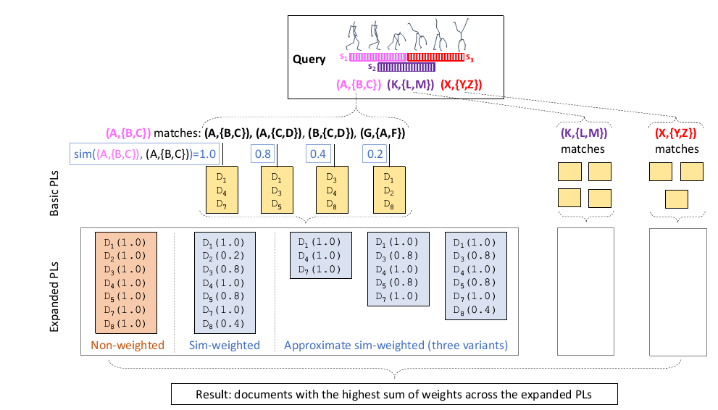
Scalable Processing of MWs – the big picture

Slide 27
Experimental Evaluation

Slide 28
Conclusions
What have we achieved?
Compact motion representation by motion words
Adaptation of inverted file indexing applicable to soft-MW documents
Approximate retrieval algorithm with near-constant query processing times for arbitrarily large data collections
To the best of our knowledge, the proposed solution is the first scalable motion retrieval method
Unsupervised -> widely applicable
Domain independent -> possibly applicable to other types of spatio-temporal data
Currently under review as a full paper for ICMR conference
So keep your fingers crossed ;)

Slide 29
Questions, please!
?
?
?
?
?
?

