Slide 1
Semantic search-based image annotation
Petra Budíková, FI MU
CEMI meeting, Plzeň, 16. 4. 2014

Slide 2
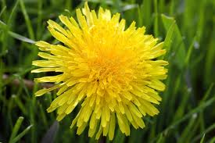
The annotation problem
Formalization
  The annotation problem is defined by a query image I and a vocabulary V of candidate concepts
  The annotation function f_{A} assigns to each concept c ∈ V its probability of being relevant for I
?
V = {flower, animal, person, building}
Basic possible approaches
  Model-based annotation
    Train classifiers
    Suitable for tasks with smaller dictionaries and available training images (e.g. medical image classification)
  Search-based annotation
    Exploit results of similarity search in annotated images
    Suitable for tasks with wide dictionaries (e.g. image annotation for web search)

Slide 3
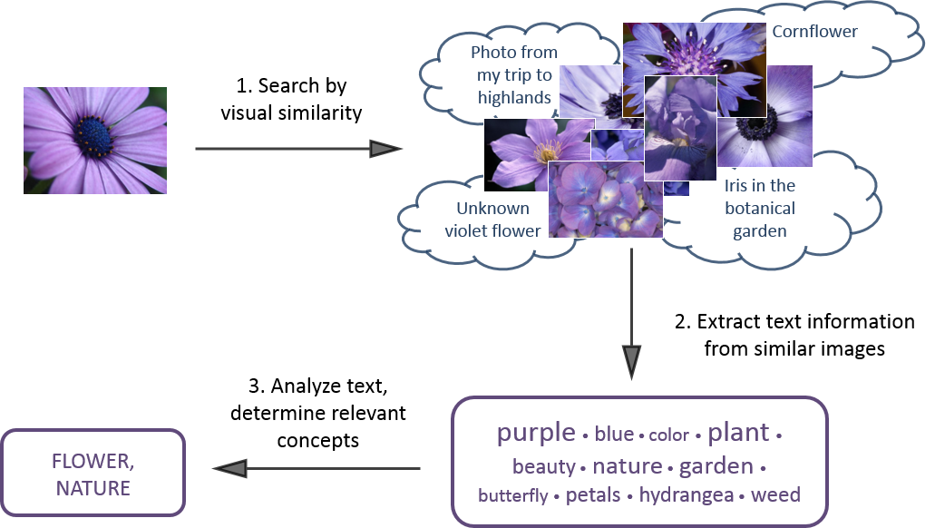
Search-based annotation in a nutshell

Slide 4
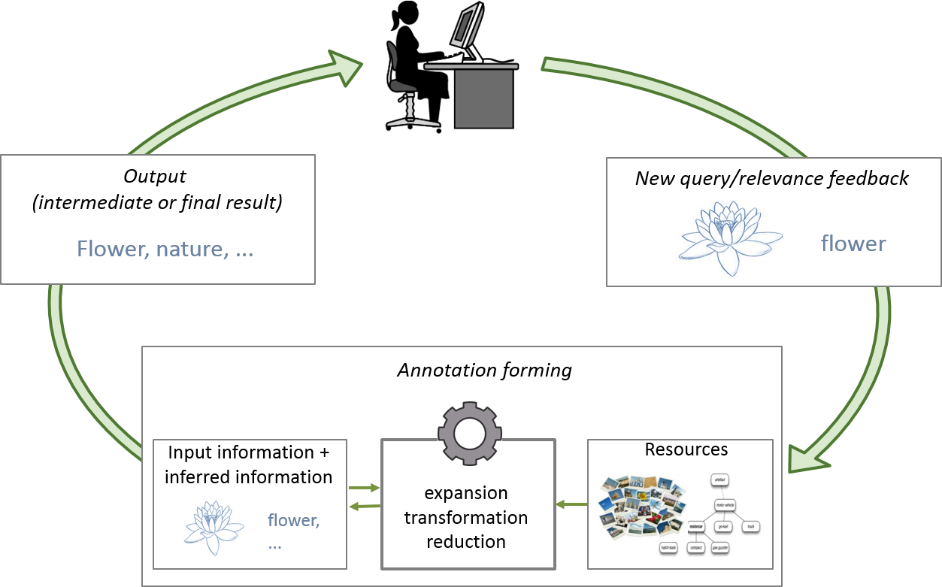
Our vision
Next generation of similarity-based annotation
  Similarity searching
  Text cleaning
  Semantic information extraction
  Classifiers
  Relevance feedback

Slide 5
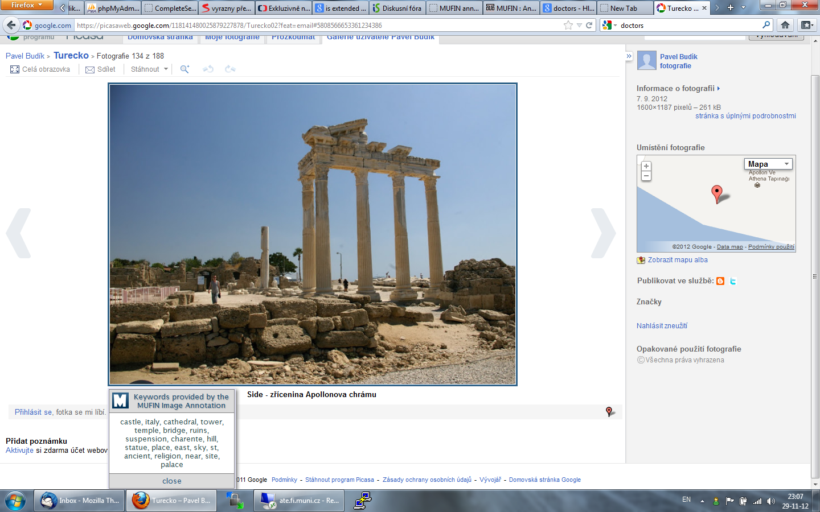
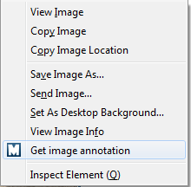

MUFIN Image Annotation
Already done (paper IDEAS 2013):
  Modular framework for annotation processing
  Implementation of basic modules
    Similarity search, text cleaning, basic WordNet-based semantic processing
  Working system for keyword annotation with 50-60 % precision
    Vocabulary V = all English words
Problems
  Not precise enough
  Results too unstructured for practical use
  Difficult to evaluate

Slide 6
Current focus
  Hierarchical approach
    Vocabulary hierarchically organized
    WordNet hypernymy/hyponymy tree, ontology
Semantics-aware processing of similar images’ descriptions
  Study and exploit suitable resources of semantic information
  Determine the relevance of candidate concepts with respect to semantic relationships
ImageCLEF evaluation
  ImageCLEF2014: scalability-oriented, no manually labelled training data
  100 test concepts, provided with links to WordNet synsets

Slide 7
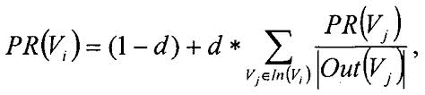
ConceptRank
Inspiration: PageRank
  Importance of a page is derived from the importance of pages that link to it
  Linear iterated process, modelled as a Markov system
  Random restarts to avoid “rank sinks”
ConceptRank idea: Semantic ranking of WordNet synsets
  A Markov system, nodes are formed by WordNet synsets
  Links between nodes connected by some WordNet relationship
    Weighted according to the type of the relationship
  Random restarts are not weighted uniformly, but reflect the initial weights of synsets as determined by similarity searching

Slide 8

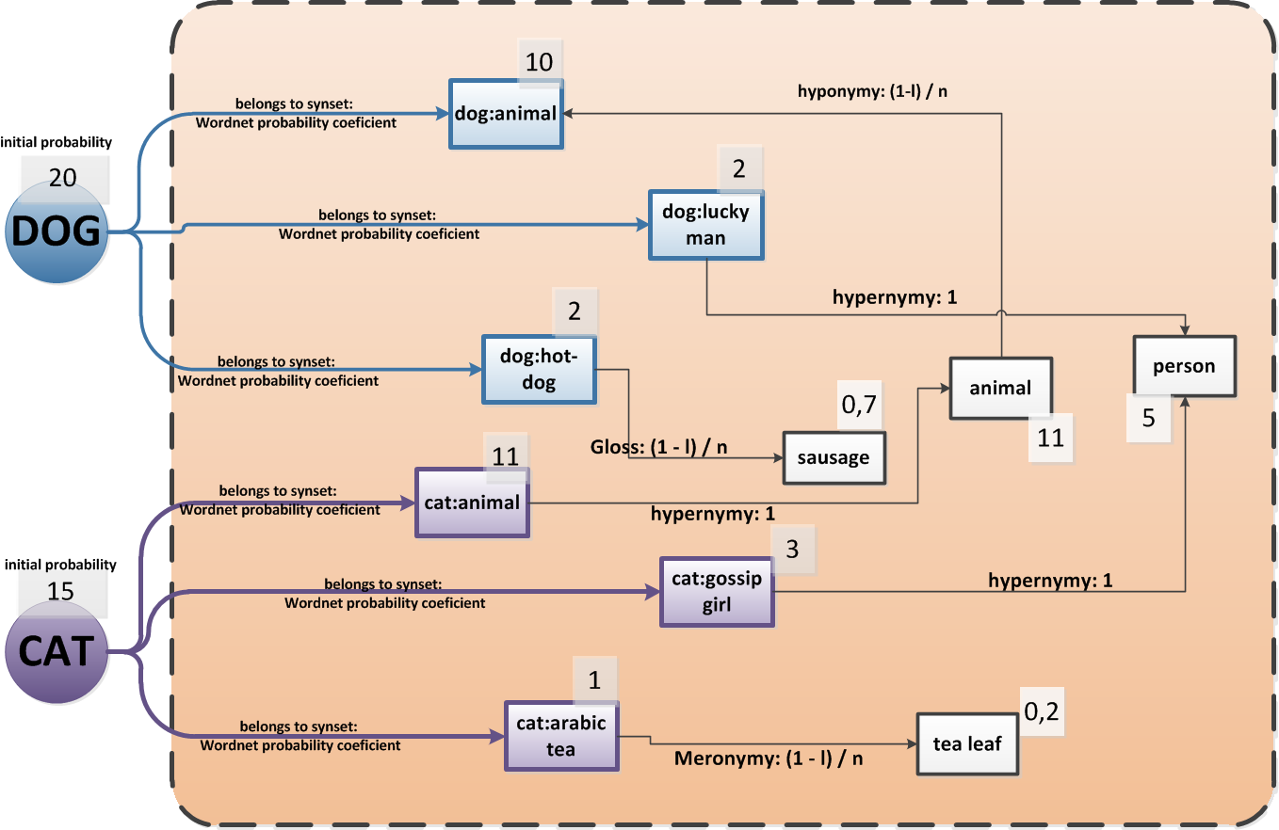





ConceptRank illustration

Slide 9
ConceptRank Resources
Content-based image retrieval
  powered by MUFIN
  20M Profiset collection, 250K ImageCLEF training data
WordNet
  Standard relationships (hypernymy, antonymy, part-whole, gloss overlap, …)
  Word similarity metrics defined on top of hyponymy/hypernymy tree
  the “language” point of view
Visual Concept Ontology (VCO)
  Semantic hierarchy of most common visual concepts, linked to WordNet
  VCO sub-trees are used to limit the search for WordNet relationships
Co-occurrence lists for keywords from Profimedia dataset
  Constructed from very large text corpus (linguists from MFF UK)
    Corpus size approximately 1 billion words
  “human/database” point of view

Slide 10
Cooperation with other CEMI teams
UFAL
  Information about keyword co-occurrence in text corpora
    Already part of MUFIN Image Annotation processing
  Other semantic resources: WikiNet
    Being studied at UFAL
ČVUT
  High-precision classifier for 1000 ImageNet concepts
    Todo: compare performance of this classifier and MUFIN search-based solution; if complementary, try to combine
  Image similarity measure derived from the classifier
    Todo: compare it to MPEG7 similarity utilized by MUFIN Image Annotation

Slide 11

Questions, comments?

