Slide 1
Search-based image annotation (ideas for joint journal paper)
CEMI meeting, Praha, 14. 3. 2014

Slide 2
Outline
Introduction
Why annotations?
State-of-the-art in multimedia annotation
Search-based image annotation
What we have
Global architecture
Basic implementation
What we are working on
Semantic PageRank
ImageCLEF evaluation
Plans for future
Relevance feedback
Additional knowledge sources
Topics for discussion

Slide 3
Motivation & Related work

Slide 4
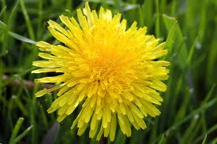
Motivation
Keyword-based image retrieval
Popular and intuitive
Needs pictures with text metadata, we do not want to create them manually
?
Information seeking: “What is in the photo?”
Tourist information / Plant identification / …
Impaired users
Classification tasks
Scientific data (medicine, astronomy, chemistry, …)
Improper content identification
Personal image gallery
Data summarization: “What images are on this computer?”
Not only images!
Sound, video, ….

Slide 5
Several dimensions of the annotation problem
Input
Image / Image and seed keyword / Image and text / Text
Type of information needed
Identification / Detection / Categorization
Vocabulary
Unlimited vocabulary / Controlled vocabulary
Form of annotation required
Sentence / Set of keywords / All relevant categories / A single category / Localization in a taxonomy
Interactivity
Online / offline annotation
Classification: identify relevant categories from a given list (vocabulary)
Annotation: wide (unlimited) vocabulary, “all relevant needed”

Slide 6
State-of-the-art text-extraction techniques
Pure text-based
Analyze the text on a surrounding web page
Content-based / Content- and text-based
Mainly exploit visual properties (+ text when available)
Content-based annotation scenario:
Basic annotation
Model-based: train a model for each concept in vocabulary
Search-based: kNN search in annotated collection
Annotation refinement
Statistical
Ontology-based
Secondary kNN search
…

Slide 7
Existing approaches – summary
Model-based techniques:
Specialized classifiers can achieve high precision
Fast processing
Training feasible only for a limited number of concepts feasible, high-quality training data needed
Search-based techniques:
Can exploit vast amounts of annotated data available online
No training needed, no limitation of vocabulary
Costly processing when large datasets need to be searched
Current implementations not precise enough
Summary of state-of-the-art:
Mostly specialized solutions for a specific type of application
Reasonable results only for simple tasks
+
+
-
+
+
-
-

Slide 8
Our approach

Slide 9
Overview
Facts
Experiments show that state-of-the-art solutions are not very successful for complex problems
Psychologic research suggests hierarchical annotation
Our vision:
Broad-domain annotation is a complex process, needs to be modeled as such
Multiple processing phases
Modular design
Hierarchic annotation
Combine multiple knowledge sources
User in the loop
The same infrastructure could be used for different applications (annotation, classification, …)
The principal components are the same
Easy evaluation, comparisons

Slide 10
Task formalization
We assume that the annotation task is defined by a query image I and a vocabulary V of candidate concepts
The annotation function f_{A} assigns to each concept c ∈ V its probability of being relevant for I
Covers different variations of keyword annotation:
Classification tasks: small V, relevance threshold to decide whether I belongs to a given class
Annotation tasks: wide or even unlimited V, N most probable concepts returned
Hierarchical annotation: vocabulary V is hierarchically structured, system returns top N categories + M descriptive keywords in each category

Slide 11
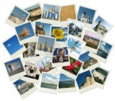
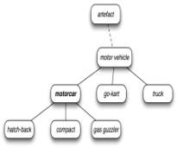
General annotation model
Output
(intermediate or final result)
New query/relevance feedback
Flower, nature, ...
flower
Annotation forming
Input information + inferred information
Resources
expansion
transformation
reduction
flower, ...

Slide 12
General annotation model (cont.)
Framework components
Query
Image / image + text / (text)
Knowledge sources
Annotated image collection, WordNet, ontologies, internet, …, user
Annotation-record
Query + candidate keywords, weights, any other knowledge
Processor modules
Expander, transformer, reducer
Evaluation scenarios
Properties
Clear structure, modularity
Can be adapted to various annotation/classification tasks
Supports extensive experiments, comparison of techniques
Knowledge source
Annotation-record
word
word
word
word
NULL
NULL
weight
weight
Expander
Transformer
Reducer

Slide 13
Basic search-based annotation
Annotated image collection
WordNet,
specialized ontologies, corpora, …
Query
Content-based search
Some magic here
Annotation-record
Relevant keywords
word
word
word
word
NULL
NULL
NULL
NULL

Slide 14
Advanced example: Hierarchic image annotation
Image collections, dictionaries, Wikipedia, …
WordNet,
specialized ontologies
Content-based search
(+ syntactic cleaner,
basic weight transformer)
animals, outdoor
Query
Global
classifiers
Semantic
weight
transformer
Basic concept
reducer
Basic level category
WordNet,
specialized ontologies
Image collections, web, dictionaries, Wikipedia, …
animals, nature, outdoor, snow, pinguins, group, standing
animals, outdoor, pinguins, whales, snow
Multi-modal search
(+ syntactic cleaner,
basic weight transformer)
Keyword /category
selection
Result or next level category
Semantic
weight
transformer
Specialized
classifiers
Relevance
feedback
Relevance
feedback
animals, outdoor, pinguins, whales, snow

Slide 15
Processing modules
Expander
Reducer
Transformer
Expanders
Provide candidate keywords
Visual-based nearest-neighbor search
Face detection software
Transformers
Adjust weights of candidate keywords
Basic weight transformer
Frequency of a keyword in the descriptions of similar images
Semantic transformer
Uses WordNet hierarchies to cluster related words
Keyword weight increased proportionately to the size of containing cluster
Reducers
Remove unsuitable candidates
Syntactic cleaner
Stopword removal, translation, spell-correction

Slide 16
Current implementation
We have a working annotation tool
http://disa.fi.muni.cz/prototype-applications/image-annotation/
Testing
160 test images, annotation results evaluated by humans
Average precision: 38 % “perfect” + 22 % “acceptable”
Processing times: 3 s with 10 similar images, 14.5 s with 30 similar images

Slide 17
Work in progress

Slide 18
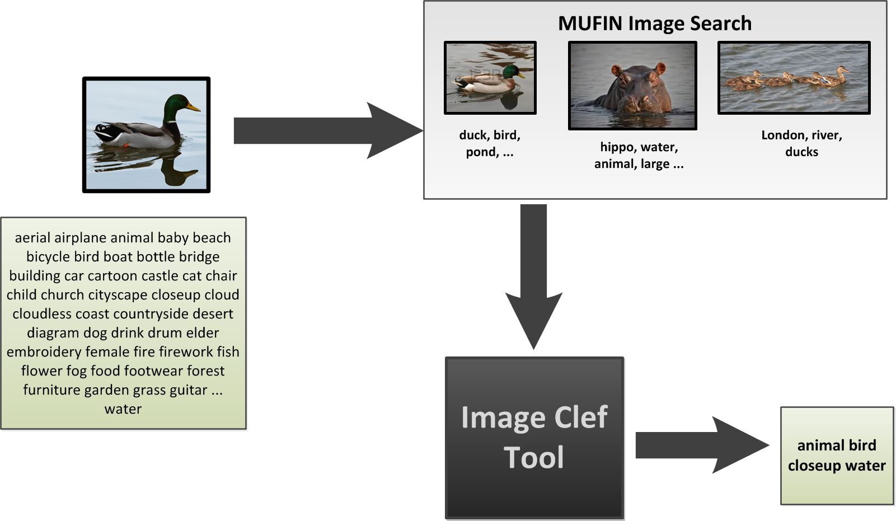
Advanced semantic transformer
Problem recapitulation: Using descriptions of visually similar images, choose the most probable keywords from a given vocabulary V
?

Slide 19
Resources
Content-based image retrieval
powered by MUFIN
20M Profiset collection, 250K ImageCLEF training data
WordNet
Standard relationships
Word similarity metrics defined on top of hyponymy/hypernymy tree
Visual Concept Ontology
Semantic hierarchy of most common visual concepts, linked to WordNet
Co-occurrence lists for keywords from Profimedia dataset
Constructed by Institute of Formal and Applied Linguistics (MFF UK)

Slide 20
WordNet vs. co-occurences
WordNet – fundamental technology
Meanings, relations, multiple word types
Hypernymy, antonymy, part-whole, gloss overlap, …
“language” point of view
Co-occurrence table of related words
Constructed from very large text corpus (linguists from MFF UK)
Corpus size approximately 1 billion words
Only words with frequency > 5000 in the whole corpus considered
For each word that occurrs in Profiset descriptions, we have 100 most co-occurring words
No word types attached
“human/database” point of view

Slide 21
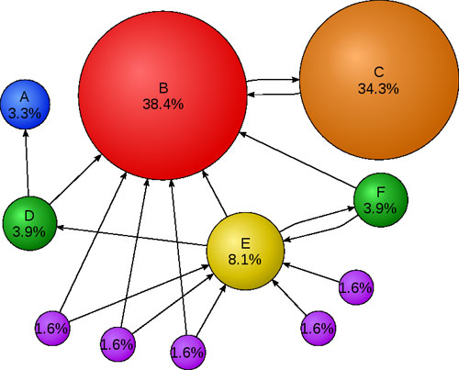
Semantic network idea
Graph representation of semantic relationships
Nodes: keywords/synsets
Edges: WordNet/co-occurrence/… relationships between nodes
Edge weight: “relevance transfer” capacity
Inspired by PageRank

Slide 22
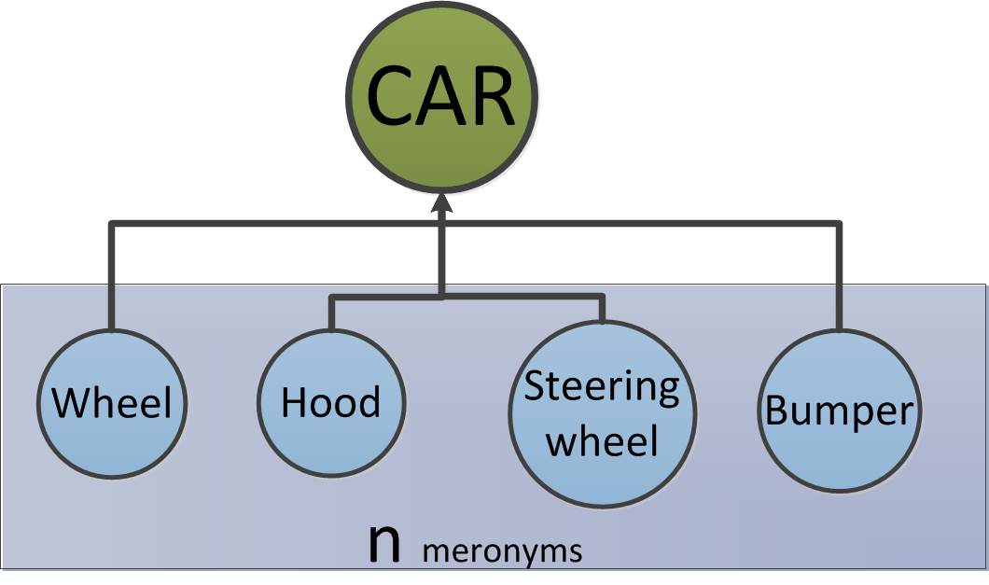
Semantic network (cont.)
The probability-transfer coefficients of links between individual nodes are defined for different types of relations: hypernymy, synonymy, meronymy, word co-occurrence, …
Hypernym (generalization): 1 (i.e. 100 %)
Hyponym (specialization): (1-l)/n
l – calibration constant, n – number of hyponyms
Meronyms (whole -> parts): (1-l)/n
…

Slide 23
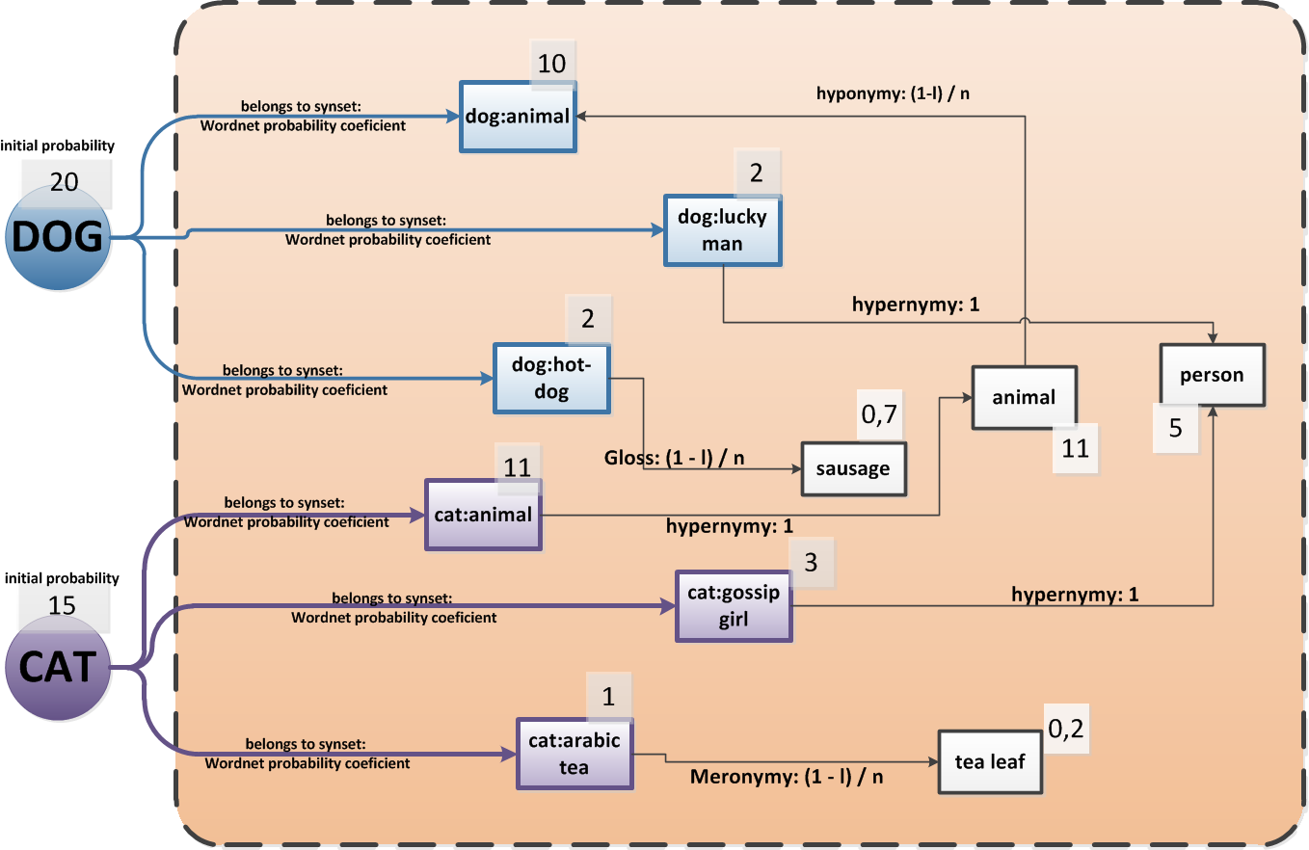
Network example

Slide 24
Algorithm steps
Assign probability values to initial nodes
Initial nodes are formed by keywords of visually similar images
2) Build the network
Extend initial nodes by related synsets AND co-occurring words
Assign “probability-transfer coefficients” to links between nodes (determined by the type of relationship)
3) “Page-ranking” process
Run a process where synsets will mutually boost one another’s probability values
4) Select the most probable synsets

Slide 25
Utilization of co-occurrence lists
Enrichment of keywords from similar images
For each initial keyword, add K most frequently co-occurring words
Need to choose a suitable K, 100 is probably too much
The weight of the respective edge (i.e. the probability transfer coefficient) proportional to the score of co-occurring words
After the enrichment step, connect all keywords to possible synsets
Edge weights proportional to the WordNet score of a given synset
If we have word types of co-occurring words, we can have smaller graph (but possibly introduce errors)
Continue working only with synsets and WordNet relationships

Slide 26
Unresolved issues
Calibration of probability-transfer coefficients
What constants should be used?
Initial step: assignment of initial probabilities to keywords from similar images
Take into account ranking by similarity, distance?
Details of the probability transfer algorithm
Final step: Selecting of the most probable concepts
Take top-N concepts with the highest probabilities, N fixed?
Or use some probability threshold?

Slide 27
Evaluation: ImageCLEF 2014
ImageCLEF: Competition in cross-language image annotation and retrieval
Tasks in 2014:
Robot vision – object recognition
Plant identification
Medical image identification
Image Annotation
Scalable Concept Image Annotation 2014 (deadline: 20.04.2014)
Focus on scalability – no manually labeled training data
Noisy training data downloaded from internet are only available
Development data – 10000 images with ground truth concepts
Participants are allowed to use no manually labeled training data that was created directly for machine learning
Profiset is OK, since it is a by-product of another activity (image selling)

Slide 28
Evaluation plan
Overall effectiveness:
Baseline ImageCLEF implementation vs. our solution
We have Matlab code for evaluation of results during development
Influence of different semantic resources
The “Big Data” effect:
Compare annotation results over different image bases used for selection of similar images
20M Profiset images
250K ImageCLEF web images
250K Profiset images (random subset of Profiset)

Slide 29
Plans for future

Slide 30
Future work
Add classifiers
Face detector
…
More semantic resources
WikiNet?
For the next journal paper: Relevance feedback
We are preparing interface
How to use the feedback is an open question
No related work that we know of
Possibilities: new similarity search with visual example and text, adjustment of initial weights of keywords; allow negative feedback?

Slide 31
Discussion

Slide 32
Possible structure of the paper
Search-based approach to image annotation:
Why, basic idea
Applications
Phase 1: Content-based retrieval of similar images
Phase 2: Analysis of image metadata
Semantic PageRank
Complementing linguistic tools, ontologies and data from text corpora
Implementation framework
Already presented – IDEAS 2013
Evaluation: effectiveness, efficiency
Manual evaluation within our framework
ImageCLEF results

Slide 33
Topics for discussion
Co-occurrence lists
How exactly are the lists constructed? Could you add word types? What is the interpretation of the probability coefficients of co-occurring words?
Utilization of co-occurring words – any ideas, suggestions?
Would an online service for computing co-occurrence distance between keywords be a) feasible, b) useful?
Anything you would like to try/test?
Wikinet – how could it be used to improve annotations?
Named entity processing would be very useful
Some other suitable resources?
Where to publish??
Short joint presentation at CEMI meeting in April?

