Slide 1
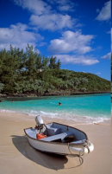
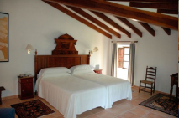
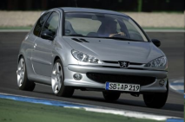
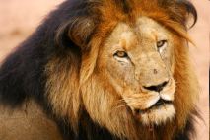
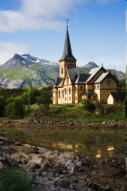
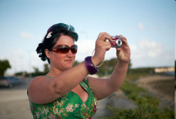
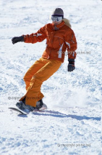
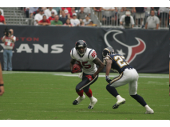
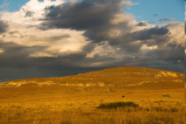
Evaluation Platform for Content-based Image Retrieval Systems
Petra Budikova, Michal Batko, Pavel Zezula
Masaryk University, Czech Republic
<result id=“1”>
<object id=“1” relevance=“0.5”/>
<object id=“2” relevance=“0.0”/>
<object id=“3” relevance=“0.5”/>
<object id=“4” relevance=“0.9”/>
…
</result>

Slide 2
Outline
Motivation
Why is it important to create a new evaluation platform?
Profimedia evaluation platform
Dataset
Dataset properties, descriptors
Test query objects
Topics, query definition
Partial ground truth
Creation, statistics
Services
Collection download, ground truth expansion, evaluation of search results
Conclusion & discussion

Slide 3
Motivation
Test collections with ground truth (GT) necessary for evaluation of search methods
Research reports, evaluation competitions (i.e. ImageCLEF)
Existing image collections not satisfactory for large-scale image search
Corel – small
MIR Flickr – small, GT only accessible to ImageCLEF participants
CoPhIR – GT not available
Desired platform properties
Large dataset with real-world data
Query topics with ground truth
Extensibility

Slide 4
Profimedia dataset
Data
20 million images from Profimedia photostock
http://www.profimedia.com
High quality photos of nature, people, places
Thumbnail images, link to full size original image
Metadata
Supervised annotations
Title (3 to 10 words)
Keywords (20 on average)
Five MPEG7 descriptors
Shape and color visual descriptors
Scalable Color, Color Structure, Color Layout, Edge Histogram, Region Shape

Slide 5
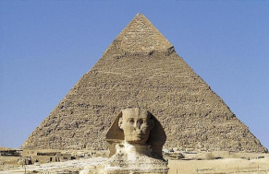
Profimedia dataset – example
id: 0000023096
link to Profimedia source page: http://www.profimedia.cz/image/detail/0000023096
title: Statue in front of pyramid, The Sphinx, Pyramid of Chephren, Giza, Cairo, Egypt keywords: africa, egypt, cairo, northern, near gizeh, with sphinx, heritage, chephren-pyramides, north, world
MPEG-7 descriptors:
Scalable Color: -42, -51, -127, 55, 52, 33, 23, 31, -19, -8, 10, 20, 14, 12, 19, 22, 5, -1, 0, 2, 15, -16, 1, 2, 10, 0, 2, 0, 12, 5, 1, -4, 2, 3, 2, 1, 0, 0, 1, 2, 1, 6, 2, 3, 1, 1, 4, 3, -5, -3, 0, 2, 2, 3, 3, 0, -1, -4, 0, -2, 1, 0, -3, -3
Color Structure: 78, 189, 6, 0, 0, 0, 0, 0, 57, 20, 255, 60, 122, 12, 0, 0, 0, 0, 0, 0, 0, 0, 1, 0, 255, 208, 105, 18, 105, 37, 10, 0, 0, 0, 0, 0, 8, 3, 3, 0, 70, 10, 7, 0, 36, 0, 0, 0, 0, 0, 0, 0, 6, 1, 1, 0, 33, 0, 0, 1, 0, 0, 0, 0
Color Layout: 14, 17, 23, 9, 18, 9; 9, 14, 14; 31, 15, 17
Edge Histogram: 4, 3, 6, 7, 2, 4, 3, 6, 7, 4, 3, 4, 7, 6, 3, 4, 2, 7, 5, 6, 3, 4, 2, 6, 6, 3, 4, 4, 5, 6, 4, 3, 6, 6, 5, 4, 2, 7, 6, 4, 3, 3, 5, 7, 4, 3, 4, 6, 6, 4, 3, 2, 7, 4, 6, 5, 1, 6, 6, 4, 2, 2, 6, 7, 3, 3, 1, 2, 7, 6, 3, 3, 7, 3, 3, 5, 3, 5, 4, 4
Region Shape: 15, 12, 15, 8, 10, 8, 15, 14, 7, 12, 7, 12, 15, 10, 8, 13, 11, 7, 15, 14, 0, 6, 8, 9, 10, 8, 0, 7, 2, 7, 7, 5, 5, 8, 7, 1

Slide 6
Test query objects
Objectives
Choice of query topics
Diverse topics
Different difficulty levels
Clear ground truth
Definition of a topic
Support multimodal search
Profimedia queries
100 query objects, 14 tematic groups (e.g. animal, art, building, event, …)
Popular queries from Profimedia logs
Easy/difficult queries from our experience
Query is defined by an example image and one or several keywords
At least 10 relevant results must exist

Slide 7
Test query objects – example

Slide 8
Partial ground truth
Ground truth
Relevance of each object in the dataset with respect to each query
100 x 2 000 000 = 200 M relevance assessments
Obtaining full ground truth very difficult
Automated approaches?
Human participation – crowdsourcing
Partial ground truth
New concept
Only promising objects are evaluated with respect to given query
To obtain the promising objects, a number of diverse search methods are evaluated

Slide 9
Partial GT – obtaining promising objects
State-of-the-art retrieval methods
Nearest neighbor queries
Text-based, content-based, multimodal
Multi-phase query processing
Query expansion
Basic search
Ranking
Different parameter settings
Implementation uses MESSIF framework
Altogether 140 search methods evaluated for each query
Top 20 objects from each method get to the evaluation pool
Average size of evaluation pool: 578 objects

Slide 10
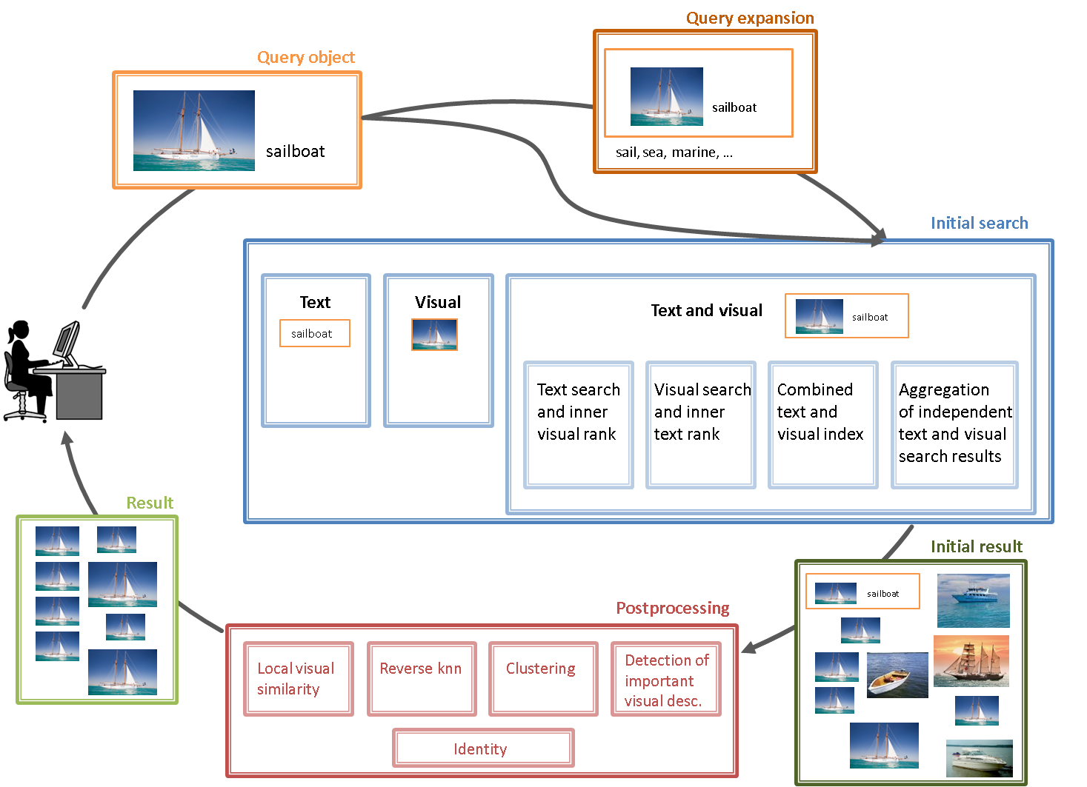
Partial GT – promising objects II

Slide 11
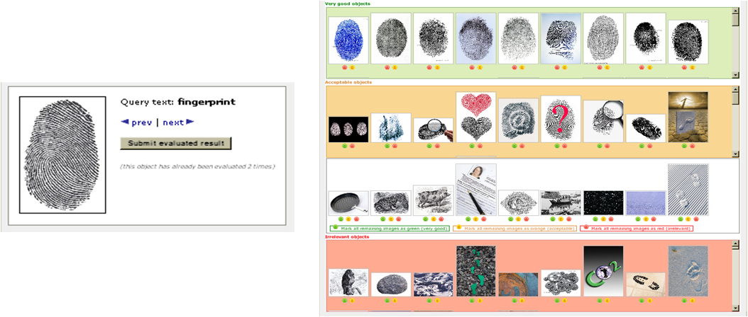
Partial GT – evaluation
Manual evaluation of promising objects
At least two people evaluate each query-result pair
Three relevance levels: very good (100 %), acceptable (50 %), irrelevant (0 %)
Final relevance evaluated as average
Web interface for relevance assessments

Slide 12
Partial GT – statistics
Evaluation process
15 relevance judges (students and researchers in IT)
1 month evaluation, net time estimation = 100 hours
Total of 128,141 evaluated query-result-user triplets
GT statistics
Average result evaluation: out of 578 result objects, 105 perfect ones (100 % relevance), 223 good objects (>= 50 %), 315 irrelevant (0 %)
Diverse results quality for individual queries => different difficulty of queries (as desired)
Significant agreement in evaluations by individual judges

Slide 13
Profimedia platform services
Three services available
Data download
Evaluation of submitted results
Expansion of the partial ground truth
Data download
Registration and agreement to the usage terms
Access to 20 M Profimedia images and 100 query topics
Public demo for collection browsing: http://mufin.fi.muni.cz/profimedia

Slide 14
Profimedia platform services II
Evaluation of submitted results
Users submit their results in XML format
The relevance of results is checked against the partial GT and exported to XML
Objects with unknown relevance can be evaluated manually
<profimedia_evaluated_result_set created="2011-04-19T18:46:01">
<result id="qoWordnet-textAndVisual_kw2.5_size2000-reverseKnnRank_iw0.0" query_id="0000023096">
<aggregate_relevance_statistics>
<average_relevance value="12.5"/>
<standard_deviation value="30.980984670161995"/>
…
</aggregate_relevance_statistics>
<objects_evaluation>
<eval_object id="0000023096" average_relevance="100.0" number_of_evaluations="2"/>
<eval_object id="0002282845" average_relevance="0.0" number_of_evaluations="2"/>
…
</objects_evaluation>
<not_evaluated_objects>
<object id="0012716237"/>
<object id="0043240911"/>
</not_evaluated_objects>
</result>
</profimedia_evaluated_result_set>

Slide 15
Profimedia platform services III
Expansion of the partial ground truth
New query objects can be introduced
Candidate sets created using our set of methods, external ones or both
Existing candidate sets can be expanded by external search methods
Web interface for evaluation of new candidates
All additions immediately available for download and evaluation service

Slide 16
Conclusion
Objective
Large, freely available collection for evaluation of image search methods
Data collection with ground truth for queries
Result: Profimedia evaluation platform
20 million images, free for non-commercial use
100 query topics, new topics can be added via service
Partial ground truth, service for collaborative extending
Service for automatic evaluation of submitted results
http://mufin.fi.muni.cz/profiset

