Slide 1
Visual Exploration of Human Motion Data
Petra Budikova, Daniel Klepac, David Rusnak, Milan Slovak
Laboratory of Data Intensive Systems and Applications
Faculty of Informatics, Masaryk University, Brno, Czechia
disa.fi.muni.cz

Slide 2
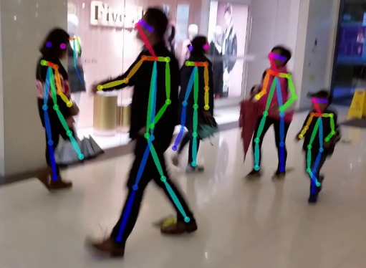
Motivation
Thanks to the rapid development of neural networks, human motion data can nowadays be extracted from ordinary videos
Huge application potential: medicine, sports, elderly care, …
Needs user-friendly tools for motion data management
Motion data in raw format completely incomprehensible for humans

Slide 3
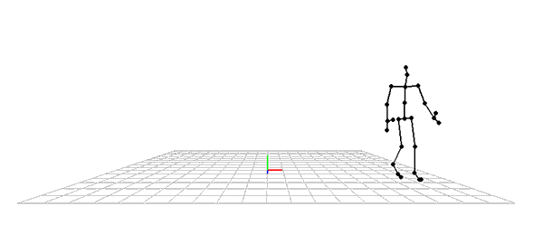
Visualization of motion data
Usual way: animation
Detailed but time-consuming
Not suitable for collection browsing or comparing multiple motion sequences
Our approach: complete motion visualized in single image
Can be read at a glance
MocapViz: JavaScript library for visualization of motion data
Visualization of single motion sequence
Understanding motion similarity
Exploration of human motion datasets

Slide 4
Visualization of Single Motion Sequence
Digitized human motion is represented as sequence of poses
Pose = 3D coordinates of important body joints in a specific time moment
5 seconds of motion -> 600 poses (for FPS=120)
Motion image construction
Keypose selection by curve simplification algorithm
Plus additional low-opacity poses -> feeling of motion
Fixed viewpoint chosen so that maximum information is shown
Bird-eye view (“map”) shows movement in space

Slide 5
Understanding Motion Similarity
How do we compare two motions?
Raw skeleton sequences: spatio-temporal data
Sequence alignment methods, typically Dynamic Time Warping
High computation costs, may not discover complex relationships between motions
Can be intuitively explained
State-of-the-art motion classification: NNs, derived features and complex similarity models
Very good application results
Similarity computation is embedded in the learned model and cannot be easily explained
Our objective: explain motion similarity
Sequence alignment more suitable

Slide 6
Understanding Motion Similarity (cont.)
MocapViz motion similarity module:
Optimal pose-level alignment of the sequences
Motion images connected by pose-mapping lines
Red-green coloring expresses the closeness of the mapped poses
Context: two specific sequences / whole database
Analysis of influence of individual body parts
Analysis of time warping
Detailed view on pose similarity
Torso
Left hand
Right hand
Left leg
Right leg
Overall pose matching

Slide 7
Exploration of Human Motion Datasets
Typical motion dataset:
Thousands of short motions, typically labelled by category
How do we find out what’s inside?
Diversity of categories
Semantic labelling vs. content-based similarity
…
Data exploration
Reveals the content of a whole multimedia collection
Well known to image retrieval community
Two main steps:
Hierarchical organization of the collection
User interface for exploration of the hierarchy

Slide 8
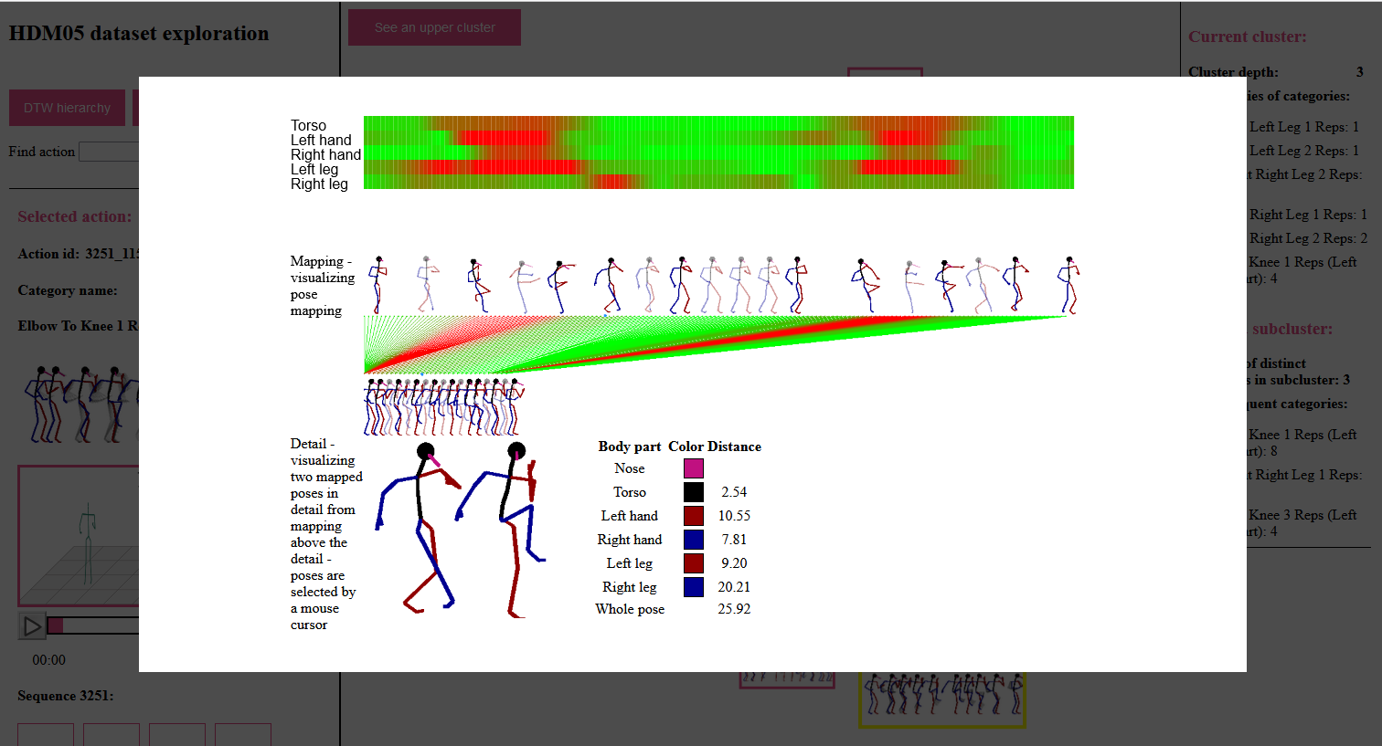
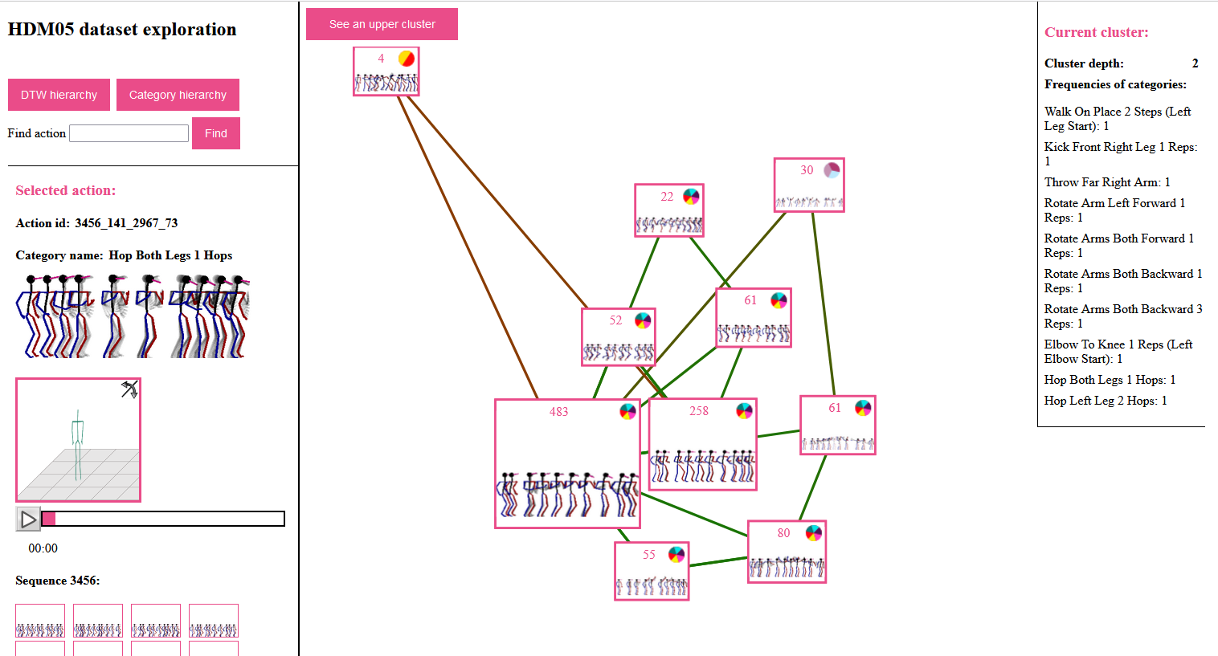
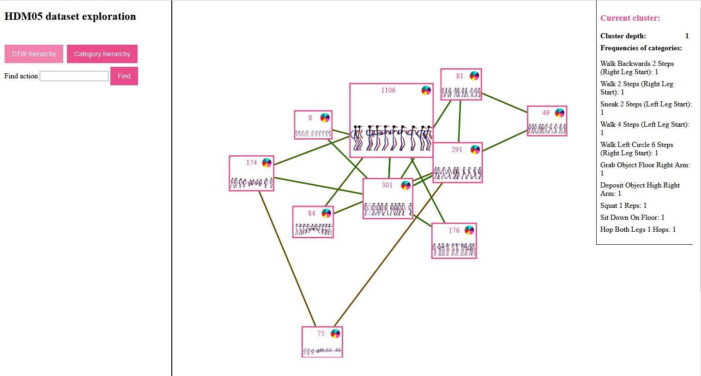
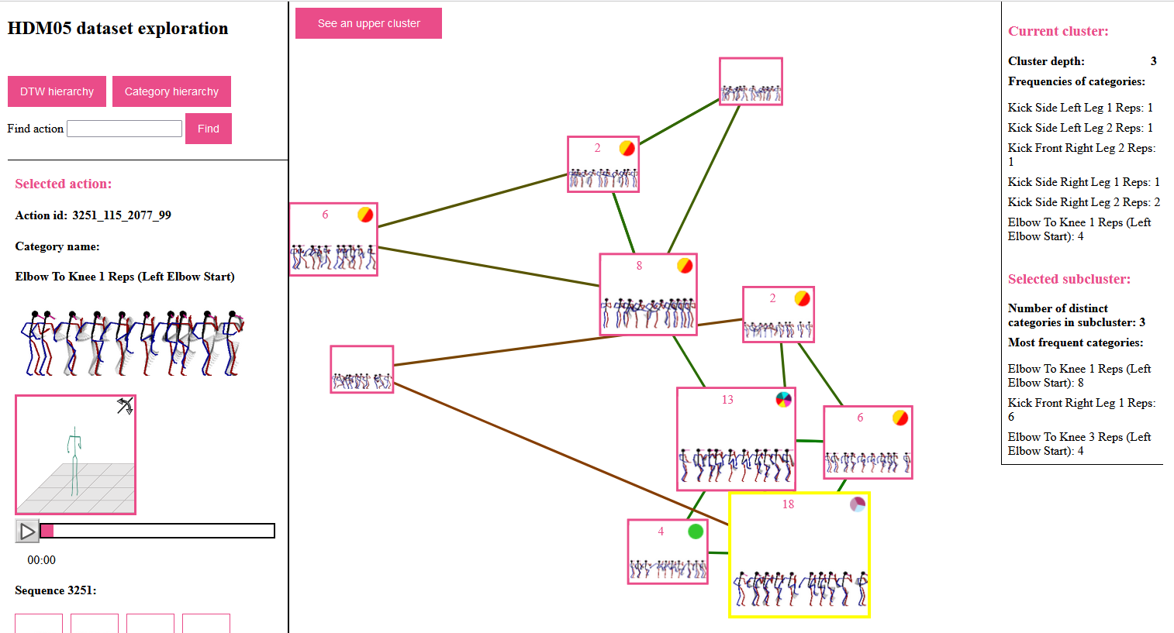
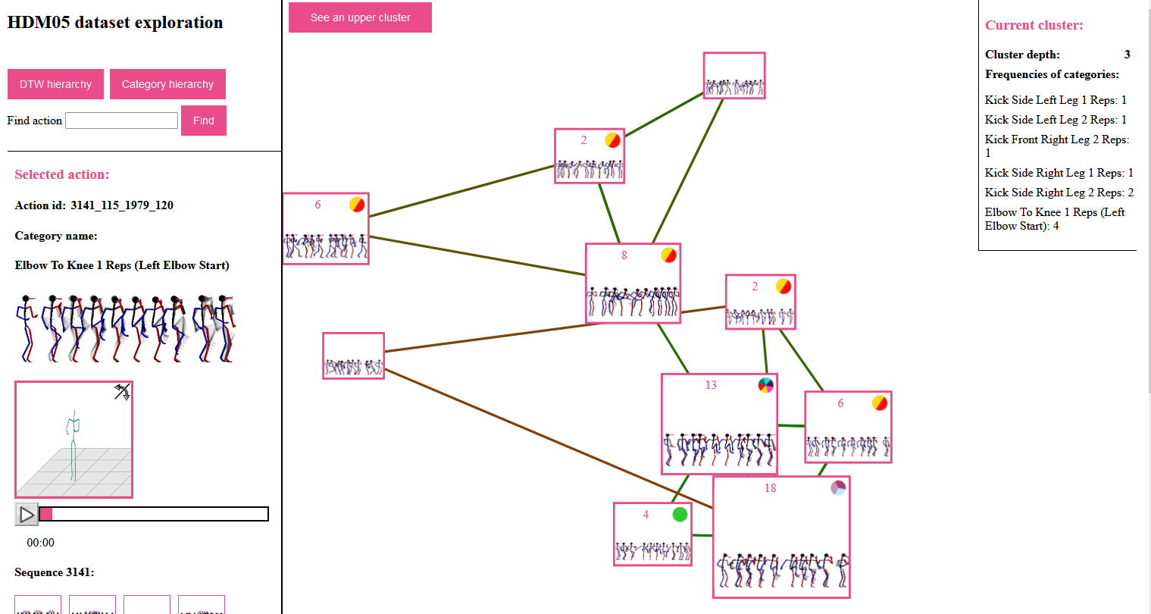
Exploration of Human Motion Datasets (cont.)
Step 1: hierarchical k-medoid clustering
Computed offline (MESSIF library for content-based data management)
1 hierarchy for whole collection + hierarchies for individual categories
Step 2: exploration interface

Slide 9
Conclusions
MocapViz: New JavaScript library for motion data visualization
Easy to use and understand
Publicly available, easy to integrate with existing motion processing tools
Generic, modular, works with different MoCap models
Two public exploration interfaces for widely used motion datasets
HDM05
PKU-MMD
More info + all the software:
disa.fi.muni.cz/research-directions/motion-data/mocapviz/

