Slide 1
Content-Based Annotation and Classiﬁcation Framework: A General Multi-Purpose Approach
Michal Batko, Jan Botorek, Petra Budikova, Pavel Zezula
Laboratory of Data Intensive Systems and Applications
Faculty of Informatics, Masaryk University, Brno
IDEAS 2013

Slide 2
Outline
Motivation
Why annotations?
State-of-the-art in multimedia annotation
General annotation model
Global architecture
Application to selected tasks
Speciﬁcation of components
Web image annotation
Current implementation
Experimental evaluation
Conclusions and future research directions

Slide 3
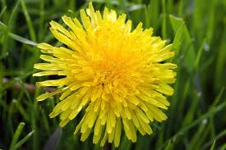
Motivation
nature
Yellow flower
dandelion
Taraxacum officinale
Flower, yellow, dandelion, detail, close-up, nature, plant, beautiful
The first dandelion that bloomed this year in front of the White House.
„Image is worth a thousand words.“

Slide 4
Why do we need the thousand words?
Keyword-based image retrieval
Popular and intuitive
Needs pictures with text metadata, we do not want to create them manually
Information seeking: “What is in the photo I just took?”
Tourist information / Plant identification / …
Impaired users
Classification tasks
Scientific data (medicine, astronomy, chemistry, …)
Improper content identification
Personal image gallery
Data summarization: “What images are on this computer?”
Not only images!
Sound, video, ….

Slide 5
Several dimensions of the annotation problem
Input
Image / Image and seed keyword / Image and text / Text
Type of information needed
Identification / Detection / Categorization
Vocabulary
Unlimited vocabulary / Controlled vocabulary
Form of annotation required
Sentence / Set of keywords / All relevant categories / A single category / Localization in a taxonomy
Interactivity
Online / offline annotation
Classification: identify relevant categories from a given list (vocabulary)
Annotation: wide (unlimited) vocabulary, “all relevant needed”

Slide 6
State-of-the-art text-extraction techniques
Pure text-based
Analyze the text on a surrounding web page
Content-based / Content- and text-based
Mainly exploit visual properties (+ text when available)
Content-based annotation scenario:
Basic annotation
Model-based: train a model for each concept in vocabulary
Search-based: kNN search in annotated collection
Annotation refinement
Statistical
Ontology-based
Secondary kNN search
…

Slide 7
Limitations of existing approaches
Applicability of state-of-the-art methods:
Mostly specialized solutions for a specific type of application
Reasonable results only for simple tasks
Model-based techniques:
Specialized classifiers can achieve high precision
Fast processing
Training feasible only for a limited number of concepts feasible, high-quality training data needed
Search-based techniques:
Can exploit vast amounts of annotated data available online
No training needed, no limitation of vocabulary
Costly processing when large datasets need to be searched
Content-based similarity measures often not precise enough
+
+
-
+
+
-
-

Slide 8
Our approach
Facts
Experiments show that state-of-the-art solutions are not very successful for complex problems
Psychologic research suggests hierarchical annotation
Our vision:
Broad-domain annotation is a complex process, needs to be modeled as such
Multiple processing phases
Modular design
Hierarchic annotation
Combine multiple knowledge sources
User in the loop
The same infrastructure can be used for different applications (annotation, classification, …)
The principal components are the same
Easy evaluation, comparisons

Slide 9
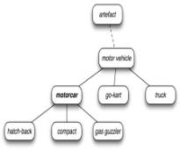
General annotation model
Output
(intermediate or final result)
New query/relevance feedback
Flower, nature, ...
flower
Annotation forming
Input information + inferred information
Resources
expansion
transformation
reduction
flower, ...

Slide 10
General annotation model (cont.)
Framework components
Query
Image / image + text / (text)
Knowledge sources
Annotated image collection, WordNet, ontologies, internet, …, user
Annotation-record
Query + candidate keywords, weights, any other knowledge
Processor modules
Expander, transformer, reducer
Evaluation scenarios
Properties
Clear structure, modularity
Can be adapted to various annotation/classification tasks
Supports extensive experiments, comparison of techniques
Knowledge source
Annotation-record
word
word
word
word
NULL
NULL
weight
weight
Expander
Transformer
Reducer

Slide 11
Simple examples
Basic search-based annotation
Simple model-based annotation
Annotated image collection
Query
Content-based search
Selection of most frequent words
Annotation-record
Simple annotation
word
word
word
word
NULL
NULL
weight
weight
Annotated image collection, WordNet
Query
Concept classifiers
Expansion by synonyms and co-occurring words
Annotation-record
Simple annotation
word
word
word
word
NULL
NULL
weight
weight

Slide 12
Advanced example: Hierarchic image annotation
Image collections, dictionaries, Wikipedia, …
WordNet,
specialized ontologies
Content-based search
animals, outdoor
Query
Global
classifiers
Semantic
weight
transformer
Basic concept
reducer
Basic level category
WordNet,
specialized ontologies
Image collections, web, dictionaries, Wikipedia, …
animals, nature, outdoor, snow, pinguins, group, standing
animals, outdoor, pinguins, whales, snow
Multi-modal search
Keyword /category
selection
Result or next level category
Semantic
weight
transformer
Specialized
classifiers
Relevance
feedback
Relevance
feedback
animals, outdoor, pinguins, whales, snow

Slide 13
Processing modules
“The brain of the annotation process”
Expanders
Provide candidate keywords
Visual-based nearest-neighbor search
Similarity measured by MPEG-7 global descriptors
Metric search provided by efficient M-index structure
Knowledge source: annotated image collection
Face detection software
Luxand FaceSDK
commercial library for detection and recognition of faces
Depending on number of faces detected, people-related concepts are added to annotation-record
Expander
Reducer
Transformer

Slide 14
Processing modules (cont.)
Transformers
Adjust weights of candidate keywords
Basic weight transformer
Frequency of a keyword in the descriptions of similar images
Similarity score of each image with the particular keyword
Knowledge source: descriptions of similar images
Semantic transformer
Uses WordNet hierarchies to cluster related words
Keyword weight increased proportionately to the size of containing cluster
Knowledge source: WordNet
Reducers
Remove unsuitable candidates
Syntactic cleaner
Stopword removal, translation, spell-correction
Knowledge sources: WordNet, dictionaries, Wikipedia

Slide 15
Web image annotation problem
Task specification
“Given an image, provide the K most relevant keywords that describe the content of this image.”
Use case
A professional photographer uploading images to a photo-selling site needs to provide accompanying keywords to enable text search
Basic solution
Budikova, Batko, Zezula: Online image annotation. SISAP 2011.
Annotated image collection
Query
Content-based
search
Annotation-record
Weight
transformer
(word frequency)
Annotation-record
Final keyword
selection
word
word
word
word
word
word
word
word
NULL
NULL
NULL
NULL
NULL
NULL
weight
weight

Slide 16
Web image annotation problem (cont.)
A more complex solution
Annotated image collection
Dictionary, Wikipedia, WordNet
Query
Content-based
search
Annotation-record
Syntactic
cleaner
Annotation-record
Weight
transformer
(word frequency)
word
word
word
word
word
word
NULL
NULL
NULL
NULL
NULL
NULL
Annotation-record
WordNet
word
word
weight
weight
Flight, fly, airplane, sky, aircraft, plane, aviation
Final keyword
selection
Annotation-record
Weight
transformer
(WordNet
relationships)
Annotation-record
Face
detection
word
word
word
word
word
word
word
word
NULL
NULL
NULL
NULL
weight
weight
weight
weight

Slide 17
Web image annotation – evaluation
Methods under comparison
Original search-based annotation
Cleaned keywords
Boosting by distance
Clustering by WordNet meaning
Face detector boosting
Face detector enrichment
Evaluation methodology
160 test queries
Categories easy/medium/difficult
20 best keywords requested
Result relevance evaluation:
User-provided (result relevance assessments)
Automatic (comparison to image description provided by author)

Slide 18
Web image annotation – evaluation (cont.)
Easy query
entertainment, art, sparkling, event, enjoyment, show, display, air, celebration, festival, flash, level, fireworks, cracker, explosion, fire, excitement, firecracker, light, bang
Medium query
blossom, location, plant, bird, food, trees, natural, citrus, flowers, generic, antique, destinations, nature, recreation, tree, foliage, botany, fruit, determination, flower
Difficult query
form, station, antique, interior, frame, bookcase, indoors, group, animal, antiques, snack, person, construction, food, chinese, study, wood, architecture, dynasty, building

Slide 19
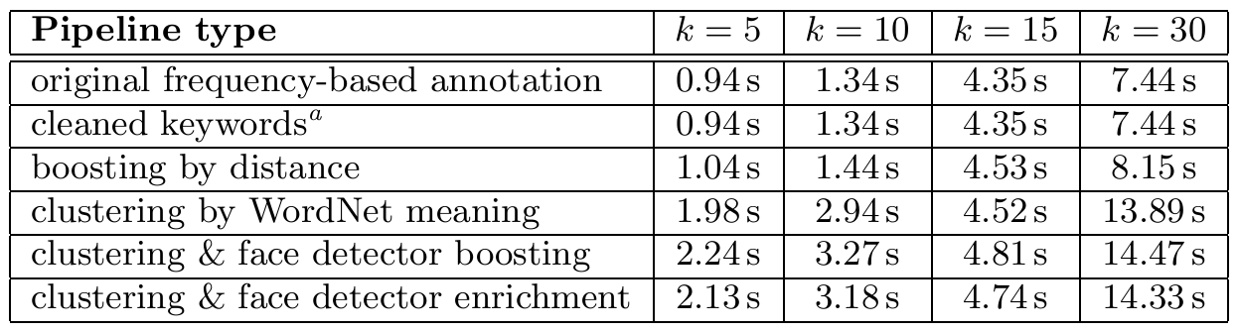
Web image annotation – evaluation (cont.)
Precision – user evaluation
highly relevant keywords (dark) + relevant keywords (light)
query type
Processing costs

Slide 20
Conclusions
Image annotation remains a challenging task
Broad domains, interactive applications, lack of training data, …
Our contributions
General annotation model & implementation framework
Implementation & evaluation of several processing components
Improved annotation tool
http://disa.fi.muni.cz/prototype-applications/image-annotation/
Future work
Refinement of semantical analysis
Development of new components, hierarchic annotation processing
Relevance feedback strategies for image annotation

Slide 21
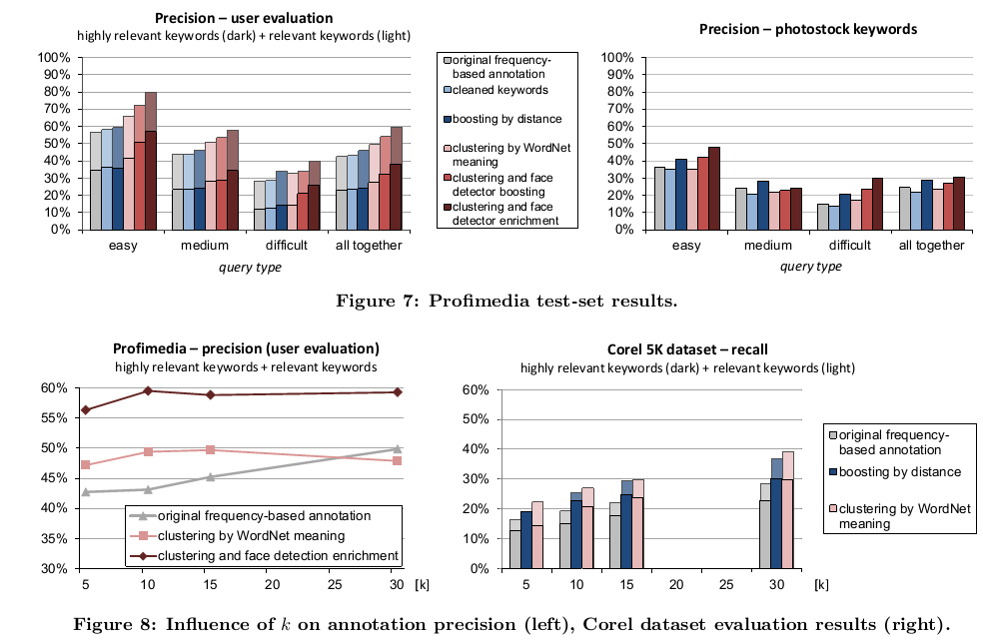
More experimental results

