Slide 1
Efficient Indexing of 3D Human Motions
Petra Budikova, Jan Sedmidubsky, Pavel Zezula
Masaryk University, Brno, Czech Republic
ACM International Conference on Multimedia Retrieval 2021

Slide 2
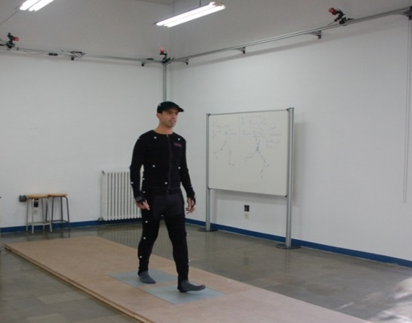
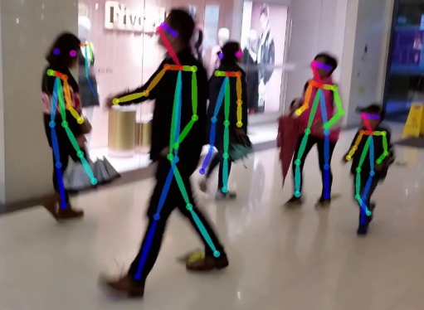
Motivation & Background
Human motion can be described by a sequence of skeleton poses
Pose = 3D coordinates of important body joints in a specific time moment
Thanks to advances of NNs, motion capturing is becoming easily available
Raw motion data are complex and bulky => we need more compact representations
Hand-crafted motion features
NN-based features
Text-like motion representations
Synchronized
cameras
Pose captured in a given
time moment
Notes:
The complexity of raw motion data is not such a drawback for classification scenarios but there are many others – similarity-based motion retrieval over unlabeled data, subsequence searching etc.

Slide 3
Text-based Motion Processing
Idea: Let’s transform the motion search problem into a different problem for which good solutions already exist – text retrieval!
Challenge I: Transformation of motion data into text-like representations
J. Sedmidubsky, P. Budikova, V. Dohnal, and P. Zezula. Motion Words: A text-like representation of 3D skeleton sequences. In 42nd European Conference on Information Retrieval (ECIR). Springer, 2020, pp. 527– 541.
Challenge II: Adaptation of text-processing techniques
Can we apply the bag-of-words model and inverted file indexing on the Motion Words?

Slide 4
Motion Words – idea
Cut motion into short, overlapping segments
Quantize the segment space
Represent original sequence by identifiers
of quantized segments
Measuring similarity of MWs:${match}^{MW}: MW×MW →\left\{0,1\right\}$
Goal: similarity-preserving quantization: with high probability,
similar segment pairs are mapped to matching MWs
dissimilar segment pairs are mapped to non-matching MWs
…
…
…
…
… A, A, B, O, M, M, P, D, …
A
C
D
F
G
B
E

Slide 5
Motion Words – details
A
D
base
B
expanded
s₁
s₂
s₃
C
Hard MWs:
s₁ → A s₂ → C s₃ → C
two MWs match if they are identical
Unwanted behavior: s₂ matches s₃ but not s₁
Soft MWs:
s₁ → (A,{D}) s₂ → (C,{A,B}) s₃ → (C,{D})
two MWs match if their intersection contains at least one base element
s₂ matches both s₃ and s₁
s₁ → (A,{D}) s₂ → (C,{A,B}) s₃ → (C,{D})

Slide 6
Motion Words – baseline evaluation
Task: action search over the PKU-MMD dataset
20K actions, 43 classes of daily activities (e.g., “drink”, “wave hand”, “stand-up”)
20-NN search
Method: sequential scan with Dynamic Time Warping (DTW)
Important observations about soft MWs:
Action -> motion document, average size 25 soft MWs
Soft-MWs work well when there is quite a high number of elements per MW
We use 1500 partitions and up to 20 elements per MW; 372K unique soft MWs
This implies that each MW has many matching MWs
On average, there are 12,436 matches for each soft MW
Method | Precision | Costs [ms]
DTW on skeletons | 54.19 % | 92,589
DTW on hard MWs | 51.82 % | 415
DTW on soft MWs | 60.60 % | 648

Slide 7
Efficient Processing of Soft-MW Documents
Basic idea: adopt inverted files indexing from text retrieval
Model: Treat documents as bags of words (BoW)
Compare query Q and document D using Cosine similarity
Indexing: Construct posting lists (PLs) for individual words
Ordered using TF-IDF weights
Searching: Traverse only promising parts of PLs for query words
Soft-MWs in the bag-of-words model
Motions can be easily represented by bags of soft MWs
To achieve sufficient search quality, we apply two-phase retrieval
BoW+Cosine for candidate retrieval
MW sequences+DTW for re-ranking
Cosine computation is problematic because of the soft-MW matching
A single MW from Q can match multiple MWs in D and vice versa
There are 12,436 matches for each soft MW!
TF-IDF weighting does not work
We needed to re-think the PL construction and processing

Slide 8
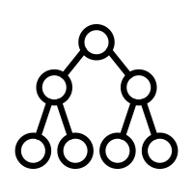
Basic and Expanded Posting Lists
Basic posting list: PL(w) is the standard list of documents containing MW w
Expanded posting lists: PL⁺(w) consists of documents that contain w or any of its matching words
PL⁺(w) can be constructed by merging basic PLs of all words that match w
We store the basic PLs and construct the necessary PL⁺ during query evaluation
Low memory requierements
We need auxiliary index for fast identification of matching MWs
(A,{B,C}) matches: (A,{B,C}), (A,{C,D}), (B,{C,D}), (G,{A,F})
(A,{B,C})
D₁
D₄
D₇
D₁
D₄
D₇
D₁
D₃
D₅
D₃
D₄
D₈
D₁
D₂
D₈
Basic PLs
MW-matching index
Expanded PL for (A,{B,C})
D₁ D₂ D₃ D₄ D₅ D₇ D₈

Slide 9
Scalable Processing of MW Posting Lists
Assume query Q = (q₁, q₂, q₃)
Merging PL⁺(q₁), PL⁺(q₂), PL⁺(q₃) will provide correct result for query Q
Problem: merging basic PLs into PL⁺ is the efficiency bottleneck
Solution: construct approximate PL⁺(q) using the most promising matches of q
Ranking matching MWs: Jaccard similarity over the sets of all elements of the two MWs
User-defined level of approximation: to construct PL⁺(q), do
Find all matches of q and order them by decreasing similarity from q
Gradually construct PL⁺(q) until a user-defined size limit is reached
A
D
base
B
expanded
s₁
s₂
s₃
C
base, expanded
s₁ → (A, {D}) s₂ → (C, {A, B}) s₃ → (C, {D})

Slide 10
Scalable Processing of MWs – the Big Picture
Query
s₁
s₂
s₃
MW-matching index
(A,{B,C}) (K,{L,M}) (X,{Y,Z})
(A,{B,C}) matches: (A,{B,C}), (A,{B,C,D}), (B,{C,D}), (G,{A,F})
(K,{L,M}) matches
(X,{Y,Z}) matches
0.5
0.5
0.75
0.5
sim((A,{B,C}), (A,{B,C}))=1.0
0.75
0.5
0.2
0.75
1.0
0.75
1.0
1.0
D₁
D₄
D₇
D₁
D₃
D₅
D₁
D₄
D₇
D₁
D₃
D₅
D₃
D₄
D₈
D₁
D₂
D₈
D₃
D₄
D₈
D₁(1.0)
D₃(0.75)
D₄(1.0)
D₅(0.75)
D₇(1.0)
D₈(0.5)
D₁(1.0)
D₃(0.75)
D₄(1.0)
D₇(1.0)
D₁(1.0)
D₃(0.75)
D₄(1.0)
D₅(0.75)
D₇(1.0)
D₁(1.0)
D₄(1.0)
D₇(1.0)
Result: documents with the highest sum of weights across the expanded PLs

Slide 11
Experimental Evaluation

Slide 12
Conclusions
We have proposed efficient indexing and retrieval scheme for human motion data
Compact motion representation by Motion Words
Efficient retrieval algorithm based on inverted file indexing
Approximate searching with near-constant query processing times for arbitrarily large data collections
To the best of our knowledge, the proposed solution is the first scalable motion retrieval method
Unsupervised -> widely applicable
Domain independent -> possibly applicable to other types of spatio-temporal data

