Slide 1
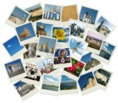
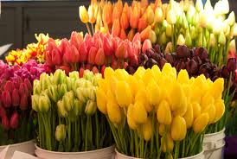
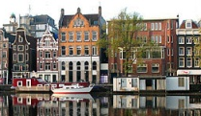
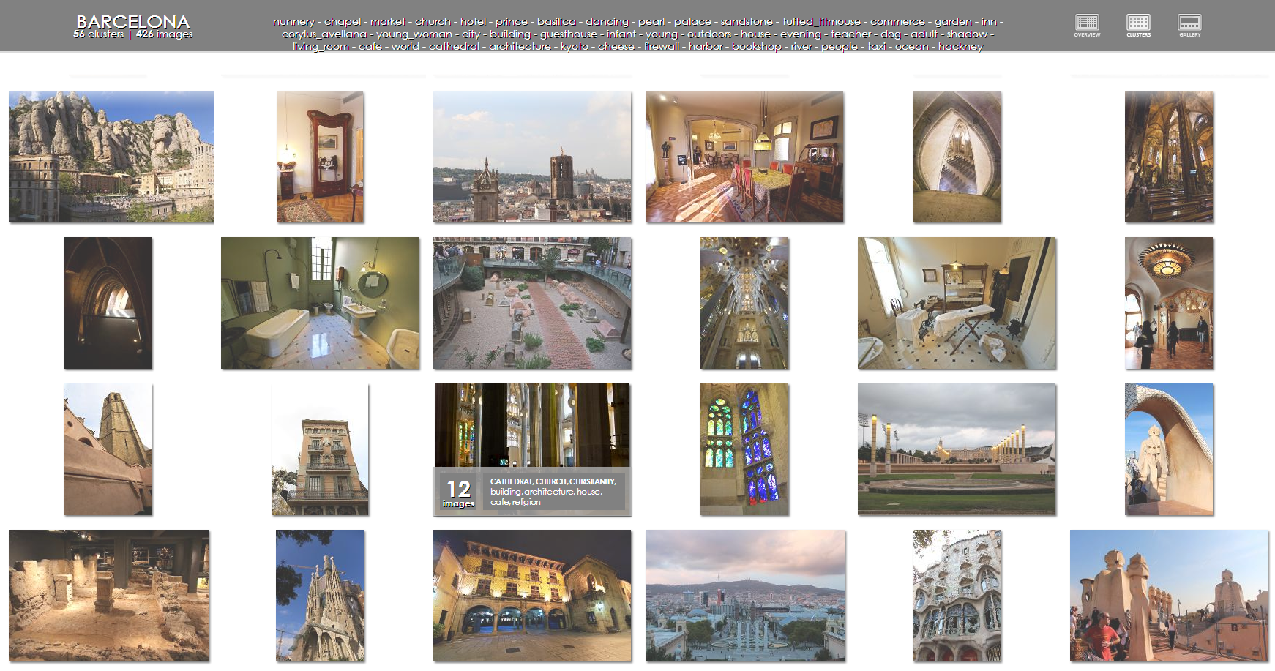
Laboratory of Data Intensive Systems and Applications, Masaryk University, Czech Republic
CLAN Photo Presenter
A Multi-modal Summarization Tool for Image Collections
Michal Batko ▪ Petra Budikova ▪ Petr Elias ▪ Pavel Zezula
Motivation
Amount of images produced is huge
Summarization tools are needed
Available for visual-only summaries
Difficult to index and search
Objectives
Automatic multi-modal image summarization
Various algorithms for visual clustering
Automatic keyword annotation
Summary annotation for each cluster
Intuitive, user-friendly interface
Results presented as a web page
Solution
Preprocessing
Resize images
Extract MPEG7 descriptors
Clustering
Run clustering algorithm
Params: number of clusters, clustering algorithm,
number of repetitions, cluster optimality measure,
postprocessing options
Annotation
Retrieve annotations for cluster representants
Params: number of images from each
cluster to be annotated
External web service: MUFIN image annotation
Plants, flower, garden, summer, blue , blossom, …
My trip to Amsterdam
Presentation
Flowers, buildings, people, cheese
Create the web presentation
CLAN Photo Presenter Application
Desktop application written in Java
Visual clustering methods based on MPEG7 global visual descriptors
k-Means, Bisecting k-Means, Distinct kNN
Repeated clustering to increase the quality
Quality measures: Davies Bouldin Index, Silhouette Coefficient, Dunn Index
Postprocessing methods to compensate for clustering anomalies
Single-member clusters removal, outliers merging
Annotation of clusters
Selection of cluster representatives, MUFIN Annotation Web Service
Processing times
Collection size | Clustering method | # of clusters | Preprocessing time [s] | Clustering time [s] (25 repetitions) | Annotation time [s] (5-union) | Overall costs [min]
160/500/1000 | Bisecting k-means | 16/20/30 | 76/214/471 | 12/138/610 | 229/299/418 | 5.3/10.9/25.0
160/500/1000 | K-means | 16/20/30 | 76/214/471 | 3/18/69 | 229/299/418 | 5.1/8.9/16.0
160/500/1000 | Distinct kNN | 25/50/100 | 76/214/471 | 3/20/82 | 373/696/1428 | 7.5/15.5/33.0
http://disa.fi.muni.cz/clan
Sample output – Barcelona
Collection description 426 high-resolution photos from a trip to Barcelona
Clustering method Distinct kNN clustering – Centroid, 25 runs, Davies Bouldin Index
Postprocessing Singleton merging
Annotation method 2-union annotation
Processing time 32 minutes (costly preprocessing of large photos – 26 minutes)
ICMR 2014, Glasgow, United Kingdom

