Slide 1
Motion Words: A Text-like Representation of 3D Skeleton Sequences
Jan Sedmidubsky, Petra Budikova, Vlastislav Dohnal, Pavel Zezula
Laboratory of Data Intensive Systems and Applications
Faculty of Informatics, Masaryk University, Brno, Czechia
disa.fi.muni.cz

Slide 2
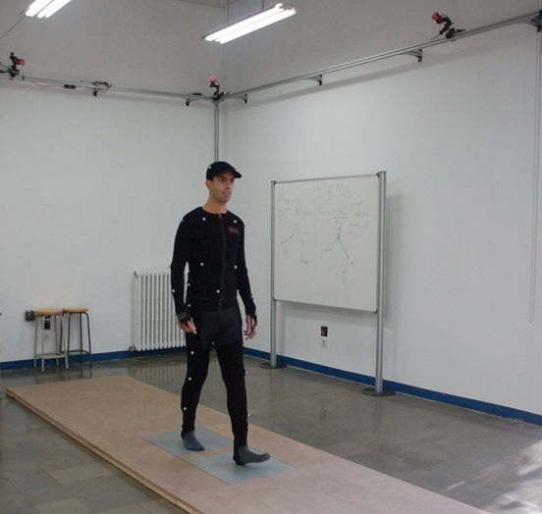
What are 3D skeleton sequences?
Simplified representation of human motion
Sequence of poses that keep the 3D coordinates of important body joints in a specific time moment
Recorded by specialized motion capture devices or extracted from common video by 3D pose-estimation methods
Synchronized
cameras
Pose captured in a given
time moment

Slide 3
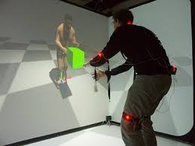
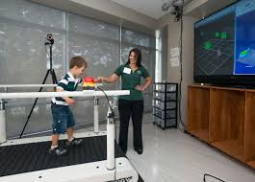
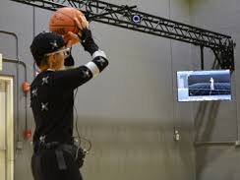
What are 3D skeleton sequence good for?
Many application domains:
Computer animation – virtual and augmented reality
Medicine – rehabilitation, detection of movement disorders
Sports – assessment of performance, digital referees
Smart-homes – detection of falls of elderly people
Military – simulation of conflict resolving situations
…

Slide 4
What is our paper about?
MOTION WORDS = new compact representation of motion data that keeps important information and can be efficiently processed

Slide 5
Three important questions (talk outline)
WHY motion words?
State-of-the-art in motion processing
Inspiration from other domains
HOW can motions be represented by motion words?
Basic idea
Simple motion words and their limitations
Generalized motion words
DOES IT WORK?
Experimental evaluation with real data and application
Lessons learned and future research directions

Slide 6
State-of-the-art in motion processing
Most research focuses on action recognition: classifying manually segmented motions using labeled training data
Typically solved using convolutional or recurrent NN classifiers
Not-so-well-studied tasks: motions captured as long continuous sequences without semantic partitioning, no labeled data
E.g. subsequence search, similarity joins, …
Needs efficient and scalable evaluation of similarity queries
DTW alignment of 3D skeletons is not applicable
Our idea: lets try text-based processing!
Axel jump
Pirouette
Axel jump
Find all occurrences of similar motions!
Twizzle
Rittberger jump
Step sequence
query
query
training data
unsegmented data

Slide 7
Inspiration from image processing
Image processing in 2000s:
Local image features are in fashion
Thousands of high-dimensional features per image
– pairwise matching neither feasible nor useful
Josef Sivic, Andrew Zisserman: Video Google: A Text Retrieval Approach to Object Matching in Videos. ICCV 2003.
Use clustering to quantize feature descriptors into visual words
Apply text-processing techniques
Great success!

Slide 8
Quantizing motion data – the big picture
Input: long sequence of 3D skeleton data
Step 1: segmentation
Fixed-sized overlapping segments (length 0.67 s, shift 20 %)
Step 2: quantization of the segment space
Output:
MW representation of the input sequence
A
C
D
F
G
B
E
…
…
…
…
… A, A, B, O, M, M, P, D, …

Slide 9
Quantizing motion data – the big picture (cont.)
Two main components of the MW model
MW vocabulary – produced by quantization
MW matching function – defines semantic relationship between MWs
$${match}^{MW}: MW×MW →\left\{0,1\right\}$$
Goal: similarity-preserving quantization: with high probability,
similar segment pairs are mapped to matching MWs
dissimilar segment pairs are mapped to non-matching MWs
Simple solution: hard MWs
Generalized solutions:
soft MWs
multi-overlay MWs

Slide 10
Basic solution: Hard MWs
Hard quantization
Segment space divided into non-overlapping partitions
Partition identifiers become the hard MWs
Each motion segment is associated with exactly one hard MW
Trivial MW matching: only identical MWs match
Properties:
Hard MWs can be readily processed by text-retrieval tools
Border problem
☺
☹
MW A
MW D
s₁ → A s₂ → C s₃ → C
trivial match^{MW}: s₁ ≈ s₂, s₁ ≈ s_{3,} s₂ ≈ s₃
s₁
MW B
s₂
s₃
MW C

Slide 11
Better solution: Soft MWs
The border problem occurs when a segment lies near partition border
How can we put the divided segments back together?
Soft quantization:
Partition identifiers become MW elements
Soft MW for s₁ is an ordered set of one or more MW elements
Base element – identifies the partition containing s₁
Expanded elements – additional partitions that have borders near to s₁
Soft-base MW matching: two MWs match if their intersection contains at least one base element
element A
base, expanded
element D
s₁ → {A,D} s₂ → {C,A,B} s₃ → {C,D}
soft-base match^{MW}: s₁ ≈ s₂, s₁ ≈ s_{3,} s₂ ≈ s₃
base
element B
expanded
s₁
s₂
s₃
element C

Slide 12
Better solution II: Multi-overlay MWs
Multi-overlay quantization:
Multiple independent partitioning overlays
Multi-overlay MW for s₁ is an n-tuple of MW elements assigned to s₁ in individual overlays
m-out-of-n MW matching: two MWs match if they agree on at least m positions of the respective n-tuples
s₁ → (A,G) s₂ → (C,G) s₃ → (C,H)
1-out-of-2 match^{MW}: s₁ ≈ s₂, s₁ ≈ s_{3,} s₂ ≈ s₃
Overlay 1
A
Overlay 2
E
D
s₁
B
s₁
F
s₂
s₂
s₃
C
s₃
H
G
Properties of soft and multi-overlay MWs:
Border problem is supressed
Non-trivial MW matching requires adjustments of IR techniques
☺
☹

Slide 13
Implementation highlights
Segment space partitioning: Voronoi partitions, 3 pivot selection methods
random
k-means clustering
hierarchical k-means clustering
Hard MW parameters:
Number of partitions
Soft MW parameters:
Maximum estimated distance between s₁ and border of expanded MW element
Maximum number of MW elements
Multi-overlay MW parameters:
Number of overlays
Number of overlays required to agree

Slide 14
MW quality evaluation
Application-independent: Are MWs similarity-preserving?
Similar segment pairs should be mapped to matching MWs and vice-versa
GT of similar and dissimilar segment pairs:
Similarity and dissimilarity thresholds are derived from distance distribution
Used for computing Precision, Recall, and F-score
Precision: (# of similar matched pairs)/(# of all matched pairs)
Recall: (# of similar matched pairs)/(# of all similar pairs)
Application-specific: Are MWs useful in applications?
kNN classification of action category
Similar action search
Data: HDM05 dataset
exercising and daily movement activities
2,345 short motions categorized in 130 classes
After segmentation: 28,000 segments

Slide 15
Selected results: application-independent eval.
Hard MWs
Settings: segmentation determined by k-means clustering, k=350
Similarity-preserving property: precision 90.8 %, recall 34.9 %
Low recall because of the border problem!
Soft MWs
Settings: 350 MW elements, up to 6 MW elements per segment
Similarity-preserving property: precision 87.2 %, recall 72.1 %
Multi-overlay MWs
Settings: 5 overlays, each partitioned by k-means, k=350; 2-out-of-5 matching
Similarity-preserving property: precision 85.3 %, recall 72.8 %

Slide 16
Selected results: application-specific eval.
Query processing costs:
3D skeletons + DTW, sequential scan: 2.3 s per query on average
MWs + DTW, sequential scan: 0.013 s per query

Slide 17
Conclusions
Our achievements:
MW model
Text-like representation of unlabeled 3D skeleton data
Allows efficient processing using mature IR technologies
Soft-assignment and multi-overlay partitioning
Reduces the border problem
Achieves high retrieval quality
Application-independent evaluation of the MW vocabulary quality
Allows to estimate MW usefulness in applications
The MW parameters can be tuned using data distribution only
Future research directions:
preparation and preprocessing of the short segments
scalable indexing and search algorithms for the MW data

Slide 18
Questions, please!
?
?
?
?
?
?
In case of more questions, don’t hesitate to contact me: budikova@fi.muni.cz

