Slide 1


Motion Words: A Text-like Representation of 3D Skeleton Sequences
Jan Sedmidubsky, Petra Budikova, Vlastislav Dohnal, Pavel Zezula
Laboratory of Data Intensive Systems and Applications
Faculty of Informatics, Masaryk University, Brno, Czechia
disa.fi.muni.cz

Slide 2
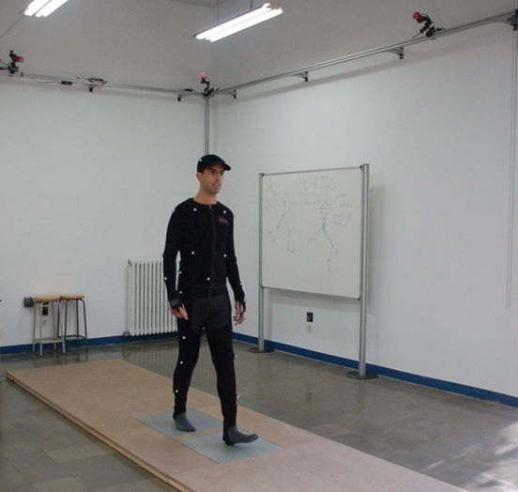








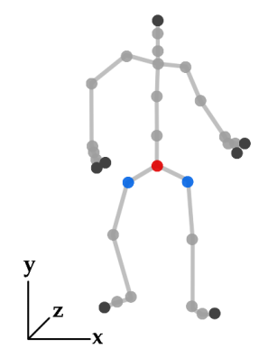
What are 3D skeleton sequences?
Simplified representation of human motion
Sequence of poses that keep the 3D coordinates of important body joints in a specific time moment
Recorded by specialized motion capture devices or extracted from common video by 3D pose-estimation methods
Synchronized
cameras
Pose captured in a given
time moment

Slide 3
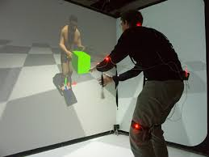
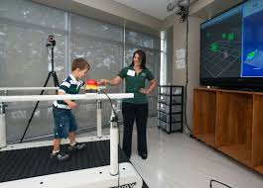
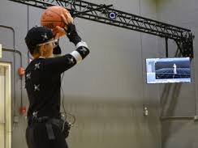
What are 3D skeleton sequence good for?
Many application domains:
  Computer animation – virtual and augmented reality
  Medicine – rehabilitation, detection of movement disorders
  Sports – assessment of performance, digital referees
  Smart-homes – detection of falls of elderly people
  Military – simulation of conflict resolving situations
  …

Slide 4
What is our paper about?
MOTION WORDS = new compact representation of motion data that keeps important information and can be efficiently processed

Slide 5
Three important questions (talk outline)
WHY motion words?
  State-of-the-art in motion processing
  Inspiration from other domains
HOW can motions be represented by motion words?
  Basic idea
  Simple motion words and their limitations
  Generalized motion words
DOES IT WORK?
  Experimental evaluation with real data and application
  Lessons learned and future research directions

Slide 6
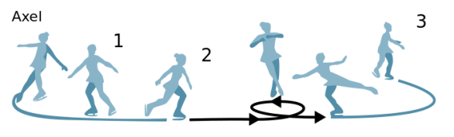
  State-of-the-art in motion processing
Most research focuses on action recognition: classifying manually segmented motions using labeled training data
  Typically solved using convolutional or recurrent NN classifiers
    Not-so-well-studied tasks: motions captured as long continuous sequences without semantic partitioning, no labeled data
  E.g. subsequence search, similarity joins, …
  Needs efficient and scalable evaluation of similarity queries
    DTW alignment of 3D skeletons is not applicable
  Our idea: lets try text-based processing!
Axel jump
Pirouette
Axel jump
Find all occurrences of similar motions!
Twizzle
Rittberger jump
Step sequence
query
query
training data
unsegmented data

Slide 7
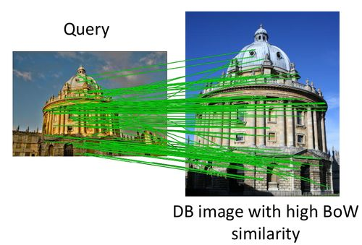
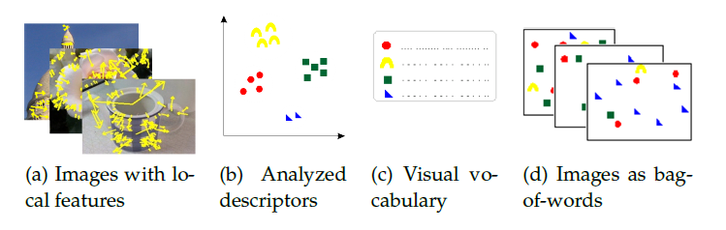
Inspiration from image processing
Image processing in 2000s:
  Local image features are in fashion
  Thousands of high-dimensional features per image
  – pairwise matching neither feasible nor useful
Josef Sivic, Andrew Zisserman: Video Google: A Text Retrieval Approach to Object Matching in Videos. ICCV 2003.
  Use clustering to quantize feature descriptors into visual words
  Apply text-processing techniques
  Great success!

Slide 8
Quantizing motion data – the big picture
Input: long sequence of 3D skeleton data
Step 1: segmentation
  Fixed-sized overlapping segments (length 0.67 s, shift 20 %)
Step 2: quantization of the segment space
Output:
  MW representation of the input sequence
A
C
D
F
G
B
E
…
…
…
…
… A, A, B, O, M, M, P, D, …

Slide 9
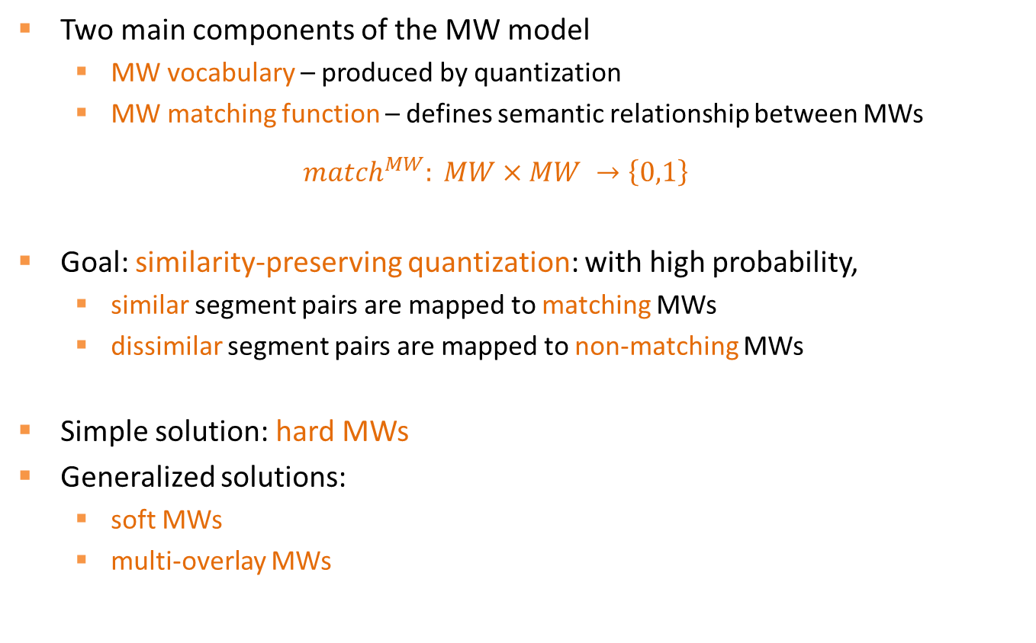
Quantizing motion data – the big picture (cont.)
Two main components of the MW model
  MW vocabulary – produced by quantization
  MW matching function – defines semantic relationship between MWs
  $${match}^{MW}: MW×MW →\left\{0,1\right\}$$
Goal: similarity-preserving quantization: with high probability,
  similar segment pairs are mapped to matching MWs
  dissimilar segment pairs are mapped to non-matching MWs
Simple solution: hard MWs
Generalized solutions:
  soft MWs
  multi-overlay MWs

Slide 10
Basic solution: Hard MWs
Hard quantization
  Segment space divided into non-overlapping partitions
  Partition identifiers become the hard MWs
  Each motion segment is associated with exactly one hard MW
Trivial MW matching: only identical MWs match
Properties:
  Hard MWs can be readily processed by text-retrieval tools
  Border problem
☺
☹
MW A
MW D
      s₁ → A s₂ → C s₃ → C
      trivial match^{MW}: s₁ ≈ s₂, s₁ ≈ s_{3,} s₂ ≈ s₃
s₁
MW B
s₂
s₃
MW C

Slide 11
Better solution: Soft MWs
  The border problem occurs when a segment lies near partition border
    How can we put the divided segments back together?
Soft quantization:
  Partition identifiers become MW elements
  Soft MW for s₁ is an ordered set of one or more MW elements
    Base element – identifies the partition containing s₁
    Expanded elements – additional partitions that have borders near to s₁
Soft-base MW matching: two MWs match if their intersection contains at least one base element
element A
base, expanded
element D
      s₁ → {A,D} s₂ → {C,A,B} s₃ → {C,D}
      soft-base match^{MW}: s₁ ≈ s₂, s₁ ≈ s_{3,} s₂ ≈ s₃
base
element B
expanded
s₁
s₂
s₃
element C

Slide 12
Better solution II: Multi-overlay MWs
Multi-overlay quantization:
  Multiple independent partitioning overlays
  Multi-overlay MW for s₁ is an n-tuple of MW elements assigned to s₁ in individual overlays
m-out-of-n MW matching: two MWs match if they agree on at least m positions of the respective n-tuples
      s₁ → (A,G) s₂ → (C,G) s₃ → (C,H)
      1-out-of-2 match^{MW}: s₁ ≈ s₂, s₁ ≈ s_{3,} s₂ ≈ s₃
Overlay 1
A
Overlay 2
E
D
s₁
B
s₁
F
s₂
s₂
s₃
C
s₃
H
G
Properties of soft and multi-overlay MWs:
  Border problem is supressed
  Non-trivial MW matching requires adjustments of IR techniques
☺
☹

Slide 13
Implementation highlights
Segment space partitioning: Voronoi partitions, 3 pivot selection methods
  random
  k-means clustering
  hierarchical k-means clustering
Hard MW parameters:
  Number of partitions
Soft MW parameters:
  Maximum estimated distance between s₁ and border of expanded MW element
  Maximum number of MW elements
Multi-overlay MW parameters:
  Number of overlays
  Number of overlays required to agree

Slide 14

MW quality evaluation
Application-independent: Are MWs similarity-preserving?
  Similar segment pairs should be mapped to matching MWs and vice-versa
  GT of similar and dissimilar segment pairs:
    Similarity and dissimilarity thresholds are derived from distance distribution
    Used for computing Precision, Recall, and F-score
      Precision: (# of similar matched pairs)/(# of all matched pairs)
      Recall: (# of similar matched pairs)/(# of all similar pairs)
Application-specific: Are MWs useful in applications?
  kNN classification of action category
  Similar action search
Data: HDM05 dataset
  exercising and daily movement activities
  2,345 short motions categorized in 130 classes
    After segmentation: 28,000 segments

Slide 15
Selected results: application-independent eval.
Hard MWs
  Settings: segmentation determined by k-means clustering, k=350
  Similarity-preserving property: precision 90.8 %, recall 34.9 %
    Low recall because of the border problem!
Soft MWs
  Settings: 350 MW elements, up to 6 MW elements per segment
  Similarity-preserving property: precision 87.2 %, recall 72.1 %
Multi-overlay MWs
  Settings: 5 overlays, each partitioned by k-means, k=350; 2-out-of-5 matching
  Similarity-preserving property: precision 85.3 %, recall 72.8 %

Slide 16
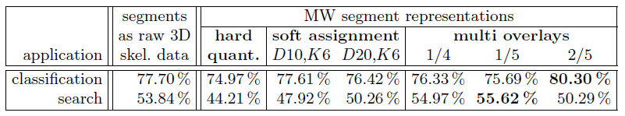
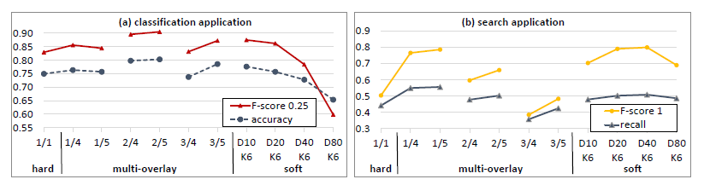
Selected results: application-specific eval.
Query processing costs:
  3D skeletons + DTW, sequential scan: 2.3 s per query on average
  MWs + DTW, sequential scan: 0.013 s per query

Slide 17
Conclusions
Our achievements:
  MW model
    Text-like representation of unlabeled 3D skeleton data
    Allows efficient processing using mature IR technologies
  Soft-assignment and multi-overlay partitioning
    Reduces the border problem
    Achieves high retrieval quality
  Application-independent evaluation of the MW vocabulary quality
    Allows to estimate MW usefulness in applications
    The MW parameters can be tuned using data distribution only
Future research directions:
  preparation and preprocessing of the short segments
  scalable indexing and search algorithms for the MW data

Slide 18
Questions, please!
?
?
?
?
?
?
In case of more questions, don’t hesitate to contact me: budikova@fi.muni.cz

