Slide 1
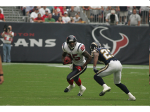
Query Language for Complex Similarity Queries
Petra Budikova, Michal Batko, Pavel Zezula
Masaryk University, Czech Republic
SELECT TOP 5 id, imageBinary
FROM SIMSEARCH :pyramidSketch AS queryObject
IN imageDataset
BY myImageDistance(queryObject, imageBinary)
METHOD FastKnnSearch
WHERE …

Slide 2
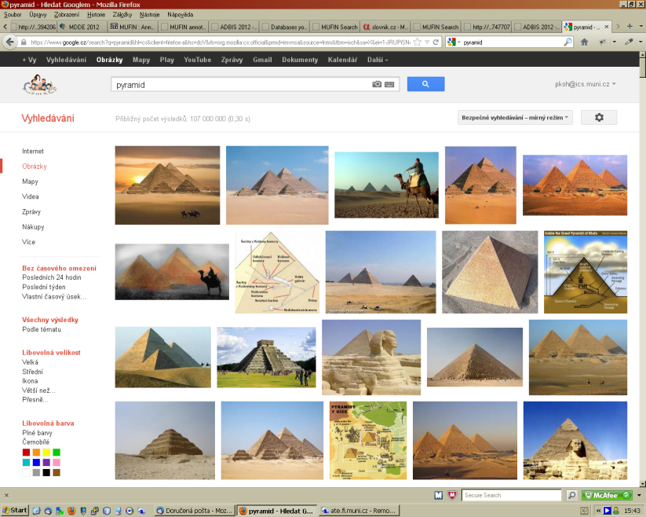
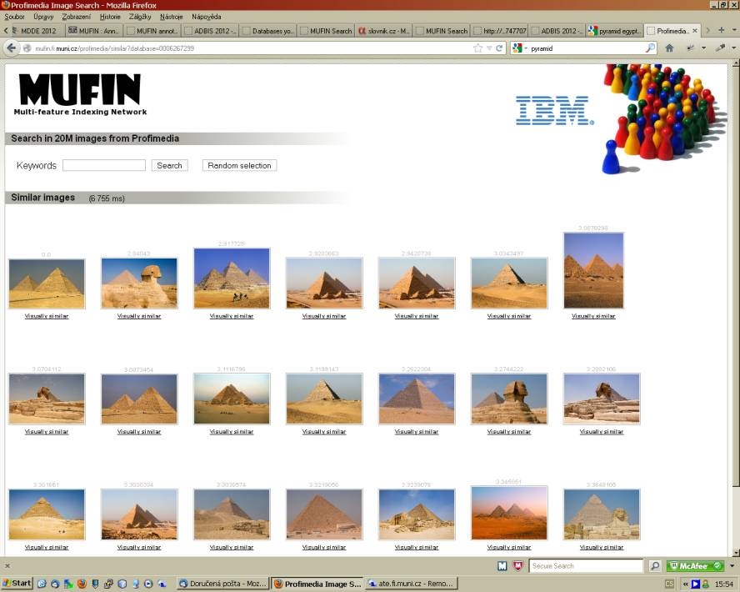
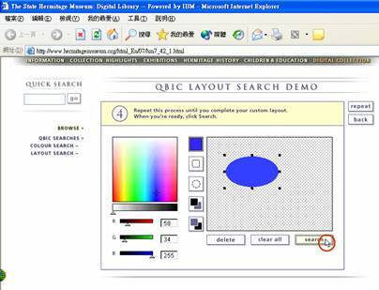
Multimedia Retrieval Today
Search by keyword
Search by example
Search by example
– advanced

Slide 3
Complex Multimedia Query
Image search use cases
A journalist is looking for an illustration of his article about Egyptian Sphinx
“Retrieve 10 images most similar to a given sketch of a pyramid which have the word ‘Sphinx’ in their annotation. Evaluate similarity of shapes only. The image should not be older than 5 years.”
Copyright protection (similarity join)
“Find all duplicates and near-duplicates in the image collection for which the names of authors differ. Check also for simple transformations of colors, rotations and resizing.”
Identification of a depicted object (multi-object query)
“Find the best matching object from the database of flower images with respect to a given set of photos. Consider both color and shape of the images, as well as the spatio-temporal aspects.”

Slide 4
Formulation of Complex Queries
Existing tools not satisfactory!
Application-specific, limited functionality, tightly related to implementation
Challenge:
Existing proposals:
Different query languages and query formulation tools
MOQL, SQL/MM, MPQF, …
Nice features and ideas, but still not general enough
Our solution:
General and extensible query language based on the relational algebra paradigm and SQL syntax
Provide a universal, general and flexible tool
that allows users to define complex similarity queries.

Slide 5
Outline
Query language design
Analysis of requirements, language fundamentals, system architecture
Data model and operations
Data model
Extensions to relational algebra data types
Operations on data types
Comparison functions, distance functions, extractors
Operations on relations
Generic similarity operations
Data indexing
Support for data indexing and query optimization
SimSeQL syntax and semantics
Novel SIMSEARCH construct in the FROM clause – definition and usage
Conclusion & future work

Slide 6
Analysis of requirements
Resources:
Current trends in multimedia information retrieval
Existing query languages (SQL/MM, POSTGRESQL-IE, MPQF, …)
MESSIF framework architecture
Selected requirements:
Support for wide range of query types
NN search, similarity joins, single- and multi-object similarity queries, spacio-temporal queries, …
Support for multi-modal searching
Adjustability of searching
Selection of similarity measure, query processing preferences (precision vs. costs)
Support for query optimization

Slide 7
Language Fundamentals
SQL-based or XML-based syntax?
Both popular in multimedia searching
XML: well suited for inter-system communication, but too eloquent
SQL: user-friendly (query structure imitates English sentences), backed by solid theoretical background of relational algebra
Extensible design
Provide generic constructs
New language primitives instead of user-defined functions
Better opportunities for optimization
System architecture
Standard RDBMS and some similarity search framework + parsing and evaluation-management overlay, or
Native RDBMS implementation

Slide 8
Data Model
Baseline – Codd’s relational data model
Relations and attributes
Operations over relations (first-order predicate logic)
Extension – “data types”
“Data type”: attribute domain + functions that can be applied on domain members
Infinite number of data types
Translation between data types by specialized functions – extractors

Slide 9
Operations on Data Types
Comparison functions
Define total ordering of domain
Enable data type to be indexed by standard methods (B-trees etc.)
Typically not available for multimedia data types
Distance functions
Evaluate dissimilarity between any two domain values
May have special properties that influence indexing
Available for all data types (at least the trivial identity distance)
Extractors
Transform values of one data type into another
Typically used on complex unstructured data types to produce data types more suitable for indexing and retrieval

Slide 10
Operations on Data Types – continued
Operation properties
Each operation can be equipped with a specification of properties
System uses these properties to control suitability of indexing methods, retrieval algorithms, and query processing optimization
List of relevant properties inherent to a particular retrieval system
Examples:
Monotonicity property
Metric distance function property
Lower bounding relationship between distance functions

Slide 11
Operations on Relations
Baseline
Standard relational algebra operations – selection, projection, joins, …
Extension – similarity-based retrieval
Generic approach: each system maintains its own set of operations
Each operation defines its input and output
Input parameters:
Number of input relations
Expected query objects
Operation-specific parameters (specification of distance function, thresholds, …)
Output: return relation scheme
Typically input relation scheme or Cartesian product of input relations
For similarity-based operations, additional attribute distance

Slide 12
Operations on Relations – continued
Properties
Similar to operations on data types
Properties mostly related to query optimization
Special operations – “generalized distance functions”
Produce scalar values
Input
Target relation
A relation with one or more query objects
Additional parameters when needed
Examples:
Set distance – e.g. minimum of distances to a set of query objects
Aggregated distance – e.g. a weighed sum of color- and shape-induced distances

Slide 13
Data Indexing
Indexing techniques
Wide range (both traditional and specialized for similarity-based searching)
Applicability of individual methods tightly related to target data properties
B-tree requires domain with linear ordering
M-tree requires metric data domain
System maintains a list of available indexes and their properties
Index properties are verified against data type properties and operation properties
Fallback data access method – Sequential Scan algorithm
Supports any search operation

Slide 14
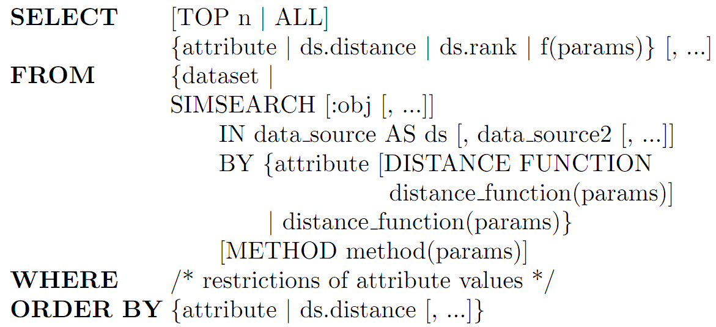
SimSeQL
Extension of SQL which enables to issue all kinds of content-based queries in addition to standard database operations
We mostly deal with query formulation
Data modification and control commands can be adapted straightforwardly
Query structure:

Slide 15
SimSeQL – Syntax Details
SIMSEARCH construct
In FROM clause, contains the similarity searching functionality
More flexible and intuitive solution than specialized operators in WHERE clause
SIMSEARCH structure:
Specification of query objects and target relation
SIMSEARCH [:obj [, …]] IN data_source AS ds [, data_source2 [, …]]
Specification of distance function
Default distance function of an attribute
SIMSEARCH … BY color
Direct calling of some available distance function
SIMSEARCH … BY color_distance(qo, color)
Constructing the distance function within the query
SIMSEARCH … BY color_dist(qo_color, color) + 2*shape_dist(qo_shape, shape)
Specification of search method
SIMSEARCH … METHOD method(params)

Slide 16
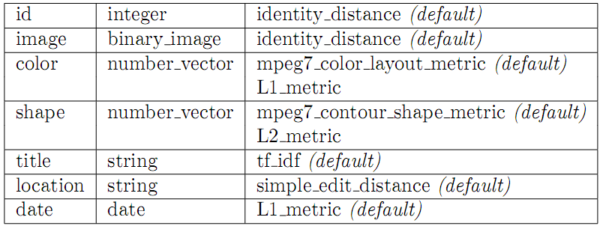
Example Scenario 1
Query: Retrieve images most similar to a set of examples (e.g. identifying a flower by supplying several photos)

Slide 17
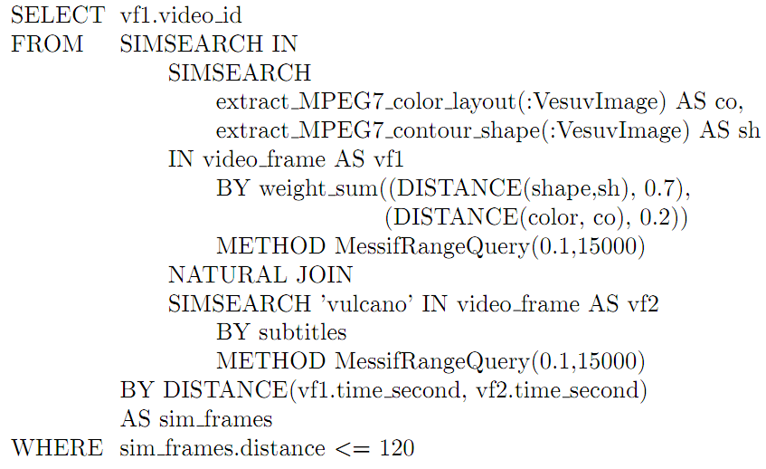
Example Scenario 2
Query: Retrieve all videos where the Vesuvius mountain appears (image similarity) and a commentator mentions volcanoes (speech/text similarity) within two minutes (time aggregation)

Slide 18
Conclusions & Future Work
Challenge: advanced query tools are needed
Popularity and rapid growth of multimedia data, complex information needs
Major requirements: universality, flexibility, intuitive usage
SimSeQL solution
SQL-based query language suited for both common and advanced users
General data model and operations
Extensible SIMSEARCH clause for similarity-based retrieval
Support for optimization
Future work
Implementation over MESSIF
Easy-to-use query formulation interface
Query optimization strategies

