Slide 1
Practical Online Retrieval Evaluation
ECIR 2013 Tutorial
Filip Radlinski (Microsoft)
Katja Hofmann (University of Amsterdam)

Slide 2
Acknowledgments
We thank Yisong Yue. These slides and the code were initially prepared by him and Filip Radlinski for a SIGIR 2011 tutorial. They were revised by Katja Hofmann and Filip Radlinski for this tutorial.
We thank Thorsten Joachims, Nick Craswell, Matt Lease, Yi Zhang, and the anonymous reviewers for providing valuable feedback.
We thank Eugene Agichtein, Ben Carterette, Olivier Chapelle, Nick Craswell, and Thorsten Joachims for providing slide material.

Slide 3
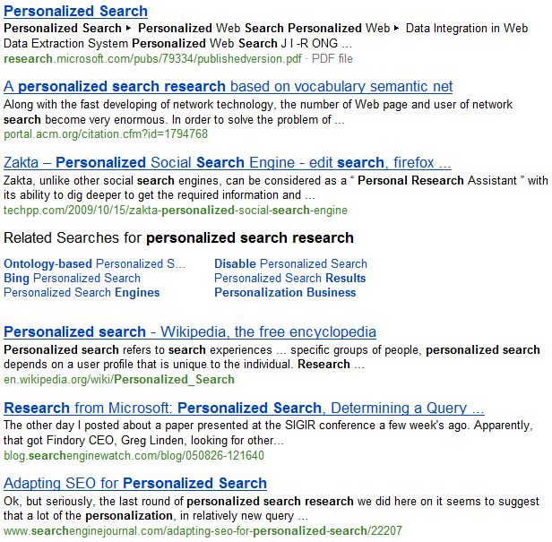
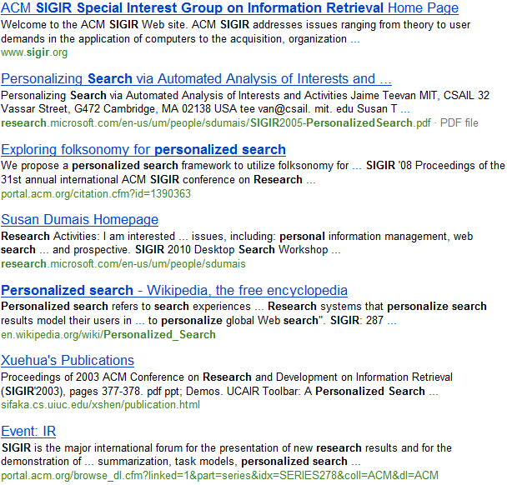
Retrieval Evaluation Goals
Baseline Ranking Algorithm
My Research Project
Which is better?
Goals: Correctness, Practicality, Efficiency

Slide 4
Retrieval Evaluation Goals
Correctness
  If my evaluation says that my ranking method is better than a baseline, would users really agree?
  If my evaluation says that my ranking method isn’t better than the baseline, is that true?
Practicality
  If I’m a researcher with a small group, can I really use this evaluation method in practice?
Efficiency
  I want to make the best use of my resources: How do I best trade off time/cost and sensitivity to changes?

Slide 5
Evaluation
Two types of retrieval evaluation:
“Offline evaluation”
  Ask experts or users to explicitly evaluate your retrieval system. This dominates evaluation today.
“Online evaluation”
  See how normal users interact with your retrieval system when just using it.
… Hybrid approaches
  Combine data collected using online and offline approaches (beyond the scope of this tutorial, see e.g., [Carterette and Jones 2007; Chapelle et al. 2009])

Slide 6
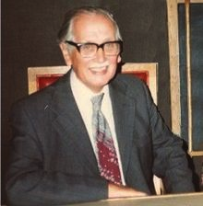
Do we need online evaluation?
Traditional offline evaluation:
The Cranfield approach
  Sample representative queries
  Run them against a number of systems
  Judge the relevance of (top) documents versus (inferred) information needs
http://wwwhome.cs.utwente.nl/~hiemstra/2008/how-cyril-cleverdon-set-the-stage-for-ir-research.html
More often: Assume that somebody else has done this
  Many groups have: TREC, OHSUMED, CLEF, NTCIR, LETOR, …
Basic evaluation method:
  For my new approach, rank a collection & combine the judgments into a summary number. Hope it goes up

Slide 7
Do we need online evaluation?
The Cranfield approach is a good idea when
  Query set is representative of cases that my research tries to address
  Judges can give accurate judgments in my setting
  I trust a particular summary value (e.g., MAP, NDCG, ERR) to accurately reflects my users’ perceptions
If these aren’t the case: Even if my approach is valid, the number might not go up
  Or worse: The number might go up despite my approach producing worse rankings in practice

Slide 8
Challenges with Offline Evaluation
Do users and judges agree on relevance?
  Particularly difficult for personalized search
  Particularly difficult for specialized documents
  Particularly difficult for ambiguous queries
Judges need to correctly appreciate uncertainty
  If you want to diversify web results to satisfy multiple intents, how do judges know what is most likely to be relevant?
How do you identify when relevance changes?
  Temporal changes: Document changes; Query intent changes
It’s expensive and slow to collect new data
  Cheaper crowdsourcing is sometimes an alternative
Summary aggregate score must agree with users
  Do real users agree with MAP@1000? NDCG@5? ERR?

Slide 9
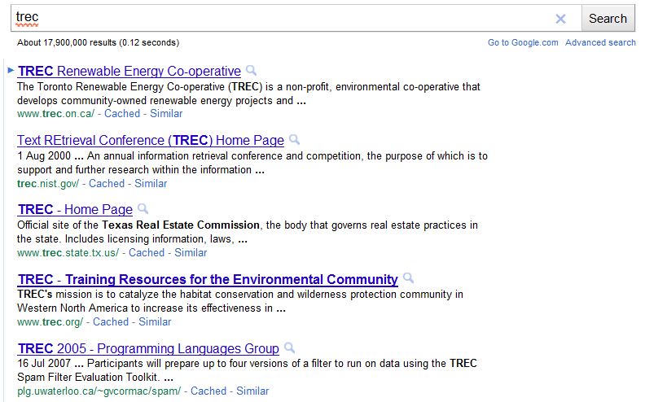
Challenges with Offline Evaluation

Slide 10
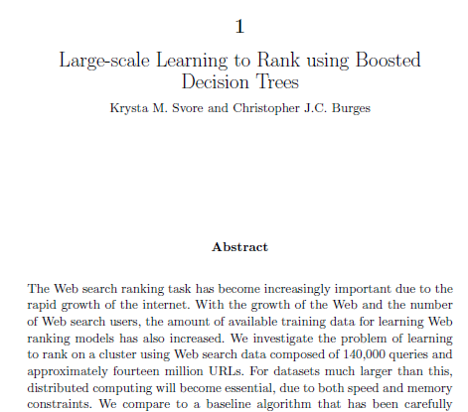
Challenges with Offline Evaluation
Query: “introduction to ranking boosted decision trees”
Document:
…

Slide 11
Tutorial Goals
Provide an overview of online evaluation
  Online metrics: What works when (especially if you’re an academic)
  Interpreting user actions at the Document or Ranking level
  Experiment Design: Opportunities, biases and challenges
Present interleaving for retrieval evaluation
  Describe one particular online evaluation approach in depth
  How it works, why it works and what to watch out for
  Provide a reference implementation
  Describe a number of open challenges
Get you started in obtaining your own online data
  How to realistically “be the search engine”
  End-to-End: Design, Implementation, Recruitment and Analysis
  Overview of alternative approaches
Quick overview of using your online data for learning

Slide 12
Outline
Part 1: Overview of Online Evaluation (Katja)
  Experiment design
  Assumptions about user (click) behavior
  Interpreting user behavior
Part 2: Focus on Interleaving (Filip)
Part 3: End-to-End, From Design to Analysis (Katja)
Part 4: Extensions and Open Problems in Click Evaluation (Filip)

Slide 13
Experiment Design
Lab Study
Ask users to come to the lab, where they perform a specific task while you record online behavior. | Controlled Task Controlled Environment
Example: Users sit in front of an eye tracker while finding the answers to questions using a specific search engine [Granka et al. 2004]
Controlled Task Field Study
Ask volunteers to complete a specific task using your system but on their computer. | Controlled Task Uncontrolled Environment
Example: Crowdsourcing tasks
General Usage Field Study
Ask volunteers to use your system for whatever they find it useful for over a longer period of time | Uncontrolled Task Uncontrolled Environment
Example: Track cursor position on web search results page [Huang et al. 2011]

Slide 14
Online Evaluation
Key Assumption: Observable user behavior reflects relevance
Implicit in this: Users behave (somewhat) rationally
  Real users have a goal when they use an IR system
    They aren’t just bored, typing and clicking pseudo-randomly
  They consistently work towards that goal
    An irrelevant result doesn’t draw most users away from their goal
  They aren’t trying to confuse you
    Most users are not trying to provide malicious data to the system

Slide 15
Online Evaluation
Key Assumption: Observable user behavior reflects relevance
This assumption gives us “high fidelity”
  Real users replace the judges: No ambiguity in information need; Users actually want results; Measure performance on real queries
But introduces a major challenge
  We can’t train the users: How do we know when they are happy? Real user behavior requires careful design and evaluation
And a noticeable drawback
  Data isn’t trivially reusable later

Slide 16
Implicit Feedback
A variety of data can describe online behavior:
  URLs, Queries and Clicks (easiest)
    Browsing Stream: Sequence of URLs users visit
    In IR: Queries, Results and Clicks
  Mouse movement, selections and hovering, scrolling, dwell time, bookmarking, …
The line between online and offline is fuzzy
  Purchase decisions: Ad clicks to online purchases
  Eye tracking
  Offline evaluation using historical online data

Slide 17
Interpreting Clicks
Click

Slide 18
Outline
Part 1: Overview of Online Evaluation (Katja)
  Experiment design
  Assumptions about user (click) behavior
  Interpreting user behavior
Part 2: Focus on Interleaving (Filip)
Part 3: End-to-End, From Design to Analysis (Katja)
Part 4: Extensions and Open Problems in Click Evaluation (Filip)

Slide 19
What do Users View / Click?
Lab study of web search
16 subjects (phase II), 5 navigational and 5 informational search tasks each
Behavior recorded using eye-tracking, proxy
[Joachims et al. 2005, 2007]

Slide 20
Are Clicks Affected by Relevance?
Average rank of click:
2.66
Average rank of click:
4.03*
[Joachims et al. 2005, 2007]

Slide 21
Position Bias
Hypothesis: Order of presentation influences where users look, but not where they click!
More relevant
1
2
1
2
→ Users appear to have trust in Google’s ability to
rank the most relevant result first.
Normal: Google’s order of results
Swapped:
Order of top 2 results swapped
[Joachims et al. 2005, 2007]
Notes:
This is for pairs of top-2 results rated by human judges. A proxy is used to randomly swap the order of results without changing the Google layout.

Slide 22
Which Results are Viewed Before Click?
Clicked Link
→ Users typically do not look at lower results before they click (except maybe the next result)
[Joachims et al. 2005, 2007]
Notes:
Eye tracking study.

Slide 23
Quality-of-Context Bias
Hypothesis: Clicking depends only on the result itself, but not on other results.
 | Rank of clicked link as sorted by relevance judges
Normal + Swapped | 2.67
Reversed | 3.27
→ Users click on less relevant results, if they are embedded between irrelevant results.
Reversed:
Top 10 results in reversed order.
[Joachims et al. 2005, 2007]

Slide 24
Click = Relevant?
Can we simply interpret clicked results as relevant?
  This would provide a relevance dataset, after which we run a Cranfield style evaluation
A variety of biases make this difficult
  Position Bias:
    Users are more inclined to examine and click on higher-ranked results
  Contextual Bias:
    Whether users click on a result depends on other nearby results
  Attention Bias:
    Users click more on results which draw attention to themselves

Slide 25
Outline
Part 1: Overview of Online Evaluation (Katja)
  Experiment design
  Assumptions about user (click) behavior
  Interpreting user behavior
Part 2: Focus on Interleaving (Filip)
Part 3: End-to-End, From Design to Analysis (Katja)
Part 4: Extensions and Open Problems in Click Evaluation (Filip)

Slide 26
Online Evaluation Designs
Click
Document-Level feedback
  E.g., click indicates document is relevant
  Document-level feedback often used to define retrieval evaluation metrics.
Ranking-level feedback
  E.g., click indicates result-set is good
  Directly define evaluation metric for a result-set.

Slide 27
Online Evaluation Designs
We have some key choices to make:
  Document Level or Ranking Level?
  Absolute or Relative?
Document Level | Ranking Level
I want to know about the documents Similar to the Cranfield approach, I’d like to find out the quality of each document. | I am mostly interested in the rankings I’m trying to evaluate retrieval functions. I don’t need to be able to drill down to individual documents.
Absolute Judgments | Relative Judgments
I want a score on an absolute scale Similar to the Cranfield approach, I’d like a number that I can compare to many methods, over time. | I am mostly interested in a comparison It’s enough if I know which document, or which ranking, is better. Its not necessary to know the absolute value.

Slide 28
Interpretation Choices
 | Absolute | Relative
Document Level | Click Rate, Cascade Models, … | Click-Skip, FairPairs
Ranking Level | Abandonment, Reciprocal Rank, Time to Click, PSkip, … | Side by Side, Interleaving

Slide 29
Interpretation Choices
 | Absolute | Relative
Document Level | Click Rate, Cascade Models, … | Click-Skip, FairPairs
Ranking Level | Abandonment, Reciprocal Rank, Time to Click, PSkip, … | Side by Side, Interleaving

Slide 30
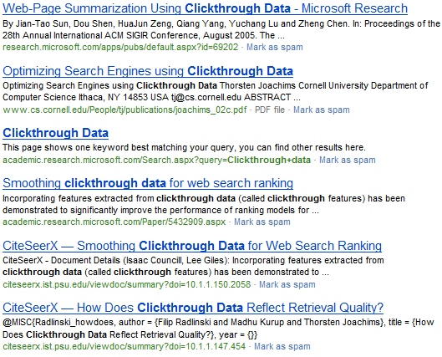
Document Level Comparisons
Is probably
better than that
This
Click
[Joachims, 2002]

Slide 31
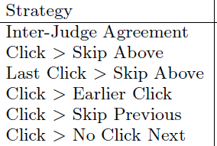
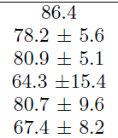
Document Level Comparisons
There are other alternatives
  Click > Earlier Click
  Last Click > Skip Above
  …
How accurate are they?
[Joachims et al, 2005]

Slide 32
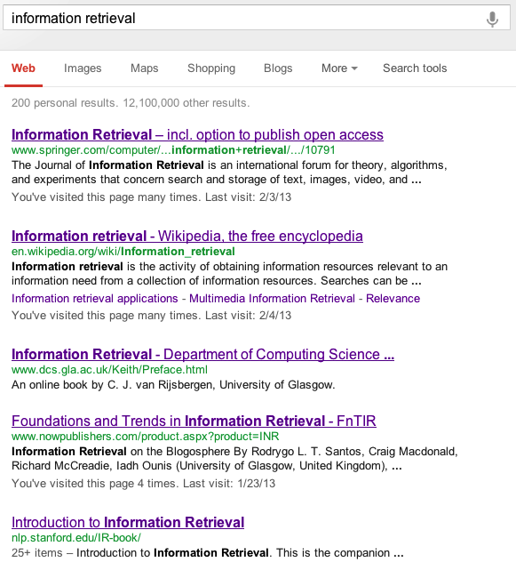
Click > Skip Heuristics
Proposed interpretations of clicks as relative preferences:
CLICK > SKIP ABOVE
LAST CLICK > SKIP ABOVE
CLICK > EARLIER CLICK
LAST CLICK > SKIP PREVIOUS
CLICK > NO-CLICK NEXT
[Joachims et al. 2005, 2007]

Slide 33
Click > Skip Heuristics
Proposed interpretations of clicks as relative preferences:
CLICK > SKIP ABOVE
LAST CLICK > SKIP ABOVE
CLICK > EARLIER CLICK
LAST CLICK > SKIP PREVIOUS
CLICK > NO-CLICK NEXT
1
2
3
Click
4
5
[Joachims et al. 2005, 2007]

Slide 34
Click > Skip Heuristics
Proposed interpretations of clicks as relative preferences:
CLICK > SKIP ABOVE
LAST CLICK > SKIP ABOVE
CLICK > EARLIER CLICK
LAST CLICK > SKIP PREVIOUS
CLICK > NO-CLICK NEXT
1
2
Click
3
4
Click
5
[Joachims et al. 2005, 2007]

Slide 35
Click > Skip Heuristics
Proposed interpretations of clicks as relative preferences:
CLICK > SKIP ABOVE
LAST CLICK > SKIP ABOVE
CLICK > EARLIER CLICK
LAST CLICK > SKIP PREVIOUS
CLICK > NO-CLICK NEXT
1
2
3
Click
4
5
Click
[Joachims et al. 2005, 2007]

Slide 36
Click > Skip Heuristics
Proposed interpretations of clicks as relative preferences:
CLICK > SKIP ABOVE
LAST CLICK > SKIP ABOVE
CLICK > EARLIER CLICK
LAST CLICK > SKIP PREVIOUS
CLICK > NO-CLICK NEXT
1
2
Click
3
4
Click
5
[Joachims et al. 2005, 2007]

Slide 37
Click > Skip Heuristics
Proposed interpretations of clicks as relative preferences:
CLICK > SKIP ABOVE
LAST CLICK > SKIP ABOVE
CLICK > EARLIER CLICK
LAST CLICK > SKIP PREVIOUS
CLICK > NO-CLICK NEXT
1
2
Click
3
4
5
[Joachims et al. 2005, 2007]

Slide 38
Click > Skip Heuristics - Evaluation
Evaluation against explicit manual preference judgments:
Method | Accuracy
Click > Skip Above | 78.2 ± 5.6
Last Click > Skip Above | 80.9 ± 5.1
Click > Earlier Click | 64.3 ± 15.4
Click > Skip Previous | 80.7 ± 9.6
Click > No Click Next | 67.4 ± 8.2
Inter-Judge Agreement | 86.4
High accuracy (up to 80%)
May suffer from position bias
[Joachims et al. 2005, 2007]

Slide 39
FairPairs
We can only observe that lower > higher
So randomly reorder pairs of documents
Half the time, show:
The other half, show:
Document 1
Document 2
What happens more often?
Document 2
Click
Document 1
Click
[Radlinski & Joachims ‘07]

Slide 40
FairPairs
We can only observe that lower > higher
So randomly reorder pairs of documents
Hybrid approach: Convert pairs to absolute
Half the time, show:
The other half, show:
Document 1
Document 2
What happens more often?
Document 2
Click
Document 1
Click
[Radlinski & Joachims ‘07]
[Agrawal et al ‘09]

Slide 41
FairPairs
Idea: remove position bias from relevance estimates using randomization
Evaluation:
Analytically: provably removes position bias under reasonable assumptions
On arxiv.org, assume that 1st result is better than 2nd, etc., on average:
[Radlinski & Joachims 2006]

Slide 42
Interpretation Choices
 | Absolute | Relative
Document Level | Clickthrough Rate, Click Models, … | Click-Skip, FairPairs
Ranking Level | Abandonment, Reciprocal Rank, Time to Click, PSkip, … | Side by Side, Interleaving

Slide 43
Absolute Document Relevance
Straightforward interpretation of clicks: use click-through rate
  May be biased
Can absolute document relevance be recovered from clicks under position bias?
  Examination hypothesis
  Cascade model
  More complex click models

Slide 44
Correcting for Position
(Absolute / Document-Level)
How to model position bias?
What is the primary modeling goal?
Position Models | Cascade Models
Clicks depend on relevance and position Each rank position has some independent probability of being examined. | Users examine ranking sequentially Users scan down the ranking until finding a relevant document to click on.
Insight into User Behavior | Estimating Relevance
Model parameters can be used to interpret how users behave “Position bias generally affects users X amount at rank 1”. Indirectly enables relevance estimation of documents. | Directly estimate the relevance of documents (or quality of rankings) “A clicked document corresponds to X% probability of being relevant”. Does not directly give insight on user behavior.
Also: Some joint models do both!

Slide 45
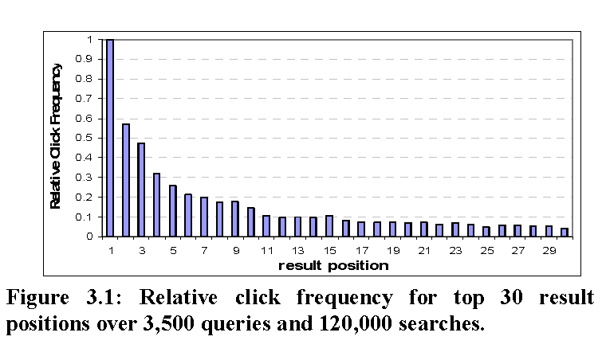
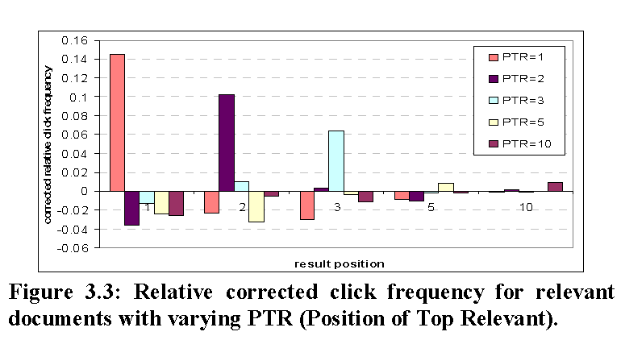
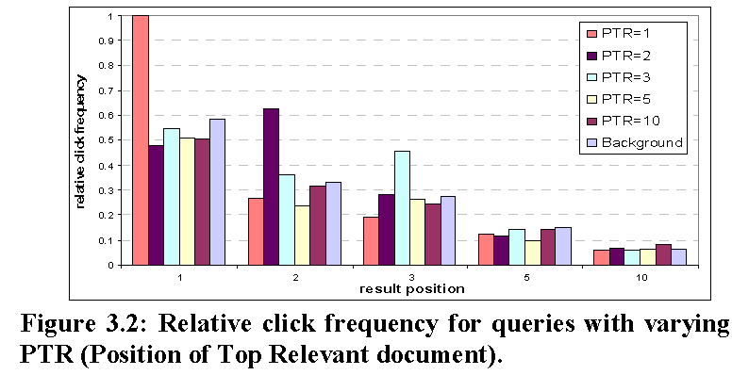
Relative Click Frequency
(Position Model)
Can also use ratio of click frequencies
called Clicks Over Expected Clicks (COEC) [Zhang & Jones 2007]
[Agichtein et al 2006a; Zhang & Jones 2007; Chapelle & Zhang 2009]

Slide 46
Explaining Clicks: Models
Baseline hypothesis: no position bias
c_{di} = r_{d} = c_{dj}
Mixture hypothesis: some users click based on position, some based on relevance
c_{di} = λ r_{d} + ( 1 − λ ) c_{i}
Examination hypothesis: clicked documents need to be examined and clicked [Richardson et al. 2007; Craswell et al. 2008]
c_{di} = r_{d} x_{i}
Cascade model: users examine documents one by one, click first relevant [Craswell et al. 2008]
c_{di} = r_{d} Π_{i<j} (1 − r_{docinrank:j})
c_{di} : probability of a click on document d at rank I; r_{d} = probability of relevance for d;
x_{i} = probability of examining documents at rank i

Slide 47
Explaining Clicks: Properties
Train on click data: choose parameters to maximize probability of observed data
Probability of relevance can be recovered
Require multiple impressions per query / document pair (ideally with different rankings)

Slide 48
Explaining Clicks: Evaluation
Evaluated on data collected using FairPairs
Task: given CTR on ordering AB, predict CTR on BA
Good explanation of position bias for top-ranked documents (cascade model)
[Craswell et al. 2008]

Slide 49
Dynamic Bayesian Network
(Extended Cascade Model)
Like cascade model, but with added steps
  Examines result at rank j
  If attracted to result at rank j:
    Clicks on result
    If user is satisfied, ends session
  Otherwise, decide whether to abandon session
  If not, j ← j + 1, go to step 1
  Can model multiple clicks per session
  Distinguishes clicks from relevance
  Requires multiple query/doc impressions
[Chapelle & Zhang 2009]

Slide 50
Dynamic Bayesian Network
[Chapelle & Zhang 2009]
Notes:
E nodes are hidden variables representing whether the user examined the result.
A nodes are hidden variables representing whether the user was attracted to the result.
C nodes are observed variables representing whether the user clicked on the result.
S nodes are hidden variables representing whether the user was satisfied with the result.

Slide 51
Performance Comparison
Predicting clickthrough rate (CTR) on top result
Models trained on query logs of large-scale search engine
[Chapelle & Zhang 2009]

Slide 52
Click-Models: Extensions
Model differences between navigational and informational intent queries [Guo et al. 2009]
Model relevance contributions of several documents per query session [Dupret & Liao 2010]
Integrate additional, post-click, behaviors [Zhong et al. 2010]
Model URL-revisits [Xu et al. 2012]
Generalize across queries (application to online advertising) [Zhu et al. 2010]

Slide 53
Absolute Document Judgments (Summary)
Joint model of user behavior and relevance
  E.g., how often a user examines results at rank 3
Straightforward to infer relevance of documents
  Need to convert document relevance to evaluation metric
Requires additional assumptions
  E.g., cascading user examination assumption
Requires multiple impressions of doc/query pair
  A special case of “Enhancing Web Search by Mining Search and Browse Logs” tutorial this morning
  Often impractical at small scales

Slide 54
Interpretation Choices
 | Absolute | Relative
Document Level | Clickthrough Rate, Click Models, … | Click-Skip, FairPairs
Ranking Level | Abandonment, Reciprocal Rank, Time to Click, PSkip, … | Side by Side, Interleaving

Slide 55
Absolute Ranking-Level Judgments
Document-level feedback requires converting judgments to evaluation metric (of a ranking)
Ranking-level judgments directly define such a metric
Some Absolute Metrics
Abandonment Rate | Reformulation Rate
Queries per Session | Clicks per Query
Click rate on first result | Max Reciprocal Rank
Time to first click | Time to last click
% of viewed documents skipped (pSkip)
[Radlinski et al. 2008; Wang et al. 2009]

Slide 56
Absolute Ranking-Level Judgments
Benefits
  Often much simpler than document click models
  Directly measure ranking quality: Simpler task requires less data, hopefully
Downsides
  Can’t really explain the outcome:
    Never get examples of inferred ranking quality
    Different queries may naturally differ on metrics: counting on the average being informative
  Evaluations over time need not necessarily be comparable. Need to ensure:
    Done over the same user population
    Performed with the same query distribution
    Performed with the same document distribution

Slide 57
Monotonicity Assumption
Consider two sets of results: A & B
  A is high quality
  B is medium quality
Which will get more clicks from users, A or B?
  A has more good results: Users may be more likely to click when presented results from A.
  B has fewer good results: Users may need to click on more results from ranking B to be satisfied.
Need to test with real data
  If either direction happens consistently, with a reasonable amount of data, we can use this to evaluate online

Slide 58
Testing Monotonicity on ArXiv.org
  This is an academic search engine, similar to ACM digital library but mostly for physics.
  Real users looking for real documents.
  Relevance direction known by construction
  Orig > Swap2 > Swap4
    Orig: Hand-tuned ranking function
    Swap2: Orig with 2 pairs swapped
    Swap4: Orig with 4 pairs swapped
  Orig > Flat > Rand
    Orig: Hand-tuned ranking function, over many fields
    Flat: No field weights
    Rand : Top 10 of Flat randomly reordered shuffled
Evaluation on 3500 x 6 queries
Do all pairwise tests: Each retrieval function used half the time.
[Radlinski et al. 2008]

Slide 59
Absolute Metrics
Name | Description | Hypothesized Change as Quality Falls
Abandonment Rate | % of queries with no click | Increase
Reformulation Rate | % of queries that are followed by reformulation | Increase
Queries per Session | Session = no interruption of more than 30 minutes | Increase
Clicks per Query | Number of clicks | Decrease
Clicks @ 1 | Clicks on top results | Decrease
pSkip [Wang et al ’09] | Probability of skipping | Increase
Max Reciprocal Rank* | 1/rank for highest click | Decrease
Mean Reciprocal Rank* | Mean of 1/rank for all clicks | Decrease
Time to First Click* | Seconds before first click | Increase
Time to Last Click* | Seconds before final click | Decrease
(*) only queries with at least one click count

Slide 60
Evaluation of Absolute Metrics on ArXiv.org
[Radlinski et al. 2008]

Slide 61
Evaluation of Absolute Metrics on ArXiv.org
How well do statistics reflect the known quality order?
Evaluation Metric | Consistent (weak) | Inconsistent (weak) | Consistent (strong) | Inconsistent (strong)
Abandonment Rate | 4 | 2 | 2 | 0
Clicks per Query | 4 | 2 | 2 | 0
Clicks @ 1 | 4 | 2 | 4 | 0
pSkip | 5 | 1 | 2 | 0
Max Reciprocal Rank | 5 | 1 | 3 | 0
Mean Reciprocal Rank | 5 | 1 | 2 | 0
Time to First Click | 4 | 1 | 0 | 0
Time to Last Click | 3 | 3 | 1 | 0
[Radlinski et al. 2008; Chapelle et al. 2012]

Slide 62
Evaluation of Absolute Metrics on ArXiv.org
How well do statistics reflect the known quality order?
Evaluation Metric | Consistent (weak) | Inconsistent (weak) | Consistent (strong) | Inconsistent (strong)
Abandonment Rate | 4 | 2 | 2 | 0
Clicks per Query | 4 | 2 | 2 | 0
Clicks @ 1 | 4 | 2 | 4 | 0
pSkip | 5 | 1 | 2 | 0
Max Reciprocal Rank | 5 | 1 | 3 | 0
Mean Reciprocal Rank | 5 | 1 | 2 | 0
Time to First Click | 4 | 1 | 0 | 0
Time to Last Click | 3 | 3 | 1 | 0
Absolute Metric Summary
None of the absolute metrics reliably reflect expected order.
Most differences not significant with thousands of queries.
(These) absolute metrics not suitable for ArXiv-sized search engines with these retrieval quality differences.
[Radlinski et al. 2008; Chapelle et al. 2012]

Slide 63
Interpretation Choices
Often more reliable & sensitive
 | Absolute | Relative
Document Level | Click Rate, Cascade Model, … | Click/Skip, FairPairs
Ranking Level | Abandonment, Reciprocal Rank, Time to Click, PSkip, … | Side by Side, Interleaving
Often more reusable
Best understood & most reusable
Often what you actually want

Slide 64
More In-Depth Analysis
Other usage patterns reflect more than relevance
  Click entropy for personalization [Teevan et al. 2008]
  Revisitations to detect “bookmarking” and long-term interests [Adar et al. 2008]
  Good or bad abandonment [Huang et al. 2011]
  Long term behavior for estimating user engagement [Dupret and Lalmas 2013]
This enables more detailed understanding of users
  Can design specific changes to better service such specific types of information needs
  Typically requires larger scale usage data
  Requires more careful experimental design
Related tutorial: “Design of Large Scale Log Analysis Studies” by Dumais et al, at HCIC 2010
Notes:
See related tutorial: http://research.microsoft.com/en-us/um/people/sdumais/Logs-talk-HCIC-2010.pdf

Slide 65
Summary of Part 1
Considered online versus offline evaluation
  Under which conditions is each better
With online data: focus on clicks
  Compared absolute & relative interpretations
  Compared document level & ranking level interpretations
Part 2 will focus on interleaving

Slide 66
Practical Online Retrieval Evaluation
Part 2
Filip Radlinski (Microsoft)
Katja Hofmann (University of Amsterdam)

Slide 67
Outline
Part 1: Overview of Online Evaluation
Part 2: Relative Ranking Level Evaluation
  Relative => Interleaving algorithms
  Evaluating the evaluation algorithm
  Back to Clicks versus Relevance
Part 3: End-to-End, From Design to Analysis
Part 4: Extensions and Open Problems

Slide 68
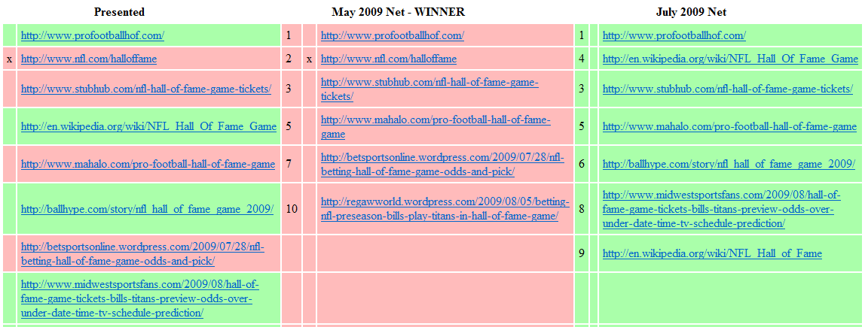
Comparing Rankings Efficiently
Suppose you want to compare two rankings
So far, we’ve only considered things we can measure when showing A to users, or B to users
What if we can show something different? Can we learn more about ranking quality?
Ranking A
Ranking B

Slide 69
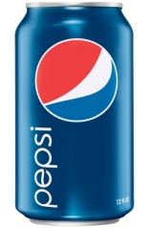
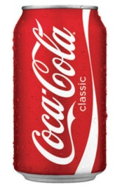
Taste-test analogy
Suppose we conduct taste experiment: vs
  Want to maintain a natural usage context
Experiment 1: absolute metrics
  Each participant’s refrigerator randomly stocked
    Either Pepsi or Coke (anonymized)
  Measure how much participant drinks
Issues:
  Calibration (person’s thirst, other confounding variables…)
  Higher variance

Slide 70
Taste-test analogy
Suppose we conduct taste experiment: vs
  Want to maintain natural usage context
Experiment 2: relative metrics
  Each participant’s refrigerator randomly stocked
    Some Pepsi (A) and some Coke (B)
  Measure how much participant drinks of each
    (Assumes people drink rationally!)
Issues solved:
  Controls for each individual participant
  Lower variance
A
B

Slide 71
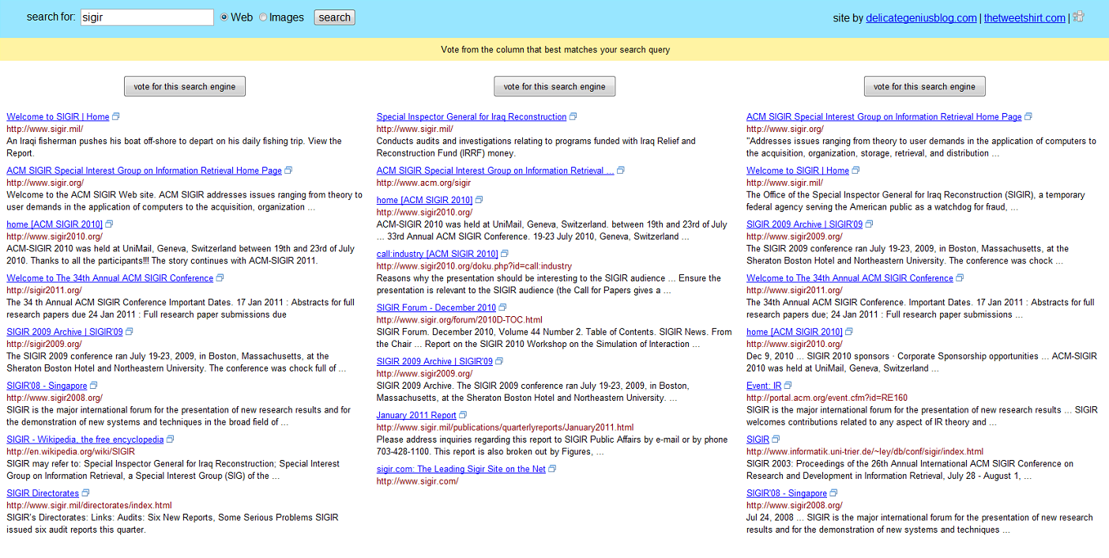
A Taste Test in Retrieval:
Ranking Level Comparisons
What about obtaining a preference between rankings?
Not natural (even getting rid of the “vote” button)
If you’re an expert, maybe you can guess which is which
e.g. [Thomas & Hawking, 2008]

Slide 72
Online Evaluation with Interleaving
A within-user online ranker comparison
  Presents results from both rankings to every user
Ranking A
Ranking B
Shown to users (randomized)

Slide 73
Why might mixing rankings help?
Say results are worth money. For a certain query:
  Ranker A: Offers $11, $10 or $2
  ➔ User clicks
  Ranker B: Offers $250, $250 or $95
  ➔ User also clicks
Users of A may not know what they’re missing
Difference in behavior is small, hard to discern
But if we can mix up results from A & B
  Strong preference for B
Challenge: Mix in a way to avoid biases

Slide 74
Online Evaluation with Interleaving
A within-user online ranker comparison
  Presents results from both rankings to every user
The ranking that gets more of the clicks wins
Shown to users (randomized)
Ranking B
Ranking A

Slide 75
Team Draft Interleaving
Ranking A
Napa Valley – The authority for lodging...
www.napavalley.com
Napa Valley Wineries - Plan your wine...
www.napavalley.com/wineries
Napa Valley College
www.napavalley.edu/homex.asp
4. Been There | Tips | Napa Valley
www.ivebeenthere.co.uk/tips/16681
5. Napa Valley Wineries and Wine
www.napavintners.com
6. Napa Country, California – Wikipedia
en.wikipedia.org/wiki/Napa_Valley
Ranking B
1. Napa Country, California – Wikipedia
en.wikipedia.org/wiki/Napa_Valley
2. Napa Valley – The authority for lodging...
www.napavalley.com
3. Napa: The Story of an American Eden...
books.google.co.uk/books?isbn=...
4. Napa Valley Hotels – Bed and Breakfast...
www.napalinks.com
5. NapaValley.org
www.napavalley.org
6. The Napa Valley Marathon
www.napavalleymarathon.org
Presented Ranking
Napa Valley – The authority for lodging...
www.napavalley.com
2. Napa Country, California – Wikipedia
en.wikipedia.org/wiki/Napa_Valley
3. Napa: The Story of an American Eden...
books.google.co.uk/books?isbn=...
Napa Valley Wineries – Plan your wine...
www.napavalley.com/wineries
5. Napa Valley Hotels – Bed and Breakfast...
www.napalinks.com
Napa Valley College
www.napavalley.edu/homex.asp
7 NapaValley.org
www.napavalley.org
A
B
  [Radlinski et al. 2008]

Slide 76
Team Draft Interleaving
Ranking A
Napa Valley – The authority for lodging...
www.napavalley.com
Napa Valley Wineries - Plan your wine...
www.napavalley.com/wineries
Napa Valley College
www.napavalley.edu/homex.asp
4. Been There | Tips | Napa Valley
www.ivebeenthere.co.uk/tips/16681
5. Napa Valley Wineries and Wine
www.napavintners.com
6. Napa Country, California – Wikipedia
en.wikipedia.org/wiki/Napa_Valley
Ranking B
1. Napa Country, California – Wikipedia
en.wikipedia.org/wiki/Napa_Valley
2. Napa Valley – The authority for lodging...
www.napavalley.com
3. Napa: The Story of an American Eden...
books.google.co.uk/books?isbn=...
4. Napa Valley Hotels – Bed and Breakfast...
www.napalinks.com
5. NapaValley.org
www.napavalley.org
6. The Napa Valley Marathon
www.napavalleymarathon.org
Presented Ranking
Napa Valley – The authority for lodging...
www.napavalley.com
2. Napa Country, California – Wikipedia
en.wikipedia.org/wiki/Napa_Valley
3. Napa: The Story of an American Eden...
books.google.co.uk/books?isbn=...
Napa Valley Wineries – Plan your wine...
www.napavalley.com/wineries
5. Napa Valley Hotels – Bed and Breakfast...
www.napalinks.com
Napa Balley College
www.napavalley.edu/homex.asp
7 NapaValley.org
www.napavalley.org
Click
Tie!
Click
  [Radlinski et al. 2008]

Slide 77
Quantitative Analysis
Can we quantify how well Interleaving performs?
  Compared to Absolute Ranking-level Metrics
  Compared to Offline Judgments
How reliable is it?
  Does Interleaving correctly identify the better retrieval function?
How sensitive is it?
  How much data is required to achieve a target confidence level (p-value)?
  [Radlinski et al. 2008; Chapelle et al. 2012]

Slide 78
Experimental Setup
Selected 4-6 pairs of ranking functions to compare in different settings
  Known retrieval quality, by construction or by judged evaluation
Observed user behavior in two experimental conditions
  Randomly used one of the two individual ranking functions
  Presented an interleaving of the two ranking functions
Evaluation performed on three different search platforms
  arXiv.org (academic paper repository)
  Bing Web search
  Yahoo! Web search
  [Radlinski et al. 2008; Radlinski & Craswell 2010; Chapelle et al. 2012]

Slide 79
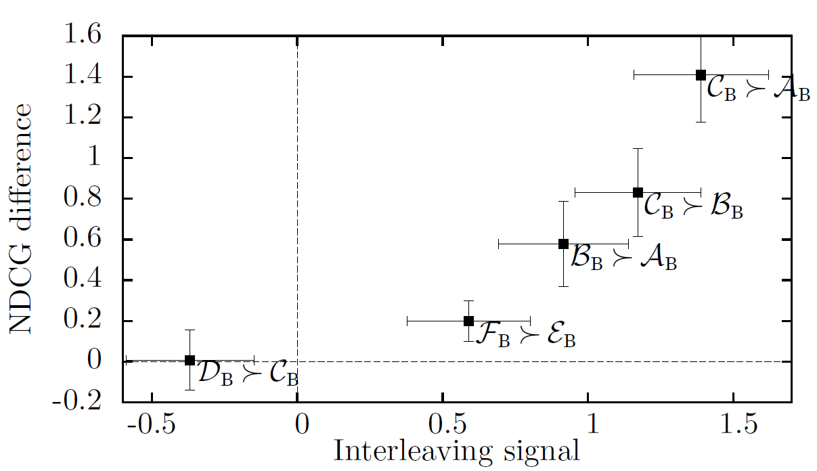
Comparison with Offline Judgments
Experiments on Bing (large scale experiment)
Plotted interleaving preference vs NDCG difference
Good calibration between expert judgments and interleaving
  [Radlinski & Craswell 2010; Chapelle et al. 2012]

Slide 80
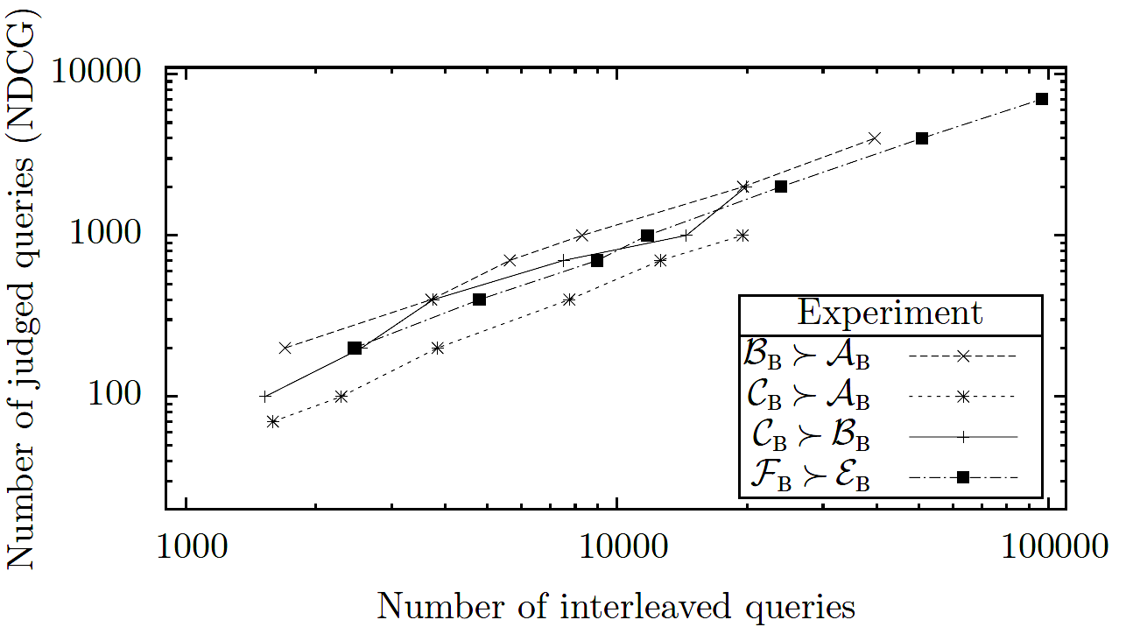
Comparison with Offline Judgments
Experiments on Bing (large-scale experiment)
Plotted queries required vs expert judgments required (for different p-values)
Linear relationship between queries and expert judgments required
One expert judged query is worth ~10 queries with clicks
  [Radlinski & Craswell 2010; Chapelle et al. 2012]

Slide 81
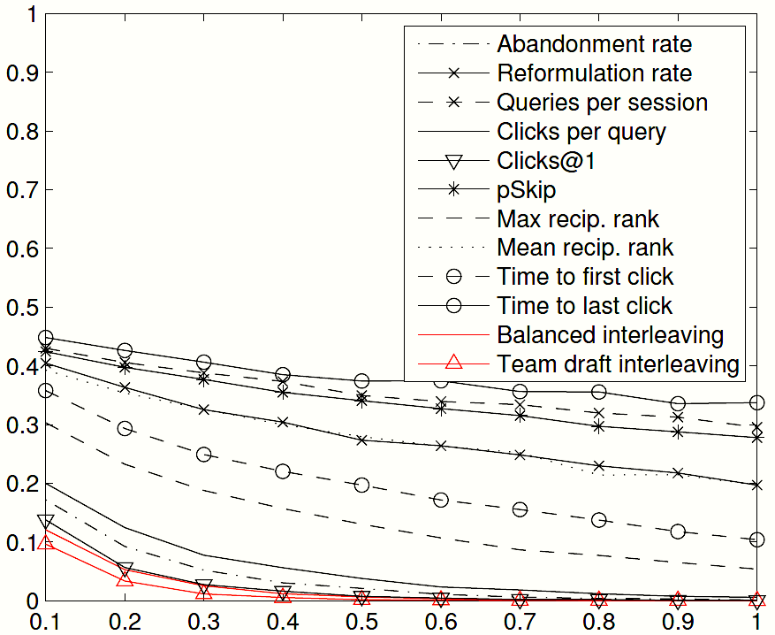
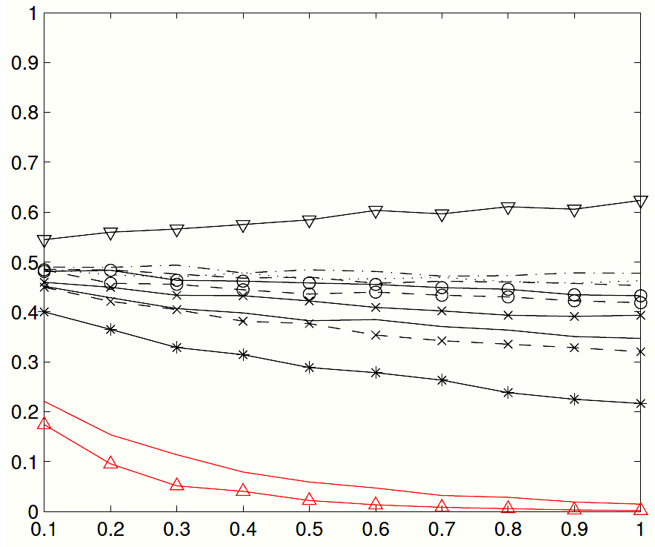
Comparison with Absolute Metrics (Online)
ArXiv.org Pair 1
ArXiv.org Pair 2
p-value
Agreement Probability
Query set size
Clicks@1 diverges in
preference estimate
Experiments on arXiv.org
About 1000 queries per experiment
Interleaving is more sensitive and more reliable
Interleaving achieves
significance faster
  [Radlinski et al. 2008; Chapelle et al. 2012]

Slide 82
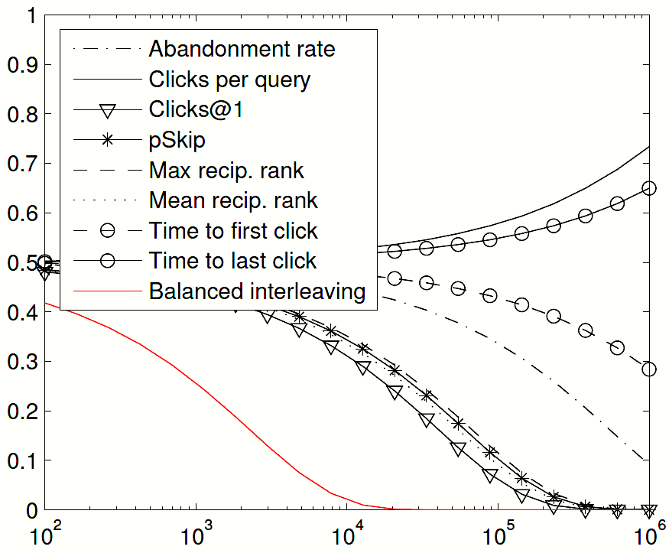
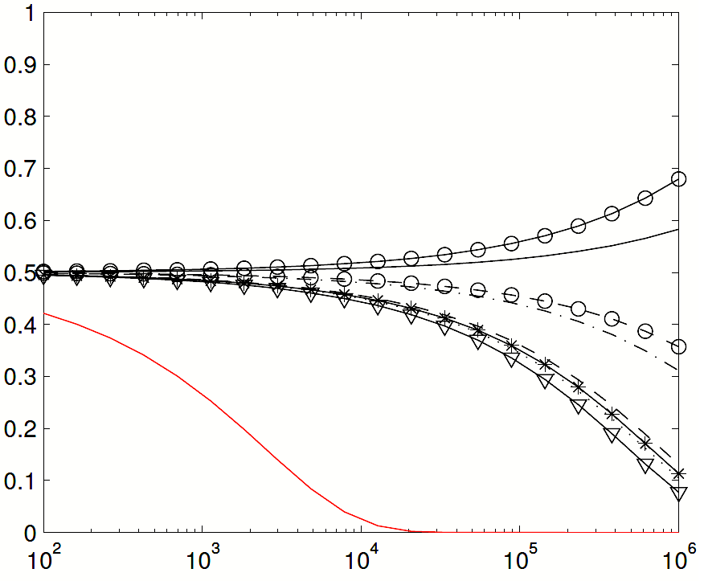
Comparison with Absolute Metrics (Online)
Yahoo! Pair 1
Yahoo! Pair 2
p-value
Agreement Probability
Query set size
Experiments on Yahoo! (much smaller differences in relevance)
Large scale experiment
Interleaving is sensitive and more reliable (~7K queries for significance)
  [Chapelle et al. 2012]

Slide 83
Comparative Summary
Method | Consistent (weak) | Inconsistent (weak) | Consistent (strong) | Inconsistent (strong)
Abandonment Rate | 4 | 2 | 2 | 0
Clicks per Query | 4 | 2 | 2 | 0
Clicks @ 1 | 4 | 2 | 4 | 0
pSkip | 5 | 1 | 2 | 0
Max Reciprocal Rank | 5 | 1 | 3 | 0
Mean Reciprocal Rank | 5 | 1 | 2 | 0
Time to First Click | 4 | 1 | 0 | 0
Time to Last Click | 3 | 3 | 1 | 0
Interleaving | 6 | 0 | 6 | 0
Comparison on arXiv.org experiments
Results on Yahoo! qualitatively similar
  [Radlinski et al. 2008; Chapelle et al. 2012]

Slide 84
Benefits & Drawbacks of Interleaving
Benefits
  A direct way to elicit user preferences
  More sensitive than many other online metrics
  Deals with issues of position bias and calibration
  Roughly 10 clicked queries =~ 1 judged query(on Bing)
Drawbacks
  Reusability: Not easy to reuse judgment data collected
    Similar to some offline settings [Carterette & Smucker, 2007]
  Benchmark: No absolute number for benchmarking
  Interpretation: Unable to interpret much at the document-level, or about user behavior

Slide 85
Rational Clicking is subtle
One Query, Three Intents
Ranking A
Ranking B
49 %
49 %
98% happy
51% happy
2 %
Team Draft Interleaving
Coin Tosses:
A
A
A
B
B
A
B
B
A
A
B
B
B
B
A
A
A
B
A
B
A gets 50%
A gets 49%
A gets 50%
A gets 49%
Ranking B is better?

Slide 86
Alternative Interleaving Algorithms
Goals of interleaving
  Paired test to maximize sensitivity
  Fair comparison to maximize reliability
There are multiple ways to interleave rankings
  We saw Team-Draft Interleaving earlier
  Another way is Balanced Interleaving
  Other methods exist, e.g., [He et al. 2009; Hofmann et al. 2011b]
There are multiple ways to assign credit for clicks
  We’ll see what the parameters are

Slide 87
Balanced Interleaving
Ranking A
Napa Valley – The authority for lodging...
www.napavalley.com
Napa Valley Wineries - Plan your wine...
www.napavalley.com/wineries
Napa Valley College
www.napavalley.edu/homex.asp
4. Been There | Tips | Napa Valley
www.ivebeenthere.co.uk/tips/16681
5. Napa Valley Wineries and Wine
www.napavintners.com
6. Napa Country, California – Wikipedia
en.wikipedia.org/wiki/Napa_Valley
Ranking B
1. Napa Country, California – Wikipedia
en.wikipedia.org/wiki/Napa_Valley
2. Napa Valley – The authority for lodging...
www.napavalley.com
3. Napa: The Story of an American Eden...
books.google.co.uk/books?isbn=...
4. Napa Valley Hotels – Bed and Breakfast...
www.napalinks.com
5. NapaValley.org
www.napavalley.org
6. The Napa Valley Marathon
www.napavalleymarathon.org
Presented Ranking
Napa Valley – The authority for lodging...
www.napavalley.com
2. Napa Country, California – Wikipedia
en.wikipedia.org/wiki/Napa_Valley
Napa Valley Wineries – Plan your wine...
www.napavalley.com/wineries
Napa Valley College
www.napavalley.edu/homex.asp
Napa: The Story of an American Eden...
books.google.co.uk/books?isbn=...
Been There | Tips | Napa Valley
www.ivebeenthere.co.uk/tips/16681
Napa Valley Hotels – Bed and Breakfast...
www.napalinks.com
[Joachims ‘02]

Slide 88
Balanced Interleaving
Winner!
Ranking A
Napa Valley – The authority for lodging...
www.napavalley.com
Napa Valley Wineries - Plan your wine...
www.napavalley.com/wineries
Napa Valley College
www.napavalley.edu/homex.asp
4. Been There | Tips | Napa Valley
www.ivebeenthere.co.uk/tips/16681
5. Napa Valley Wineries and Wine
www.napavintners.com
6. Napa Country, California – Wikipedia
en.wikipedia.org/wiki/Napa_Valley
Ranking B
1. Napa Country, California – Wikipedia
en.wikipedia.org/wiki/Napa_Valley
2. Napa Valley – The authority for lodging...
www.napavalley.com
3. Napa: The Story of an American Eden...
books.google.co.uk/books?isbn=...
4. Napa Valley Hotels – Bed and Breakfast...
www.napalinks.com
5. NapaValley.org
www.napavalley.org
6. The Napa Valley Marathon
www.napavalleymarathon.org
[
Presented Ranking
Napa Valley – The authority for lodging...
www.napavalley.com
2. Napa Country, California – Wikipedia
en.wikipedia.org/wiki/Napa_Valley
Napa Valley Wineries – Plan your wine...
www.napavalley.com/wineries
Napa Valley College
www.napavalley.edu/homex.asp
Napa: The Story of an American Eden...
books.google.co.uk/books?isbn=...
Been There | Tips | Napa Valley
www.ivebeenthere.co.uk/tips/16681
Napa Valley Hotels – Bed and Breakfast...
www.napalinks.com
Click
Click
[Joachims ‘02]

Slide 89
Random Clicking is subtle
Ranking A
Ranking B
Balanced Interleaving
Click
Ranking A wins
A
Click
Ranking B wins
Click
Ranking A wins
Random clicks A wins 2/3 of the time

Slide 90
Random Clicking is subtle
Ranking A
Ranking B
Balanced Interleaving
Click
Ranking B wins
B
Click
Ranking A wins
Click
Ranking A wins
Random clicks A wins 2/3 of the time, again

Slide 91
Biases in Interleaving
Both algorithms so far can be broken
  These are contrived edge cases
  If each edge case prefers for each ranker equally often, it doesn’t affect the outcome
These cases seem to have no/low impact across many real experiments
  But can we avoid them completely? ➔ We’ll answer that question in Part 4

Slide 92
Outline
Part 1: Overview of Online Evaluation
Part 2: Relative Ranking Level Evaluation
  Relative => Interleaving algorithms
  Evaluating the evaluation algorithm
  Back to Clicks versus Relevance
Part 3: End-to-End, From Design to Analysis
Part 4: Extensions and Open Problems

Slide 93
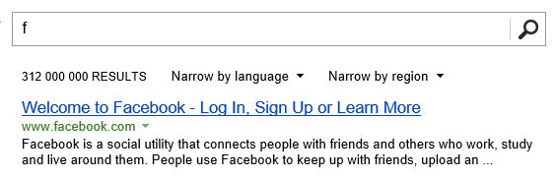


Back to Clicks versus Relevance
Presentation bias affects clicks
  Interleaving addresses position bias
  Are there other important biasing effects?
  (these affect all online evaluations)
Sometimes clicks ≠ relevance
  Sometimes the answer is in the snippet
  Otherwise, a click is the expectation of relevance
    Some snippets draw more attention
    Some are even misleading
  How do we define relevance?
    What people click on, or what the query means?

Slide 94

Attractiveness Bias
Click
Click
Does the third result look more relevant?
  i.e., judging a book by its cover
Maybe 3rd result attracted more attention
  It contains more words, more bolded query terms
  [Yue et al. 2010a]

Slide 95
Recall: Document Level Comparisons
Randomly reorder pairs of documents
Measure which is clicked more frequently when shown at lower rank
Half the time, show:
The other half, show:
Document 1
Document 2
What happens more often?
Document 2
Click
Document 1
Click
[Radlinski & Joachims ‘07]

Slide 96
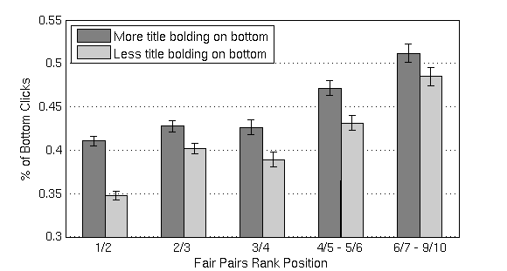
Bias due to title bolding
Click frequency on adjacent results (randomly swapped)
Click data collected from Google web search
Bars should be equal if not biased by bolding
Suggests a method to correct for attractiveness bias
Rank Pair
  [Yue et al. 2010a]

Slide 97
General attractiveness bias
How can we model the probability of a click?
  [Hofmann et al. 2012]

Slide 98
Re-weighting Clicks
Idea: re-weight clicks in interleaving experiments by the documents probability of being clicked, given its caption
From the trained model, we have:
then the click weight
estimates a document’s change in click odds given
  [Hofmann et al. 2012]
Notes:
\alpha = \frac{1}{exp(W_c \cdot X_c)}

Slide 99
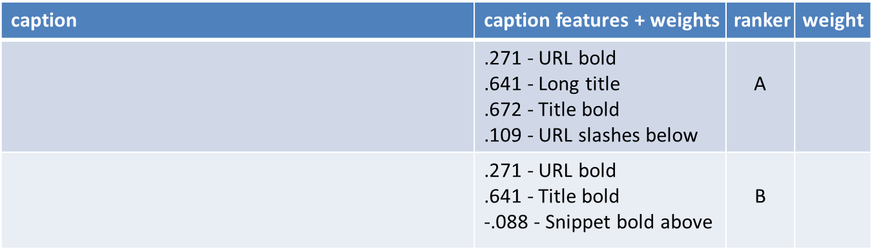


Removing the bias
Weight future clicks by P ( Click | Caption ): More likely clicks given less weight
In real online evaluations experiments, slight change in outcome of interleaving experiments,
  [Hofmann et al. 2012]

Slide 100
Part 2 Summary
Interleaving is an online relative ranking-level evaluation metric.
  Correlates well with other offline and online metrics.
  More sensitive than the other online metrics considered
Considered two interleaving algorithms
  (and when they break)
Considered the implications of assuming that clicks mean relevance

Slide 101
Practical Online Retrieval Evaluation
Part 3
Filip Radlinski (Microsoft)
Katja Hofmann (University of Amsterdam)

Slide 102
Outline
Part 1: Overview of Online Evaluation
Part 2: Relative Ranking Level Evaluation
Part 3: End-to-End, From Design to Analysis
  Setting up a search service
  Getting your own data
  Running online experiments
Part 4: Extensions and Open Problems

Slide 103

















Your System!
Information
Systems

Slide 104
A Recipe
0. Come up with a new retrieval algorithm
Create logging infrastructure
Create reranking infrastructure
Recruit some users
Wait for data
Analyze Results
Write a paper

Slide 105
User behavior we can record
Queries & results
  Context as well: Which computer & when
Clicks on results
  Metadata: What order, dwell time
The same methods can be used to observe
  Query reformulations
  Browsing of result site
With some more work
  Mouse movements, text selection, tabs, etc …

Slide 106
Being the Search Engine
To get real data, we need real users
  Need to implement an IR system that people want to use …
  … without having to break their normal routine
  Then convince some people to actually do it
Benefits
  Real users & data!
Challenges
  Make the system usable (hint: start by using it yourself)
  Effective data collection
  Make it easy to run evaluation experiments
  Important consideration: Privacy & Human Subjects

Slide 107
A spectrum of possible approaches
Web proxy
  Intercept, record & modify results before they get to the client
Browser toolbar
  Intercept and modify the page the browser gets
Search engine on top of a public search API
  Fetch results from a search API, build your own results page
  Or fetch results page like a proxy, but serve it yourself
Your own search engine
  Many tools exist to get you most of the way there
  Direct access to index, generate any rankings
  Usually for a special collection: arXiv.org, CiteSeer, PubMed, …

Slide 108
A spectrum of possible approaches
Method | Easy to get users | Easy on/off? | Easy to observe | Robust | Runs on … | Amount of work | Changes are easy
Proxy | ✓ |  | All web traffic |  | server | ✶ | ✓
Toolbar | ✓ | ✓ | Everything |  | client | 
Search API |  | ✓ | Our queries & clicks | ✓ | server |  | ✓
Write an engine |  | ✓ | Our queries & clicks | ✓ | server |  | ✓
How likely are you to need to actively keep tweaking it?
What happens when you find a bug just after setting up the 20th user?
Do you need to set up a special server?
Can you get some volunteers to spend 5 minutes to be set up, then regularly use it without thinking?
Is this something you can do before lunch?
How easy is it for a user to remember that you’re logging things? Can they just turn it off for a minute?
What data can you (the researcher) easily record?

Slide 109
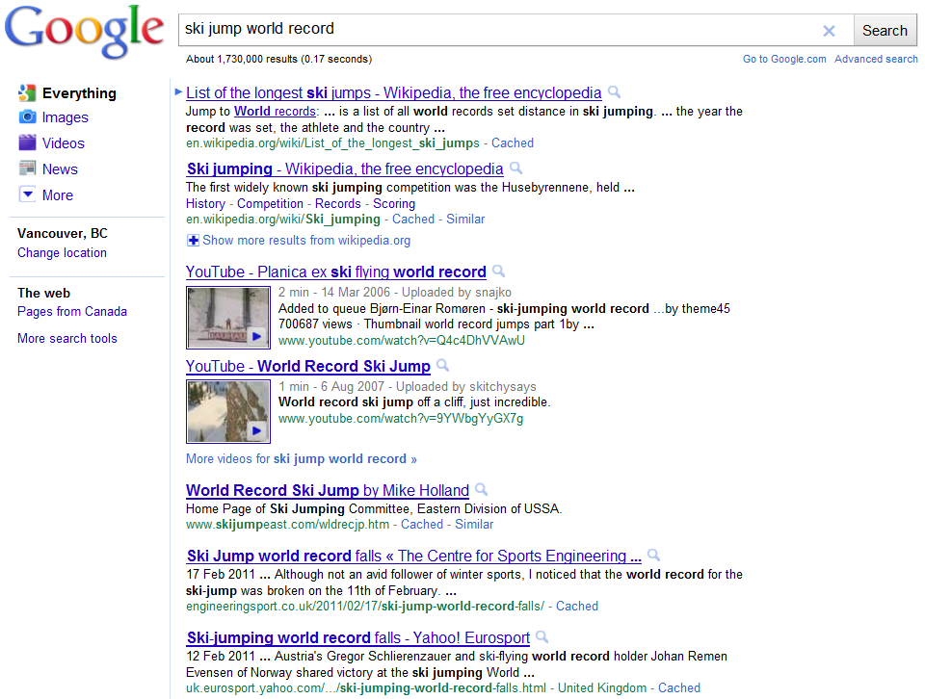
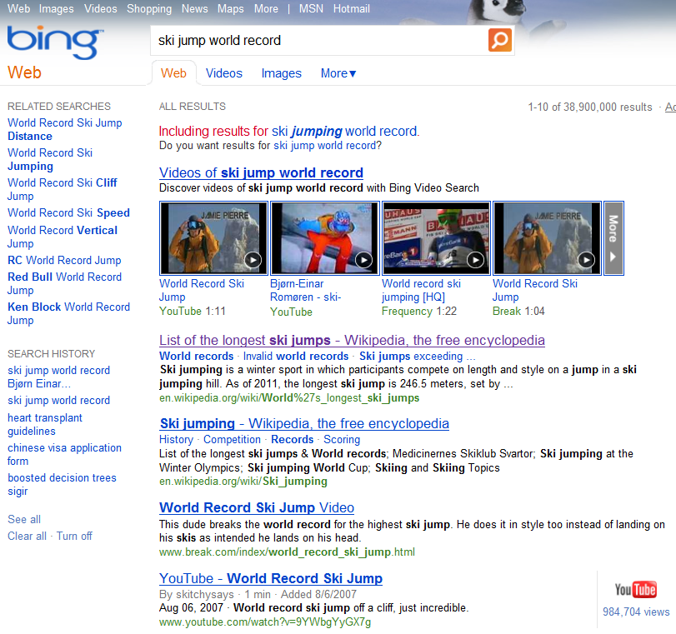
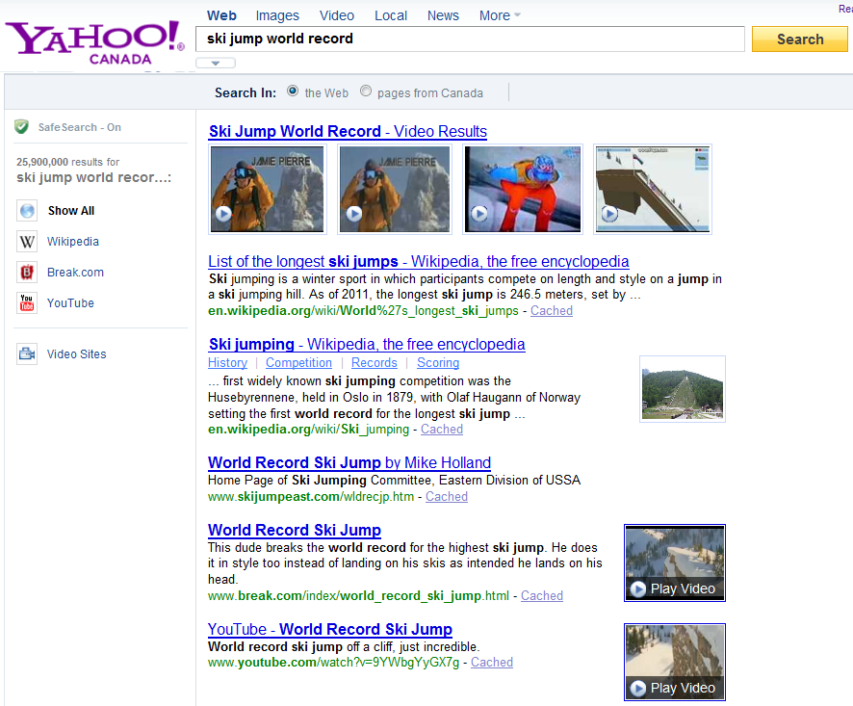
Demo Application
Some easy to use academic research systems

Slide 110
Building a Proxy
Intercepting traffic is easy
  All you need are representative users
  … who don’t mind sharing their traffic with you
Four parts to a proxy:
  Intercepting search engine requests
  Logging queries & results
  Logging clicks on results
  Substituting in your own search engine results

Slide 111
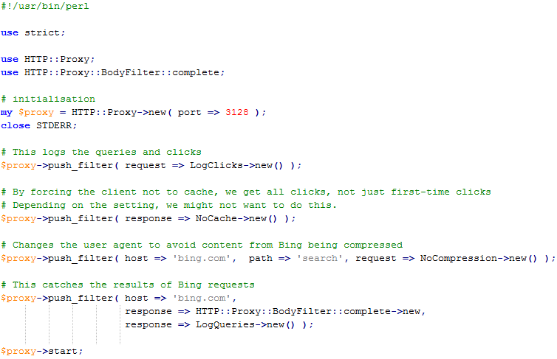
Intercepting search engine requests
Write a proxy, e.g. in Perl. Its REALLY EASY!
Set volunteers’ browsers to use this proxy
Data Logging
& Experimentation

Slide 112
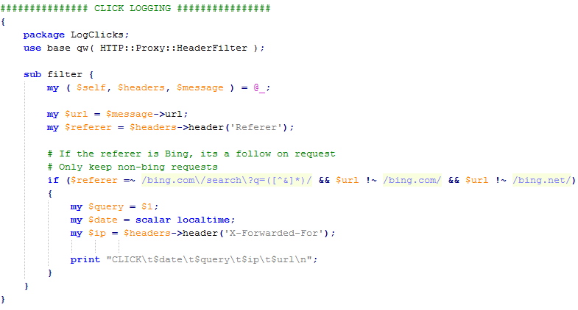
Logging clicks
Get request metadata
we want to log this request
Then log it

Slide 113
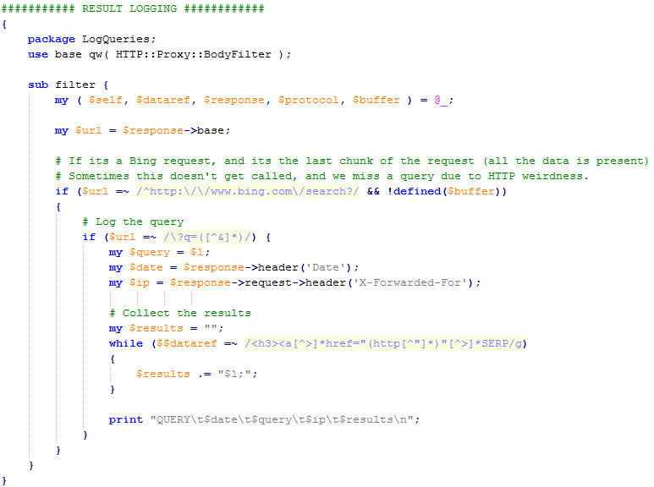
Logging queries & results
we want to log this request
Get the metadata
Parse the results

Slide 114
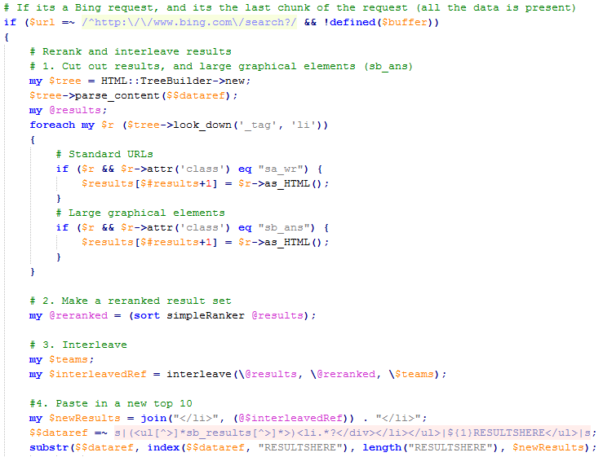
Modifying results
Get the original results
Rerank them
Set up the evaluation
Replace the old results with your new set
Notes:
Mention: Another way to log clicks is to add an “onclick” event to html

Slide 115
Demo!

Slide 116
Other approaches
Browser toolbar
  All modern browsers support custom toolbars
  They are relatively straightforward to write
  Lemur toolkit [lemurproject.org] has open source toolbars to start with. Another starting point is AlterEgo [Matthijs & Radlinski ’10]
  GreaseMonkey is another way to do limited logging & rewriting
Use a search API
  Bing, Google, Yahoo! all offer search APIs
  Many non-web-search engines (twitter, Facebook, etc) also offer APIs
  You can treat a regular search page as an API of sorts, parsing the results
  ViewSer [Lagun & Agichtein ‘11] is one example of a fetch-and-serve implementation (also shows an example of how to do mouse position tracking)
Build your own search engine
  Easy to use libraries: Lucene (java), Lucene.Net (C#)
  Easy to run-on engines: Indri, Lucene, Terrier, Zettair, and many more
Notes:
http://www.slideshare.net/7mary4/open-source-search-tools-for-www2010-conferencesourcesearchtoolswww20100426dapplications-of-open-search-tools-www2010-tutorial

Slide 117
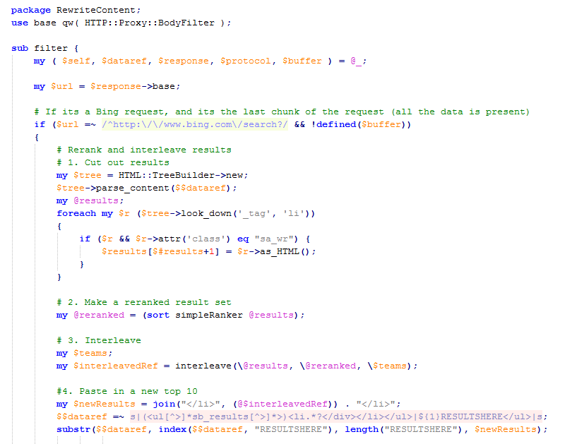
Designing interleaving experiment
Get the original results
Rerank them
Replace the old results with your new set

Slide 118
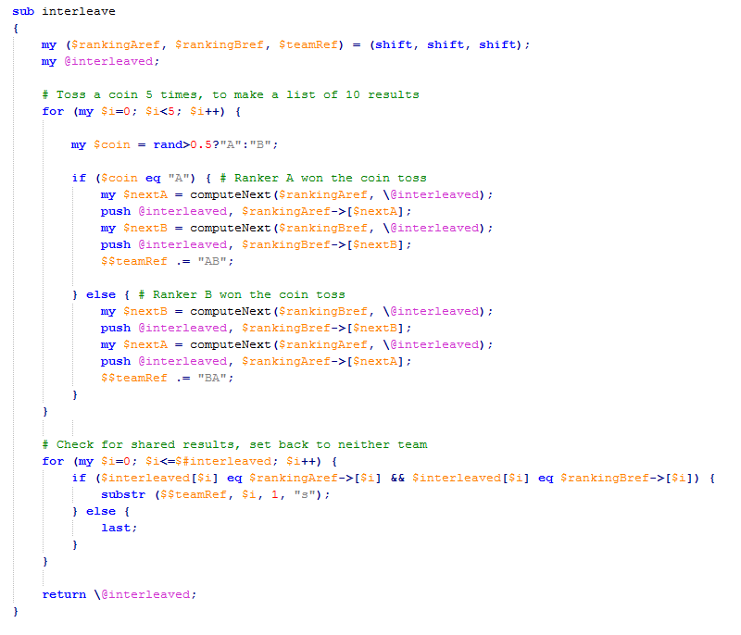
Repeat until 10
results chosen
Randomly choose which Ranker picks next
Case 1: Ranker A chooses, then Ranker B chooses
Case 2: Ranker B chooses, then Ranker A chooses
Check for shared results

Slide 119
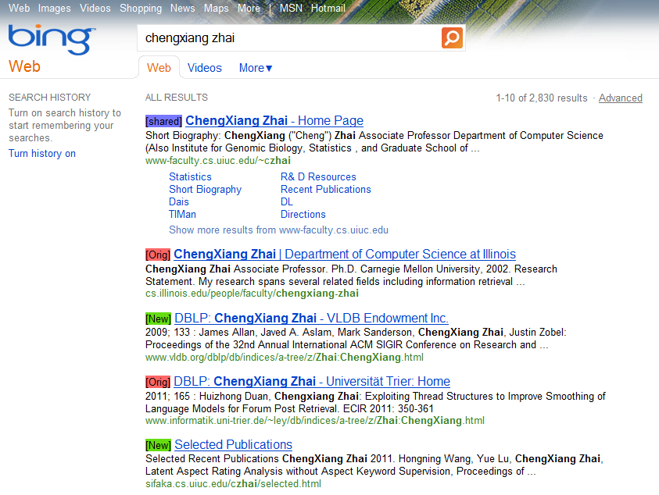
Demo!

Slide 120
So far in our recipe
0. Come up with a reranking system
Create logging infrastructure
Create reranking infrastructure
Recruit some users
Wait for data
Analyze Results

Slide 121
Recruiting Users
Questions to ask when recruiting
  Are you using the system yourself?
    If not, why not?
  Will your users find the system usable?
    A little worse than the default is ok
    A little slower than the default is ok
    A little less reliable than the default is ok
    … but never by too much
  Are you collecting private data?
    Do you really need to?
    What will you do with it?
  Is your user base representative?

Slide 122
What to ask of your users
Recall the three study setup alternatives
  Controlled task lab study
  Controlled task, uncontrolled environment
  General uncontrolled retrieval tasks
The right setup depends on the research question
  Will users naturally enter a sufficient number of queries that you want to improve?
    For example, for long question queries
  Do you need additional metadata about users?
    For example, for personalization
  Is there a natural place this system should be deployed?
    For example, on a computer in your building lobby?

Slide 123
Analyzing the Results
We have collected data of the form:
  <query> <results> <metadata>
  and <clicks> <associated query>
We want to group those into
<query> <metadata> <clicks>
And evaluate how often each retrieval function wins
<query 1> <which ranking won>
<query 2> <which ranking won>
…
Finally, we can see if the retrieval functions are different, statistically significantly.

Slide 124

Significance Testing
The simplest test: Sign Test
Suppose:
  The baseline won interleaving on 120 queries
  Your ranking won interleaving on 140 queries
  Is your ranking significantly better? [here: no]
Statistical tests:
  Run a sign test in your favorite software
  Use a Binomial confidence interval
$$p=\hat{p}±z_{α}\sqrt{\frac{\hat{p}(1−\hat{p})}{n}}$$

Slide 125
Significance Testing
We can also test the power (or consistency) of the evaluation methodology
  (Bootstrap Sampling)
Given set of logged queries Q = {q₁,…,q_{n}}
  Sample k queries Q’ from Q with replacement
    k ≤ n
    A “bag”
  Compute whether r₁ wins in Q’
  Repeat m times
Power (consistency) is fraction of bags that agree
[Efron & Tibshirani 1993]

Slide 126
Significance Testing
Example: log 4 queries Q = { }
q₁
q₂
q₃
q₄
[Efron & Tibshirani 1993]

Slide 127
Significance Testing
Example: log 4 queries Q = { }
Generate m bootstrap samples
  Sample w/ replacement
  Record who wins each sample
q₁
q₂
q₃
q₄
q₁
q₁
q₃
q₄
q₄
q₁
q₄
q₂
q₃
q₁
q₃
q₃
…
q₂
q₄
q₃
q₂
[Efron & Tibshirani 1993]

Slide 128
Significance Testing
Example: log 4 queries Q = { }
Generate m bootstrap samples
  Sample w/ replacement
  Record who wins each sample
E.g., r₁ wins in 74% of samples
  Suppose we know r₁ > r₂
  We’d make the wrong conclusion 26% of the time
  More queries = higher confidence (more consistent)
q₁
q₂
q₃
q₄
q₁
q₁
q₃
q₄
q₄
q₁
q₄
q₂
q₃
q₁
q₃
q₃
…
q₂
q₄
q₃
q₂
[Efron & Tibshirani 1993]

Slide 129
Significance Testing
Many other statistical tests exist
  Assumes a dataset sample from a population
    Query logs with clicks
  Tests on a measured quantity
    Each query has signed score indicating preference
    Is the aggregate score noticeably different from 0?
  More sensitive binomial tests
  t-Test
  Also see [Smucker et al., 2009] for another comparison of various statistical tests

Slide 130
Evaluation Demo

Slide 131
Summary of Part 3
Provided a recipe for evaluation
  Blind test, minimally disruptive of natural usage context
  A number of implementation alternatives reviewed
  Proxy implementation presented
  Demonstration of logging, interleaving, and analysis
Interleaving reference implementation
  Combining document rankings
  Credit assignment
Overview of significance testing

Slide 132
Practical Online Retrieval Evaluation
Part 4
Filip Radlinski (Microsoft)
Katja Hofmann (University of Amsterdam)

Slide 133
Outline
Part 1: Overview of Online Evaluation
Part 2: Relative Ranking Level Evaluation
Part 3: End-to-End, From Design to Analysis
Part 4: Extensions and Open Problems
  Interleaving algorithm alternatives
  Are all clicks equal ➔ Increasing sensitivity of all metrics
  Other ways we can use interleaving data

Slide 134
Reminder: Biases in Interleaving
Both algorithms so far can be broken
  There were contrived edge cases
These cases seem to have no/low impact across many real experiments…
  The algorithms here are probably not necessary for “practical” evaluations
  But can we avoid the breaking cases completely?

Slide 135
Avoiding Biases:
Probabilistic Interleaving
An alternative interleaving algorithm
Similar to Team Draft, but
  Toss a coin every pick
  Don’t always pick the top result
  Assign credit based on all possible assignments

Slide 136
Probabilistic Interleaving (1)
Ranking A
Napa Valley – The authority for lodging...
www.napavalley.com
Napa Valley Wineries - Plan your wine...
www.napavalley.com/wineries
Napa Valley College
www.napavalley.edu/homex.asp
4. Been There | Tips | Napa Valley
www.ivebeenthere.co.uk/tips/16681
5. Napa Valley Wineries and Wine
www.napavintners.com
6. Napa Country, California – Wikipedia
en.wikipedia.org/wiki/Napa_Valley
Ranking B
1. Napa Country, California – Wikipedia
en.wikipedia.org/wiki/Napa_Valley
2. Napa Valley – The authority for lodging...
www.napavalley.com
3. Napa: The Story of an American Eden...
books.google.co.uk/books?isbn=...
4. Napa Valley Hotels – Bed and Breakfast...
www.napalinks.com
5. NapaValley.org
www.napavalley.org
6. The Napa Valley Marathon
www.napavalleymarathon.org
Presented Ranking
Napa Valley – The authority for lodging...
www.napavalley.com
2. Napa Valley Wineries – Plan your wine...
www.napavalley.com/wineries
3. Napa Country, California – Wikipedia
en.wikipedia.org/wiki/Napa_Valley
4. Napa: The Story of an American Eden...
books.google.co.uk/books?isbn=...
5. Napa Valley Hotels – Bed and Breakfast...
www.napalinks.com
Napa Valley College
www.napavalley.edu/homex.asp
7 NapaValley.org
www.napavalley.org
A
B
  [Hofmann et al. 2011]

Slide 137
Probabilistic Interleaving (2)
Ranking A
Napa Valley – The authority for lodging...
www.napavalley.com
Napa Valley Wineries - Plan your wine...
www.napavalley.com/wineries
Napa Valley College
www.napavalley.edu/homex.asp
4. Been There | Tips | Napa Valley
www.ivebeenthere.co.uk/tips/16681
5. Napa Valley Wineries and Wine
www.napavintners.com
6. Napa Country, California – Wikipedia
en.wikipedia.org/wiki/Napa_Valley
Ranking B
1. Napa Country, California – Wikipedia
en.wikipedia.org/wiki/Napa_Valley
2. Napa Valley – The authority for lodging...
www.napavalley.com
3. Napa: The Story of an American Eden...
books.google.co.uk/books?isbn=...
4. Napa Valley Hotels – Bed and Breakfast...
www.napalinks.com
5. NapaValley.org
www.napavalley.org
6. The Napa Valley Marathon
www.napavalleymarathon.org
Presented Ranking
Napa Valley – The authority for lodging...
www.napavalley.com
Been There | Tips | Napa Valley
www.ivebeenthere.co.uk
3. Napa: The Story of an American Eden...
books.google.co.uk/books?isbn=...
4. Napa Country, California – Wikipedia
en.wikipedia.org/wiki/Napa_Valley
5. Napa Valley Hotels – Bed and Breakfast...
www.napalinks.com
Napa Valley College
www.napavalley.edu/homex.asp
7 NapaValley.org
www.napavalley.org
  [Hofmann et al. 2011]

Slide 138
Probabilistic Interleaving (2)
d₁
d₂
d₃
d₄
d₂
P(d|l₁)
P(d|l₂)
d₁
d₃
d₄
d₁
d₂
d₃
d₄
d₁
d₂
d₃
d₄
d₄
d₂
d₁
d₃
Define probability distributions over documents, based on the lists to be compared
During interleaving draw documents randomly
Any permutation of documents is possible
  [Hofmann et al. 2011]

Slide 139
Probabilistic Interleaving (3)
d₁
d₁
d₁
d₁
d₁
d₂
d₂
d₂
d₂
d₂
d₃
d₃
d₃
d₃
d₃
d₄
d₄
d₄
d₄
d₄
Observe interleaved list
+ clicks
Compute probabilities for
outcome for all possible input sequences
d₁
d₁
d₁
d₁
d₂
d₂
d₂
d₂
d₃
d₃
d₃
d₃
d₄
d₄
d₄
d₄
d₁
d₁
d₁
d₁
d₂
d₂
d₂
d₂
d₃
d₃
d₃
d₃
d₄
d₄
d₄
d₄
d₁
d₁
d₁
d₁
d₂
d₂
d₂
d₂
d₃
d₃
d₃
d₃
d₄
d₄
d₄
d₄

Slide 140
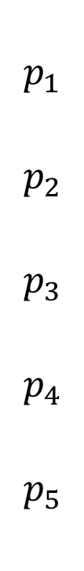
Avoiding Biases:
Optimized Interleaving
Solve for these based on desired scoring properties
Another alternative interleaving algorithm
Not a “constructive” approach
$$p_{1}$$
$$p_{2}$$
$$p_{3}$$
$$p_{4}$$
$$p_{5}$$
1
2
3
1
2
3
Ranker A
1
2
3
Team Draft
50%
50%
1
2
3
Ranker B
1
2
3
1
2
3
1
2
3
  [Radlinski & Craswell, 2013]

Slide 141
Click Weight Beyond Presentation Bias
Clicks need not be weighted equally in Interleaving evaluation
Take this Team Draft interleaving:
(this click was very likely)
(yet the user clicked again)
Is this a tie, or should Ranking B actually win here?
  Rather than making something up, lets look at some data
A
Click
B
A
B
Click

Slide 142
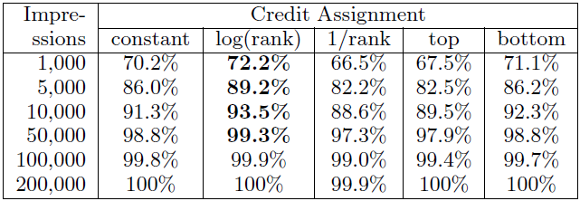
Click Weighting
A simple test:
  Suppose you saw many queries
  How often does a small subsample agree on the experiment outcome?
A
Click
B
A
Amount of data
Get the “right” outcome sooner
B
Click
Not just for interleaving!
  [Radlinski & Craswell, 2010]

Slide 143
Learning a Better Click Weighting
Represent each click as a feature vector
The score of a click is
  How do we learn the optimal ?
  [Yue et al. 2010b; Chapelle et al. 2012]

Slide 144
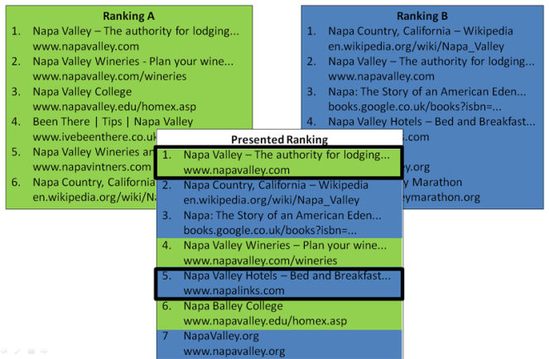
Learning a Better Click Weighting
differentiates last clicks and other clicks
  [Yue et al. 2010b; Chapelle et al. 2012]

Slide 145
Learning a Better Click Weighting
differentiates last clicks and other clicks
Suppose we interleave A vs B
Lets suppose that:
  On average there are 3 clicks per session
  The last click is on A 60% of the time
  The other 2 clicks split 50/50 random
  [Yue et al. 2010b; Chapelle et al. 2012]

Slide 146
Learning a Better Click Weighting
differentiates last clicks and other clicks
Suppose we interleave A vs B
Lets suppose that:
  On average there are 3 clicks per session
  The last click is on A 60% of the time
  The other 2 clicks split 50/50 random
Normal weighting corresponds to w = [1 1]
A weighting vector w = [1 0] has much lower variance
  [Yue et al. 2010b; Chapelle et al. 2012]

Slide 147
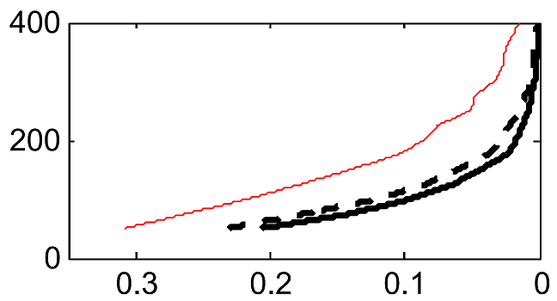
Experimental Test
Uniform click weighting
Data Required
Learning approaches
Target p-value
Click data collected from ArXiv.org with two known rankers
Solve for optimal weight vector: Maximize the sensitivity, i.e. the ratio of the metric mean to the variance
On average ~50% less data is required to reach statistical significance
However, the calibration results from Part 2 no longer hold
  [Yue et al. 2010b; Chapelle et al. 2012]

Slide 148
Explicit Credit Assignment
All the techniques we’ve presented:
  Documents are assigned to one ranker (perhaps probabilistically)
  When clicked, they give 1, or P(click), credit
  The ranker with more credit wins
What if I want to be explicit about the importance of a click? E.g.
  If a document moves further between rankers, it gives more credit.
  If a click is higher, it has bigger experimental effect
  [Radlinski & Craswell 2013]

Slide 149
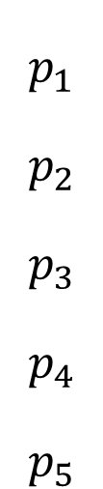
Explicit Credit Assignment
$$p_{1}$$
$$p_{2}$$
$$p_{3}$$
$$p_{4}$$
$$p_{5}$$
1
2
3
Ranker A
1
2
3
1
2
3
1
2
3
Ranker B
1
2
3
1
2
3
1
2
3
Suppose clicks on get more credit that clicks on
Then we need to show first more often than we show first.
Given a user model, this can be written as an optimization problem.
1
1
1
1
  [Radlinski & Craswell, 2013]

Slide 150
Other Online Data
Browsing data
  “The documents users browse to after issuing a query are relevant documents for that query.”
  Teevan et al. 2005; Liu et al. 2008; Bilenko & White 2008
Mouse movements
  “The search results that users mouse over often are relevant documents for that query”
  Guo et al. 2006a; 2006b; Huang et al. 2011

Slide 151
Tutorial Summary
Provided an overview of online evaluation
  Online metrics: What works when (if you’re an academic)
  Interpreting user actions at the Document or Ranking level
  Experiment Design: Opportunities, biases and challenges
Showed how to get started obtaining your own online data
  How to realistically “be the search engine”
  End-to-End: Design, Implementation, Recruitment and Analysis
  Overview of alternative approaches
Presented interleaving for retrieval evaluation
  Described one particular online evaluation approach in depth
  How it works, why it works and what to watch out for
  Provide a reference implementation
  Describe a number of open challenges

Slide 152
Questions?

Slide 153
Bibliography
1 Interleaving Algorithms & Evaluation
  1.1 Producing interleaved rankings
    HOFMANN, K., WHITESON, S., DE RIJKE, M., Fidelity, Soundness, and Efficiency of Interleaved Comparison Methods. ACM Transactions on Information Systems (TOIS) (to appear).
    JOACHIMS, T. 2002. Optimizing Search Engines Using Clickthrough Data. In Proceedings of the ACM International Conference on Knowledge Discovery and Data Mining (KDD).pp 132–142.
    JOACHIMS, T. 2003. Evaluating Retrieval Performance using Clickthrough Data. In Text Mining, J. Franke, G. Nakhaeizadeh, and I. Renz, Eds. Physica/Springer Verlag, 7996.
    RADLINSKI, F., KURUP, M., AND JOACHIMS, T. 2008. How Does Clickthrough Data Reflect Retrieval Quality. In Proceedings of the ACM Conference on Information and Knowledge Management (CIKM).
    RADLINSKI, F., KURUP, M., AND JOACHIMS, T. 2010. Evaluating search engine relevance with click-based metrics. In Preference Learning, J. Fürnkranz and E. Hüllermeier, Eds. Springer, pp 337–362.
    CHAPELLE, O., JOACHIMS, T., RADLINSKI, F., YUE, Y. 2012. Large Scale Validation and Analysis of Interleaved Search Evaluation. ACM Transactions on Information Systems (TOIS) Vol. 30 (1). Article 6.
  1.2 Alternative scoring approaches & Statistical tests
    EFRON, B., TIBSHIRANI, R. 1993. An Introduction to the Bootstrap. Chapman & Hall, CRC Monographs on Statistics & Applied Probability.
    HOFMANN, K., BEHR, F., RADLINSKI, F. 2012. On Caption Bias in Interleaving Experiments. ACM Conference on Information and Knowledge Management, pp. 115—124 (CIKM).
    RADLINSKI, F. AND CRASWELL, N. 2010. Comparing the sensitivity of information retrieval metrics. In Proceedings of the ACM International Conference on Research and Development in Information Retrieval (SIGIR).pp 667–674.
    SMUCKER, M. AND ALLAN, J. AND CARTERETTE, B. 2009. Agreement Among Statistical Significance Tests for Information Retrieval Evaluation at Varying Sample Sizes. In Proceedings of the ACM International Conference on Research and Development in Information Retrieval (SIGIR).
    YUE, Y. AND GAO, Y. AND CHAPELLE, O., ZHANG, Y., AND JOACHIMS, T. 2010. Click-Based Retrieval Evaluation. In Proceedings of the ACM International Conference on Research and Development in Information Retrieval (SIGIR).

Slide 154
  1.3 Examples of other work that uses interleaving to evaluate rankings
    RADLINSKI, F. AND JOACHIMS, T. 2005. Query chains: Learning to rank from implicit feedback. In Proceedings of the ACM International Conference on Knowledge Discovery and Data Mining (KDD).
    MATTHIJS, N. AND RADLINSKI, F. 2011. Personalizing Web Search using Long Term Browsing History. In Proceedings of the ACM International Conference on Web Search and Data Mining (WSDM).
    HE, J. AND ZHAI, C. AND LI, X. 2009. Evaluation of methods for relative comparison of retrieval systems based on clickthroughs. In Proceedings of the ACM Conference on Information and Knowledge Management (CIKM).
    HOFMANN, K. AND WHITESON, S. AND DE RIJKE, M. 2011. A Probabilistic Method for Inferring Preferences from Clicks. In Proceedings of the ACM Conference on Information and Knowledge Management (CIKM).
2 Clicks in General
  2.1 Click based evaluation
    AGICHTEIN, E., BRILL, E., DUMAIS, S., AND RAGNO, R. 2006. Learning user inter- action models for prediction web search results preferences. In Proceedings of the ACM International Conference on Research and Development in Information Retrieval (SIGIR).
    BENNETT, P., RADLINSKI, F., WHITE, R., YILMAZ, E. 2011. Inferring and Using Location Metadata to Personalize Web Search. In Proceedings of the ACM International Conference on Research and Development in Information Retrieval (SIGIR).
    CARTERETTE, B. AND JONES, R. 2007. Evaluating search engines by modeling the relationship between relevance and clicks. In Proceedings of the International Conference on Advances in Neural Information Processing Systems (NIPS).
    CHAPELLE, O., ZHANG, Y., METZLER, D., AND GRINSPAN, P. 2009. Expected Reciprocal Rank for Graded Relevance. In Proceedings of the ACM Conference on Information and Knowledge Management (CIKM).
    CHAPELLE, O. AND ZHANG, Y. 2009. A dynamic bayesian network click model for web search ranking. In Proceedings of the International Conference on the World Wide Web (WWW).pp 1–10.
    CRASWELL, N., ZOETER, O., TAYLOR, M., AND RAMSEY, B. 2008. An experimental comparison of click position-bias models. In Proceedings of the ACM International Conference on Web Search and Data Mining (WSDM).

Slide 155
    DUPRET, G., AND LIAO, C., 2010. A model to estimate intrinsic document relevance from the clickthrough logs of a web search engine. In Proceedings of the ACM International Conference on Web Search and Data Mining (WSDM).
    DUPRET, G., AND PIWOWARSKI, B. 2008. A User Browsing Model to Predict Search Engine Click Data from Past Observations. In Proceedings of the ACM International Conference on Research and Development in Information Retrieval (SIGIR).
    JOACHIMS, T., GRANKA, L., PAN, B., HEMBROOKE, H., RADLINSKI, F., AND GAY, G. 2007. Evaluating the accuracy of implicit feedback from clicks and query reformulations in web search. ACM Transactions on Information Science (TOIS) 25 (2). Article 7.
    JOACHIMS, T., GRANKA, L., PAN, B., HEMBROOKE, H., GAY, G. 2005. Accurately Interpreting Clickthrough Data as Implicit Feedback. In Proceedings of the ACM International Conference on Research and Development in Information Retrieval (SIGIR).
    RADLINSKI, F., BENNETT, P., AND YILMAZ, E. 2011. Detecting Duplicate Web Documents using Clickthrough Data. In Proceedings of the ACM International Conference on Web Search and Data Mining (WSDM).
    RADLINSKI, F., JOACHIMS, T. 2007. Active Exploration for Learning Rankings from Clickthrough Data. In Proceedings of the ACM International Conference on Knowledge Discovery and Data Mining (KDD).
    THOMAS, P., HAWKING, D. 2008. Experiences evaluating personal metasearch. In Proceedings of the Information Interaction in Context Conference (IIiX).
    WANG, K., WALKER, T., AND ZHENG, Z. 2009. PSkip: estimating relevance ranking quality from web search clickthrough data. In Proceedings of the ACM International Conference on Knowledge Discovery and Data Mining (KDD).pp 1355–1364.
    YUE, Y., PATEL, R., AND ROEHRIG, H. 2010a. Beyond Position Bias: Examining Result Attractiveness as a Source of Presentation Bias in Clickthrough Data. In Proceedings of the International Conference on the World Wide Web (WWW).
    ZHANG, W., JONES, R. 2007. Comparing Click Logs and Editorial Labels for Training Query Rewriting. In Proceedings of the International Conference on the World Wide Web (WWW).
    ZHONG, F., WANG, D., WANG, G., WEIZHU, C., ZHANG, Y., CHEN, Z., WANG, H. 2010. Incorporating Post-Click Behaviors into a Click Model. In Proceedings of the ACM International Conference on Research and Development in Information Retrieval (SIGIR).
    ZHU, Z, CHEN, W., MINKA, T., ZHU, C., AND CHEN, Z. 2010. A novel click model and its applications to online advertising. ACM international conference on Web search and data mining (WSDM '10).

Slide 156
  2.2 Limitations of clicks
    YUE, Y., PATEL, R., AND ROEHRIG, H. 2010a. Beyond Position Bias: Examining Result Attractiveness as a Source of Presentation Bias in Clickthrough Data. In Proceedings of the International Conference on the World Wide Web (WWW).
    LI, J., HUFFMAN, S., TOKUDA, A. 2009. Good Abandonment in Mobile and PC Internet Search. In Proceedings of the ACM International Conference on Research and Development in Information Retrieval (SIGIR).
  2.3 Clicks as features
    AGICHTEIN, E., BRILL, E., DUMAIS, S., AND RAGNO, R. 2006a. Learning user interaction models for prediction web search results preferences. In Proceedings of the ACM International Conference on Research and Development in Information Retrieval (SIGIR).
    AGICHTEIN, E., BRILL, E., AND DUMAIS, S. 2006b. Improving Web Search Ranking by Incorporating User Behavior Information. In Proceedings of the ACM International Conference on Research and Development in Information Retrieval (SIGIR).
    CHAPELLE, O. AND ZHANG, Y. 2009. A dynamic bayesian network click model for web search ranking. In Proceedings of the International Conference on the World Wide Web (WWW).pp 1–10.
    GAO, J., YUAN, W., LI, X., DENG, K., AND NIE, J. 2009. Smoothing clickthrough data for web search ranking. In Proceedings of the ACM International Conference on Research and Development in Information Retrieval (SIGIR).
    JI, S., ZHOU, K., LIAO, C., ZHENG, Z., XUE, G., CHAPELLE, O., SUN, G., AND ZHA, H. 2009. Global Ranking by Exploiting User Clicks. In Proceedings of the ACM International Conference on Research and Development in Information Retrieval (SIGIR).
    TEEVAN, J., DUMAIS, S., LIEBLING, D. 2008. To Personalize or Not to Personalize: Modeling Queries with Variation in User Intent. In Proceedings of the ACM International Conference on Research and Development in Information Retrieval (SIGIR).
    WANG, K., WALKER, T., AND ZHENG, Z. 2009. PSkip: estimating relevance rank- ing quality from web search clickthrough data. In Proceedings of the ACM International Conference on Knowledge Discovery and Data Mining (KDD).pp 1355–1364.

Slide 157
  2.4 Learning from Clicks
    AGRAWAL, R., HALVERSON, A., KENTHAPADI, K., MISHRA, N., AND TSAPARAS, P. 2009. Generating labels from clicks. In Proceedings of the ACM International Conference on Web Search and Data Mining (WSDM).pp 172–181.
    BOYAN, J., FREITAG, D., AND JOACHIMS, T. 1996. A Machine Learning Architecture for Optimizing Web Search Engines. Proceedings of the AAAI Workshop on Internet Based Information Systems.
    EL-ARINI, K., VEDA, G., SHAHAF, D., GUESTRIN, C. 2009. Turning down the noise in the blogosphere. In Proceedings of the ACM International Conference on Knowledge Discovery and Data Mining (KDD).
    FEIGE, U., RAGHAVAN, P., PELEG, D., UPFAL. E. 1994. Computing with Noisy Information. SIAM Journal on Computing 23(5):1001-1018.
    HOFMANN, K., SCHUTH, A., WHITESON, S., DE RIJKE, M. 2013. Reusing Historical Interaction Data for Faster Online Learning to Rank for IR. International Conference on Web Search and Data Mining (WSDM).
    JOACHIMS, T. 2002. Optimizing Search Engines Using Clickthrough Data. In Proceedings of the ACM International Conference on Knowledge Discovery and Data Mining (KDD).pp 132–142.
    LI, L., CHU, W., LANGFORD, J., SCHAPIRE, R. 2010. A contextual-bandit approach to personalized news article recommendation. In Proceedings of the International Conference on the World Wide Web (WWW).
    RADLINSKI, F. AND JOACHIMS, T. 2005. Query chains: Learning to rank from implicit feedback. In Proceedings of the ACM International Conference on Knowledge Discovery and Data Mining (KDD).
    RADLINSKI, F., JOACHIMS, J. 2007. Active Exploration for Learning Rankings from Clickthrough Data. In Proceedings of the ACM International Conference on Knowledge Discovery and Data Mining (KDD).
    RADLINSKI, F., KLEINBERG, R., AND JOACHIMS, T. 2008. Learning Diverse Rankings with Multi-Armed Bandits. In Proceedings of the International Conference on Machine Learning (ICML).
    SLIVKINS, A., RADLINSKI, F., GOLLAPUDI, S. 2010. Learning optimally diverse rankings over large document collections. In Proceedings of the International Conference on Machine Learning (ICML).
    YUE, Y., JOACHIMS, T. 2009. Interactively Optimizing Information Retrieval Systems as a Dueling Bandits Problem. In Proceedings of the International Conference on Machine Learning (ICML).
    YUE, Y., BRODER, J., KLEINBERG, R., JOACHIMS, T.. 2009. The K-Armed Dueling Bandits Problem. In Proceedings of the International Conference on Learning Theory (COLT).
    YUE, Y., JOACHIMS, T. 2011. Beat the Mean Bandit. In Proceedings of the International Conference on Machine Learning (ICML).

Slide 158
3 Online Usage Data Beyond Search Clicks
  3.1 Non-click based metrics
    BUSCHER, G., DENGEL, A., AND VAN ELST, L. 2008. Eye movements as implicit relevance feedback. In Proceedings of the ACM Conference on Human Factors in Computing Systems (CHI).pp 2991–2996.
    DUPRET, G. AND LALMAS, M. 2013. Absence time and user engagement: evaluating ranking functions. In Proceedings of the sixth ACM international conference on Web search and data mining, pp. 173—182 (WSDM '13).
    GRANKA, L., JOACHIMS, T. AND GAY, G. 2004. Eye-Tracking Analysis of User Behavior in WWW-Search, Poster Abstract, In Proceedings of the ACM International Conference on Research and Development in Information Retrieval (SIGIR).
    GUO, Q., AGICHTEIN, E., 2010. Ready to Buy or Just Browsing? Detecting Web Searcher Goals from Interaction Data. In Proceedings of the ACM International Conference on Research and Development in Information Retrieval (SIGIR).
    GUO, Q., AGICHTEIN, E., 2010. Towards Predicting Web Searcher Gaze Position from Mouse Movements. In Proceedings of the ACM Conference on Human Factors in Computing Systems (CHI).
    HUANG, J., WHITE, R., DUMAIS, S. 2011. No Clicks, No Problem: Using Cursor Movements to Understand and Improve Search. In Proceedings of the ACM Conference on Human Factors in Computing Systems (CHI).
    KELLY, D. AND TEEVAN, J. 2003. Implicit feedback for inferring user preference: A bibliography. ACM SIGIR Forum 37, 2, pp 18–28.
    KELLY, D. 2009. Methods for evaluating interactive information retrieval systems with users. Foundations and Trends in Information Retrieval, 3(1-2), 1-224.
    KELLY, D. AND SUGIMOTO, C. 2013. A systematic review of interactive information retrieval evaluation studies, 1967–2006. Journal of the American Society for Information Science and Technology, Vol. 64 (4), pp. 745–770 (JASIS&T).

Slide 159
  3.2 Clicks outside of search
    BILENKO, M., WHITE, R., RICHARDSON, M., AND Murray, C. 2008. Talking the talk vs. walking the walk: salience of information needs in querying vs. browsing. In Proceedings of the ACM International Conference on Research and Development in Information Retrieval (SIGIR).
    BILENKO, M., WHITE, R. 2008. Mining the Search Trails of Surfing Crowds: Identifying Relevant Websites From User Activity. In Proceedings of the ACM International Conference on Research and Development in Information Retrieval (SIGIR).
    LIU, Y., GAO, B., LIU, T., ZHANG, Y., Ma, Z., HE, S., AND LI, H. 2008. BrowseRank: letting web users vote for page importance. In Proceedings of the ACM International Conference on Research and Development in Information Retrieval (SIGIR).
    MATTHIJS, N. AND RADLINSKI, F. 2011. Personalizing Web Search using Long Term Browsing History. In Proceedings of the ACM International Conference on Web Search and Data Mining (WSDM).
    TEEVAN, J., DUMAIS, S., HORVITZ, E., 1995. Personalizing Search via Automated Analysis of Interests and Activities. In Proceedings of the ACM International Conference on Research and Development in Information Retrieval (SIGIR).

Slide 160
4 Learning from Pairwise Feedback
    BURGES, C., SHAKED, T., RENSHAW, E., LAZIER, A., DEEDS, M., HAMILTON, N., HULLENDER, G. 2005. Learning to Rank using Gradient Descent. In Proceedings of the International Conference on Machine Learning (ICML).
    FREUND, Y., IYER, R., SCHAPIRE, R., SINGER, Y. 2003. An Efficient Boosting Algorithm for Combining Preferences. Journal of Machine Learning Research (JMLR), Vol 4, pp 933–969
    HOFMANN, K. AND WHITESON, S. AND DE RIJKE, M. 2011. Balancing Exploration and Exploitation in Learning to Rank Online. In Proceedings of the European Conference on Information Retrieval (ECIR).
    JOACHIMS, T. 2005. A Support Vector Method for Multivariate Performance Measures. In Proceedings of the International Conference on Machine Learning (ICML).
    RADLINSKI, F., JOACHIMS, J. 2007. Active Exploration for Learning Rankings from Clickthrough Data. In Proceedings of the ACM International Conference on Knowledge
    Discovery and Data Mining (KDD).
5 Efficient Offline Evaluation
    CARTERETTE, B., ALLAN, J., SITARAMA, R. 2006. Minimal Test Collections for Retrieval Evaluation. In Proceedings of the ACM International Conference on Research and Development in Information Retrieval (SIGIR)
    CARTERETTE, B., BENNETT, P. N., CHICKERING, D. M., AND DUMAIS, S. T. 2008. Here or there: Preference judgments for relevance. In Proceedings of the European Conference on Information Retrieval (ECIR).
    CARTERETTE, B., SMUCKER, M. 2007. Hypothesis Testing with Incomplete Relevance Judgments. In Proceedings of the ACM Conference on Information and Knowledge Management (CIKM).

