Slide 1

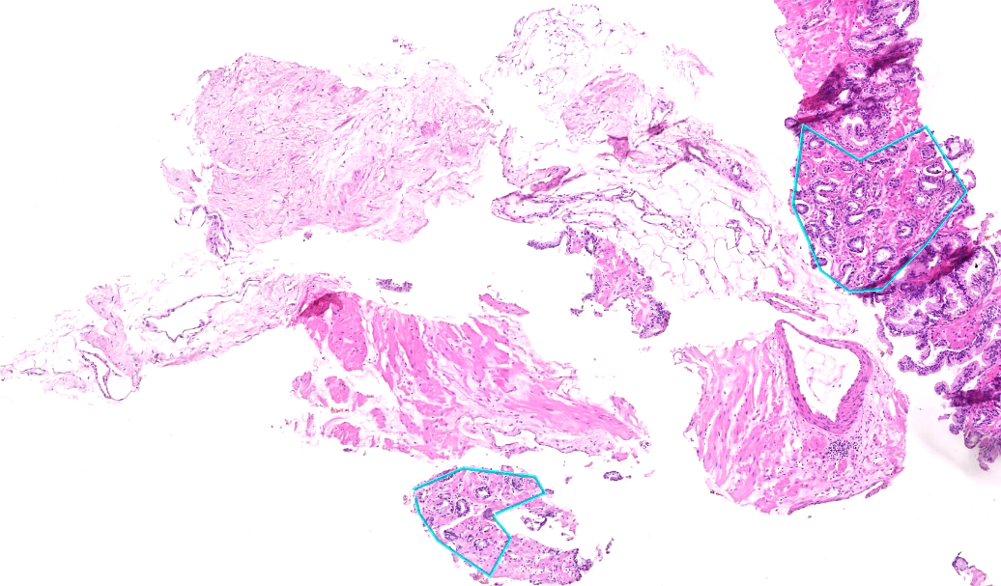


Artificial Intelligence in Digital Pathology from a Computer Scientist’s Perspective
Tomáš Brázdil

Slide 2
Who We Are
RationAI
a research group at Masaryk University (in Brno)
8 senior members, approx. 20 students
Research in AI in digital pathology, especially explainable methods and clinically relevant problems
Collaboration with MMCI, IKEM, Med Uni Graz, FN Brno, etc.
AigoPath
a startup closely related to RationAI
Products: xOpat viewer enhanced with AI tools

Slide 3
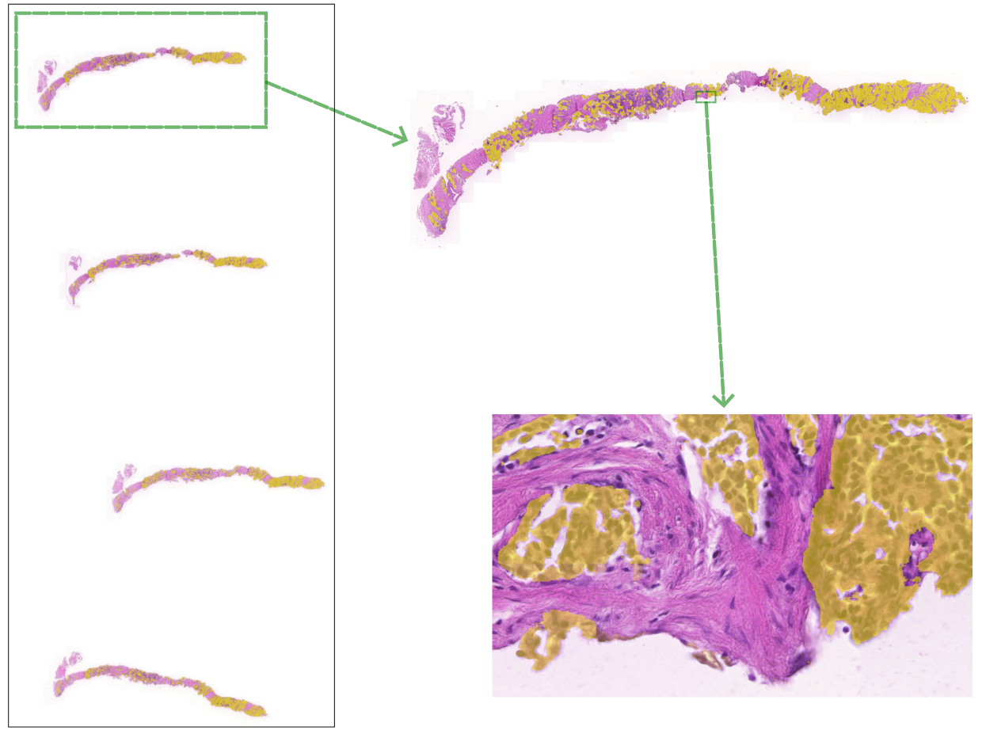
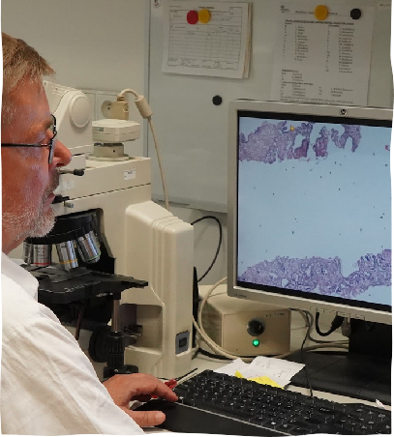
AI in DP
AI learns from data: Here microscopic images (WSI) of tissue labeled with cancer

Slide 4




AI in Digital Pathology
Needs to be
Developed
Trained
Deployed
Monetized
How to do the above in a university research group and a small startup?

Slide 5
Typical AI training workflow - the research group
The pathologist formulates the medical problem
E.g. detect prostate cancer in whole-slide images (WSI) of prostate needle biopsies
The pathologist selects the appropriate cases/slides for AI training
Cooperation of IT experts and pathologists …
IT experts do not understand pathology the pathologists are short of time
The slides are scanned
  No standard of WSI format (DICOM, MIRAX, SVS, NDPI, VSI, new proprietary formats)
  small group/company does not have official access to the formats
The resulting data transfered to safe storage
  smaller projects = thousands of WSI (terabytes)
  large projects = hundreds of thousands/millions of WSI (petabytes)
AI trained, evaluated, visualized -> feedback from the pathologist

Slide 6



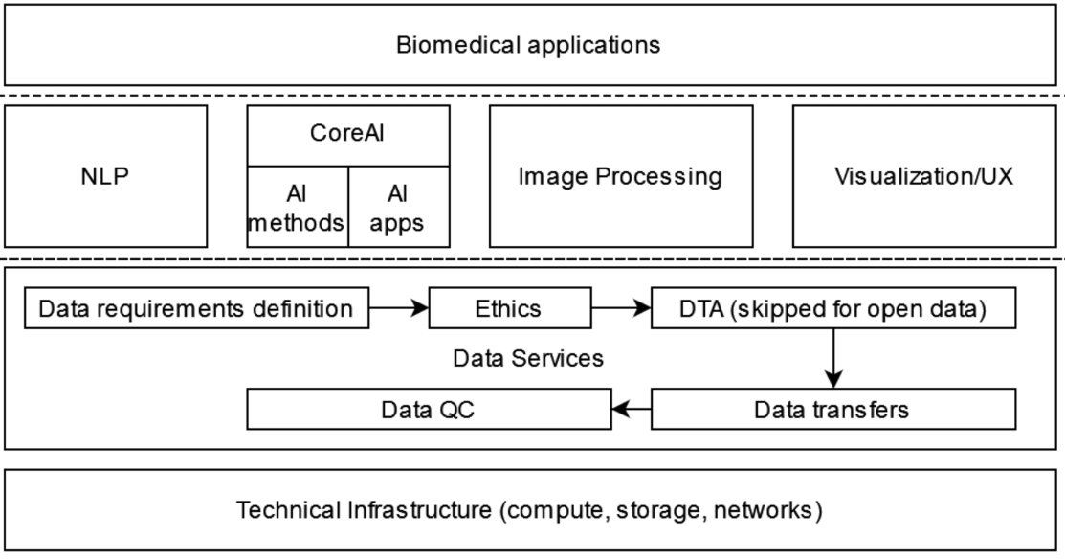



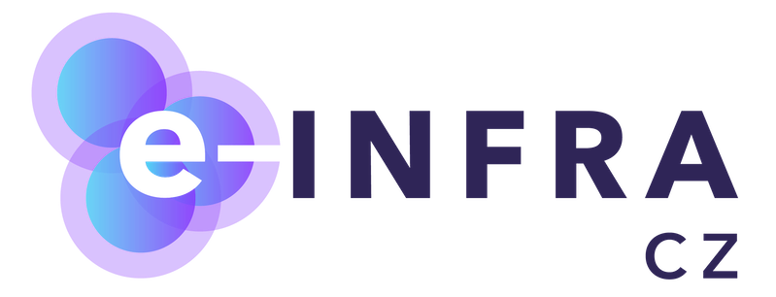
BioMedAI TWINNING project

Slide 7
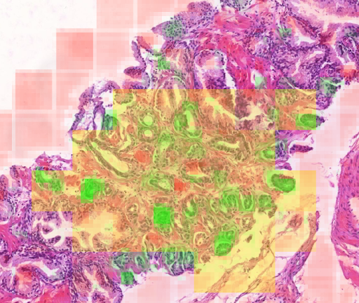
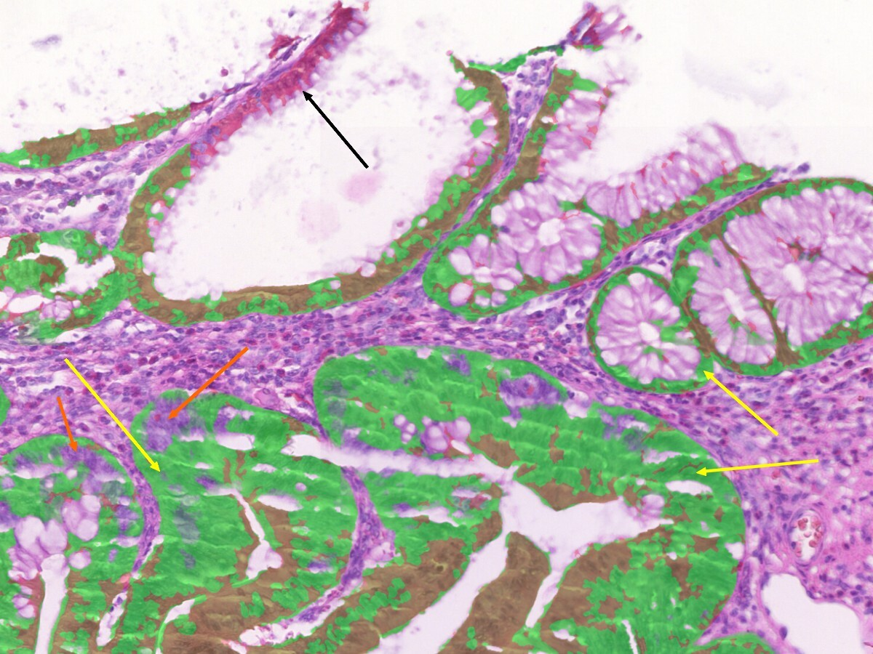
Some results of RationAI
Cancer segmentation
Prostate, breast, colon tumor segmentation
Explainable
Using foundation models
(Prov-GigaPath, etc.)
Tested on multi-centric data
Epithelium segmentation
Trained on double stained WSI
(cytokerating, H&E)
Various types of tissue, reliable, precise

Slide 8
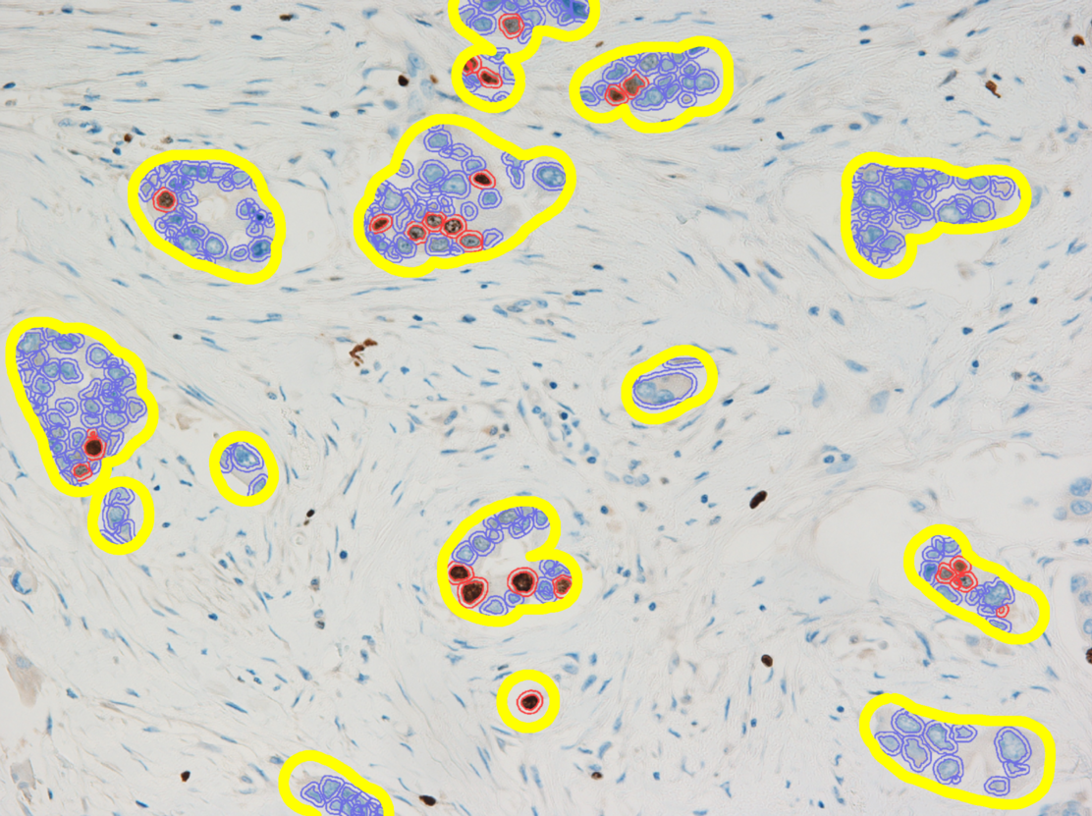
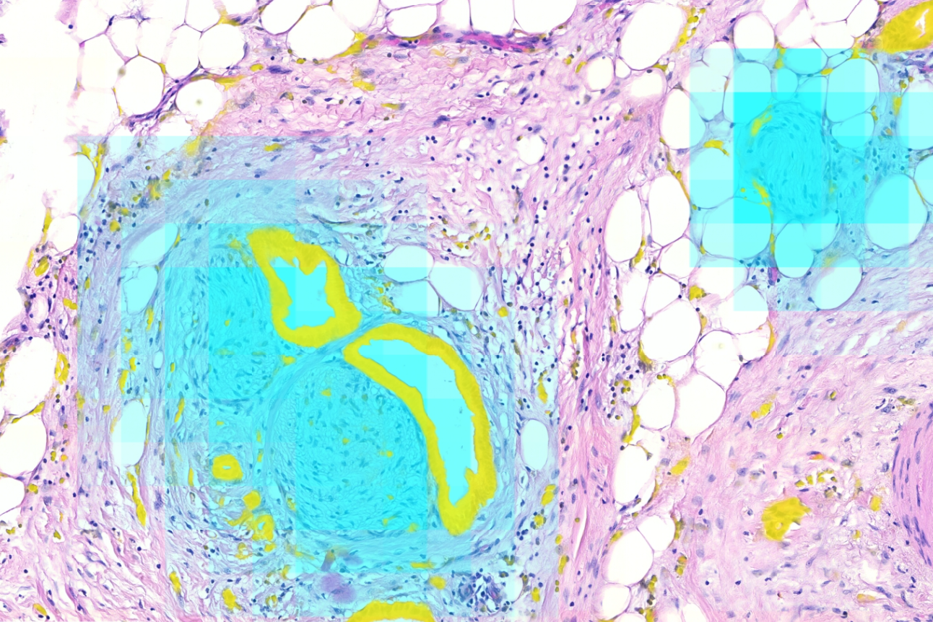
Some results of RationAI
Ki-67 proliferation index estimator in ROI
Trained on clinical data
no manual annotation
More precise than usual
“working estimates”
Perineural invasions detection in
pancreatic resections

Slide 9

AI in Digital Pathology
Needs to be
Developed
Trained
Deployed
Monetized
How to do the above in a university research group and a small startup?

Slide 10
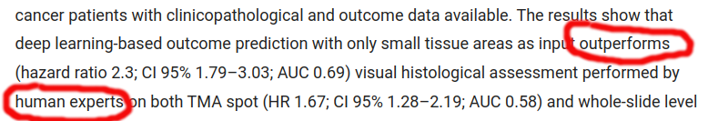
Solved by AI?
Pathologist’s view: It does not bother me and sometimes it’s helpful
IT expert’s view: In 2018
Bychkov et al (2018). Deep learning based tissue analysis predicts outcome in colorectal cancer. Scientific Reports, 8

Slide 11
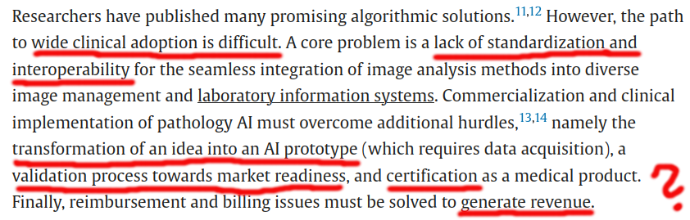
Solved by AI?
IT expert’s view: In 2024 (and still in 2025)
Zerbe et al (2024). Joining forces for pathology diagnostics with AI assistance: The EMPAIA initiative. Journal of Pathology Informatics, 15

Slide 12
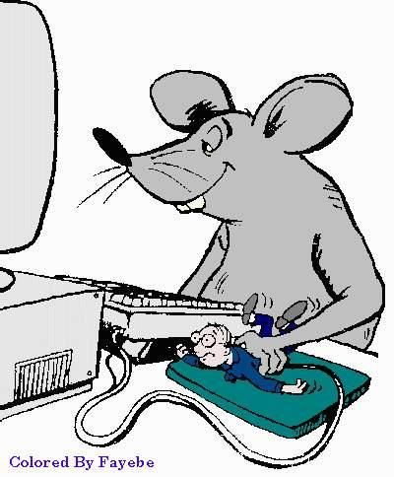
Prototype deployment:
What is expected from a clinical solution?
End users (pathologists, lab technicians) usually need
“Invisible” connection between scanner and the user interface
Quickly
  get images from the scanner to storage
  process them
  visualize results
Ergonomy, clarity, reliability of the user interface (UX classics)
  Single system for everything - LIS integration
  Images rendered quickly
Necessary tools at hand
  Annotation, morphometry, area measurement tools
  Reporting system (possibly pre filled by the AI system)
Notes:
Hlavním cílem projektu je dokončit vývoj a certifikaci aplikace AigoPath Viewer
AigoPath Viewer je webový prohlížeč snímků v digitální patologii s platformou pro AI asistenci, který zefektivňuje diagnostiku a zvyšuje její přesnost v patologických laboratořích.
Certifikace je nezbytná pro expanzi na evropský trh.

Slide 13
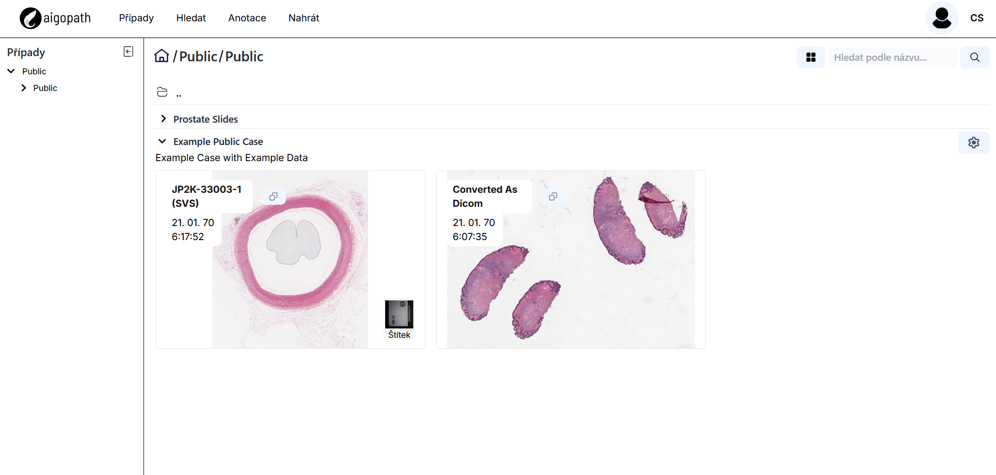
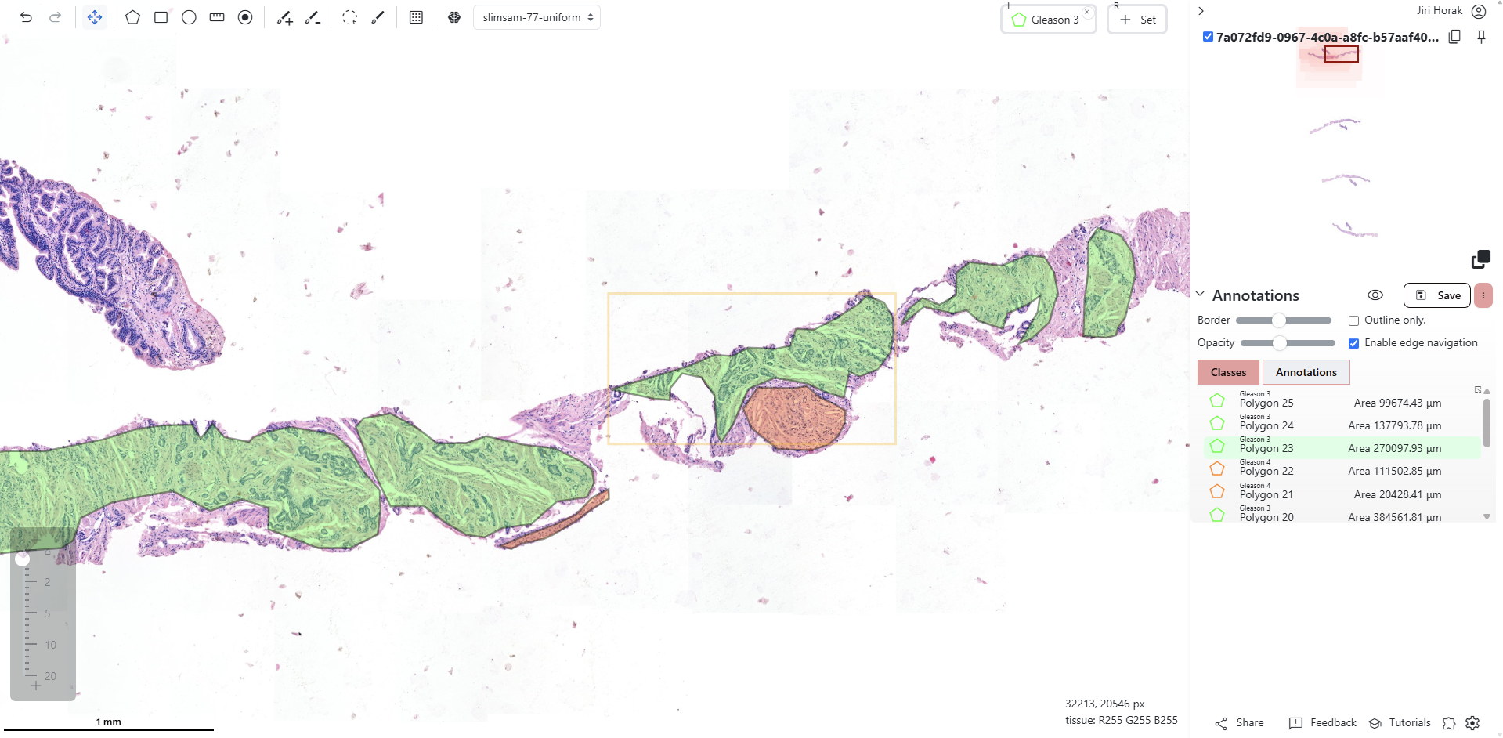
Our Deployment at MMCI
Case browser
Execution of AI models
Metadata examination
Can be substituted by LIS
xOpat viewer
Fast and reliable
Advance visualization of AI outputs, annotations
Mesurements, morphomentry

Slide 14

Prototype deployment:
What is expected from a clinical solution?
Institutional needs (laboratory, hospital)
Security of processed data and access control
Dependent on the solution: Cloud vs on-premise (next slide)
Certification (ISO, MDR, IVDR)
For small startup: Expensive, complicated, opaque
Integration with existing processes
Typically the most complicated part: User education, integration with other software solutions, cooperation of IT departments, etc.

Slide 15
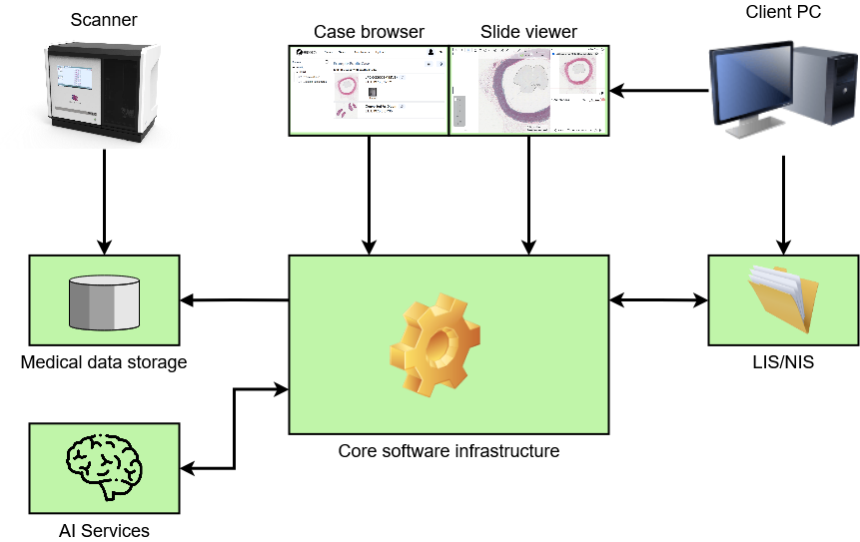
Prototype deployment: Infrastructure setup
Question: Have all this on-premise or in cloud?

Slide 16
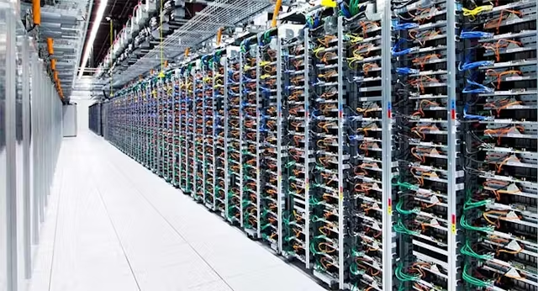
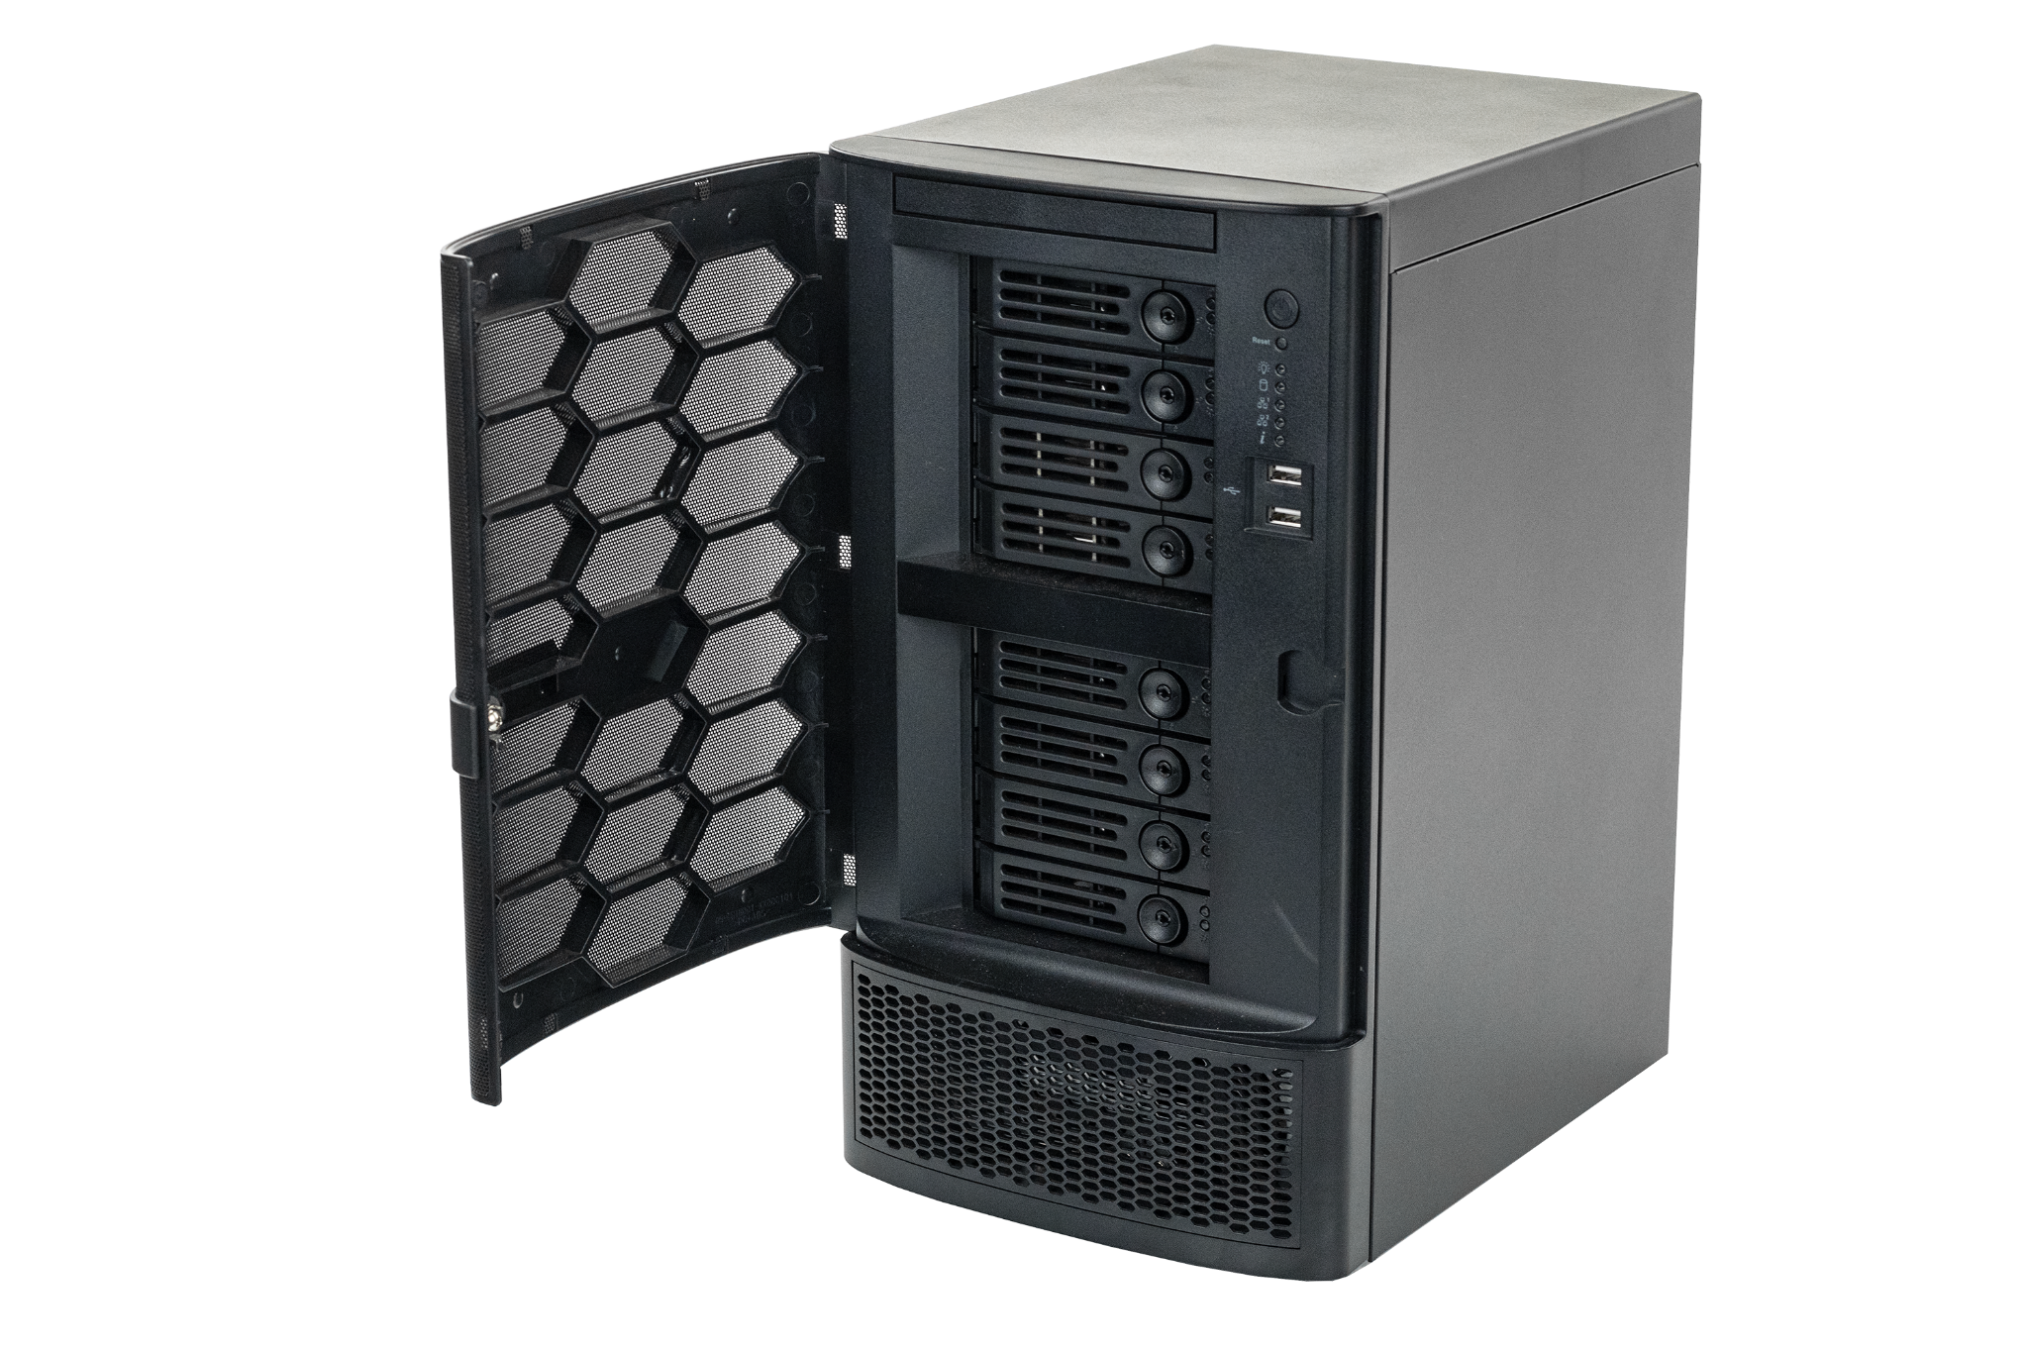
Prototype deployment: Self-managed vs cloud-based infrastructure
Self-managed
Complete control over the data
Easier security measures
Fast access to the data
(short network travel time)
Possible to optimize costs
Requires dedicated personnel
Cloud-based
Hardware managed for you
Dedicated technicians not needed
Complex services such as backups, disaster recovery, etc.
Secure clouds are expensive

Slide 17
Smooth integration
Multiple separate applications: Cumbersome, annoying, and potentially dangerous
Few providers manage to deliver smooth integration with LIS/NIS
xOpat viewer is lightweight and web-based
-> ready for integration with larger systems
First integrated solution with DS Soft Olomouc was developed in two weeks!

Slide 18
AI in Digital Pathology
Needs to be
Developed
Trained
Deployed
Monetized
How to do the above in a university research group and a small startup?

Slide 19

The market - AI company view
The usual clients
  Hospitals
  Private labs
The usual providers
  Scanner manufacturers (Roche, Leica)
  Companies from related disciplines (Sectra, Dedalus, Fujifilm)
  Startups and dedicated companies (Ibex, Proscia, Smart In Media, Pathozoom)
  Majority of LIS/NIS providers did NOT jump in yet!
The market is relatively small - compared, e.g., with radiology
Specialized - only larger institutions have pathology departments
Tender based acquisition in state-owned hospitals

Slide 20

Institutional issues when buying DP (AI) solution
Which scanner to get?
Expensive, long-term purchase
Can be borrowed for a trial
Who will operate it
Where to keep the digital images?
Self-managed in-house servers
Cloud storage (or even compute)
From whom to get the software?
Large differences in service and products
Scanner manufacturers vs sw only companies
Large companies often less amenable to customizations
Localization, customer support

Slide 21
Institutional issues when buying DP (AI) solution
How much data will we work with digitally?
Slides per day, gigabytes
Scanner and storage space
How users will access the digital slides?
Access from home or purely on-site?
On-site network capacity must be sufficient
Hospital security allowing remote access
Is LIS/NIS integration desirable?
Willingness of vendors to accommodate other vendors
Smaller providers usually more flexible and cheaper
Larger providers offer more complex services

Slide 22
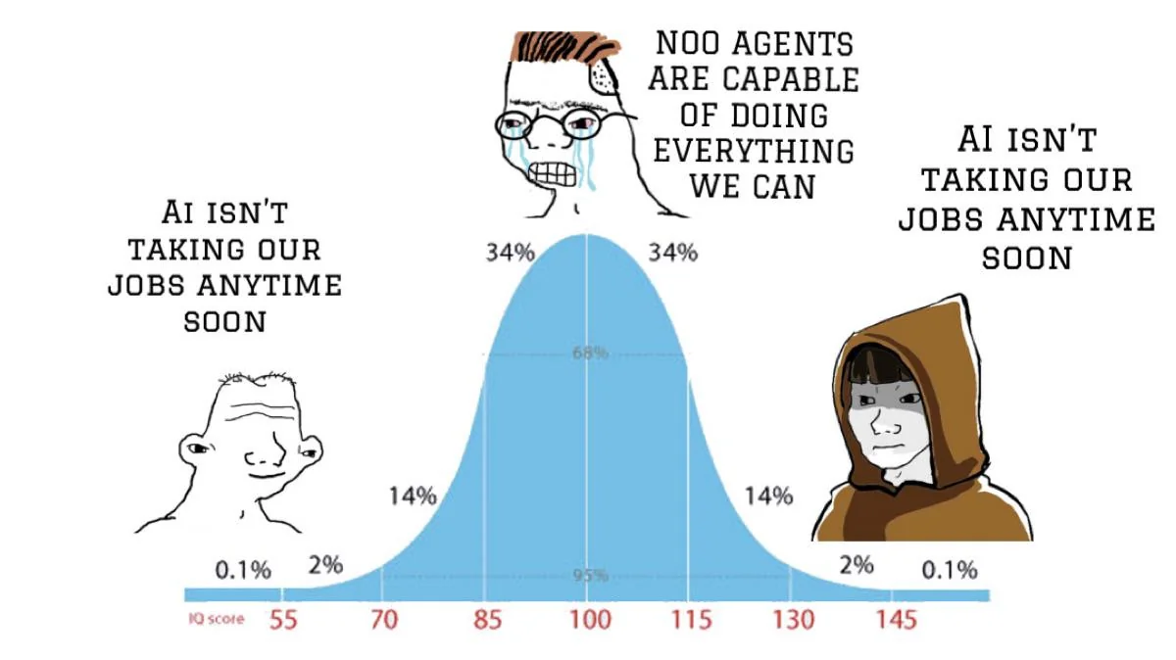
Conclusions
We have considered challenges and opportunities encountered by a small research group and a small company in AI in digital pathology
The research in the area is much faster than testing, deployment, certification, and market release
AI will assist digital pathology only when sensibly integrated within processes of pathology departments and labs
Now comes LLM based Agentic AI !

