Slide 1
R&D and education in cybersecurity and critical information infrastructures Tomáš Pitner Masaryk University Brno, Czechia

Slide 2
Cybersecurity @MU at a Glance
In context of Security Studies
(Geo)Political and Strategic
Organizational, Technological, and Law
C4e as cooperative multidisciplinary research and education centre of Masaryk University
Cybercrime and cyber security
Protection of critical infrastructures
Law
Notes:
expert advisory board (est. 2015) – members are representatives of relevant public bodies that deal with cybercrime, cybersecurity or cyber defense. The purpose of the board is to discuss strategic projects and decisions about focus of the activities of the C4e, and the university in general.

Slide 3
structure

Slide 4
Main Teams
CSIRT-MU – Institute of Computer Science MU
Lasaris, Paradise, CroCS – Faculty of Informatics MU
Institute of Law and Technology – Faculty of Law MU
Institute of Politology – Faculty of Social Science
and ad-hoc cooperation

Slide 5
CSIRT-MU
Computer Security Incident Response Team of Masaryk University
Part of the Institute of Computer Science
Accredited by Trusted Introducer
Long term experience with R&D in the field of network security monitoring
csirt.muni.cz

Slide 6
Lasaris
Lab of Software Architectures and Information Systems
Focus on the protection of critical information infrastructures
Development of resilient architectures of IT systems
www.lasaris.cz
Notes:
Est. 2008
4 full time researchers, 10+ PhDs, master students etc.
Software and system realiability, quality
Runtime properties, monitoring
Software engineering
Enterprise systems and technologies
„By-design“ approaches
www.lasaris.cz

Slide 7
CroCS
Centre for Research on Cryptography and Security
Aim to improve security and privacy through applied research
cooperation with industry
advanced education of future security professionals.
crocs.fi.muni.cz
Notes:
Est. 2008
4 full time researchers, 10+ PhDs, master students etc.
Software and system realiability, quality
Runtime properties, monitoring
Software engineering
Enterprise systems and technologies
„By-design“ approaches
www.lasaris.cz

Slide 8
Institute of Law and Technology
Focus on technology law (ICT law, data protection, intellectual property law, energy law, etc.)
Long term cooperation with public authorities
Expertise in the area of cybercrime & cyber security
cyber.law.muni.cz

Slide 9
What do we do?
Research and Development
Cooperation
Education

Slide 10
Research infrastructure

Slide 11
Cyber Range (KYPO)
Unique cloud-based virtualized infrastructure environment developed by CSIRT-MU
3 main use-cases:
Research
Digital forensics (analysis and simulations)
Cybersecurity trainings & exercises
Further extension to cyber-physical world

Slide 12
KYPO architecture

Slide 13
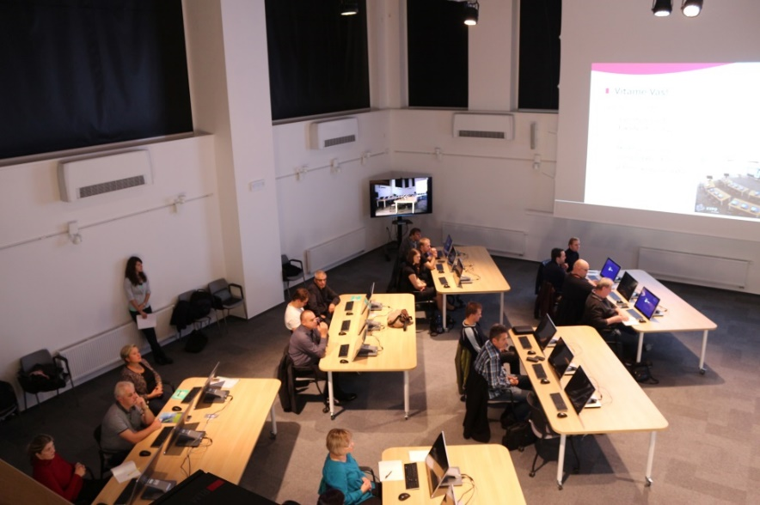
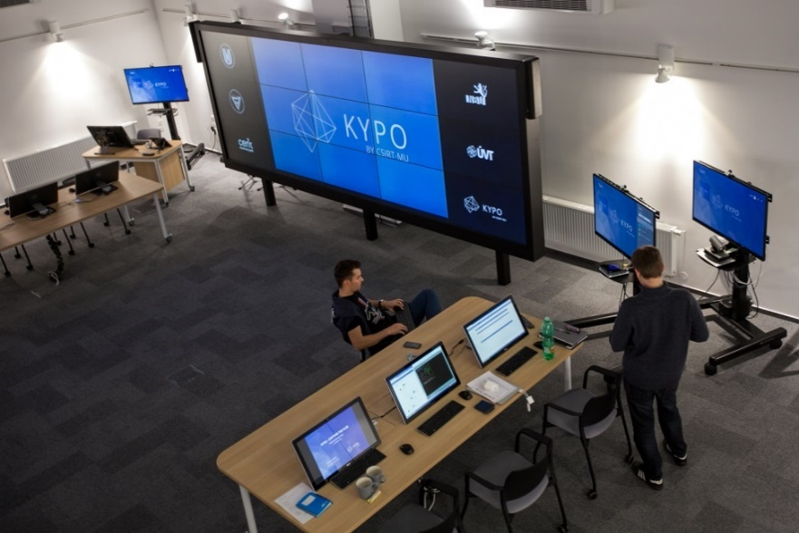
KYPO Lab

Slide 14
Research areas

Slide 15
Types of Research
Strategic
Cyber warfare, cyber terrorism, intelligence services
Technical
Detection tools, information sharing tools, training platforms, forensic tools, resilient IT systems and infrastructures
Legal
Cybercrime, cybersecurity & cyber defense law, data protection, ICT law, IP law, sectoral regulation of critical infrastructures
Focus of the research is discussed at the meeting of the rector's expert advisory board.

Slide 16
Selected Research Projects
KYPO
SABU
SENTER
LIVE_FOR
CRUSOE
Experimental research of user behavior in ICT security
Smart metering
Notes:
Kypo - development of cloud based research and training platform, that allows to create virtual network infrastructures, that can be used for forensic examination, research or as a cyber range.
Sabu – development and implementation of cybersecurity data sharing platform, that allow transfer of threat and incident data and its enhanced analysis
Senter – project focused on strenghtening of cooperation between centres of excellence in europe
Live_for – development of methodologies and recommendations for use of European investigation order for cross border electronic evidence requests
Crusoe – research of tools that can be used to enhance analysis of security of infrastructure and to support CSIRTs decision making
EX – research on actual impacts of various security duties of users on security of information systems
SM – contractual research for czech operators of electricitiy distribution networks focused on security and resilience of smart metering systems (with cvut, vut etc.)

Slide 17
Example Research area – critical infrastructure in power grids

Slide 18
Smart Metering Research Areas of C4e
According to classification given by prof. Andrea Tonello:
S1: Communication and Networking
S2: Cybersecurity and Privacy
S3: Control and Operation of Responsive Grids
S4: Smart Metering, Demand Response and Dynamic Pricing
S5: Big Data
S6: Field trials, Standardization, Regulations

Slide 19
S1: Communication and Networking
Reviews and surveys (ČEZ, ČSRES),
Reflection of international experience
Communication technology for SM and SG:
Conception
Planning (new fibre optic lines) – for ČEZ
In-lab and in-field testing – for ČEZ
Regulations on telecommunications, energy business, cybersecurity, privacy, and critical infrastructure protection

Slide 20
S2: Cybersecurity and Privacy
Joint research projects for ČSRES (Union of Regulated Energy Businesses in CZ)
Annual National Cybersecurity Technical Trainings (CyberCzech)
In-lab security testing (eg. impact of security measures on performance)
Further extension of our KyPo Cyber Range to cyber-physical systems

Slide 21
S3: Control and Operation of Responsive Grids
Joint research projects for ČEZ
Modeling
Simulations
Predictions (of consumption, of metering behavior)
Control:
Led by MycroftMind (Masaryk University spin-off) for ČEZ:
Project on Local Optimization of Distribution Grid (LODIS)

Slide 22
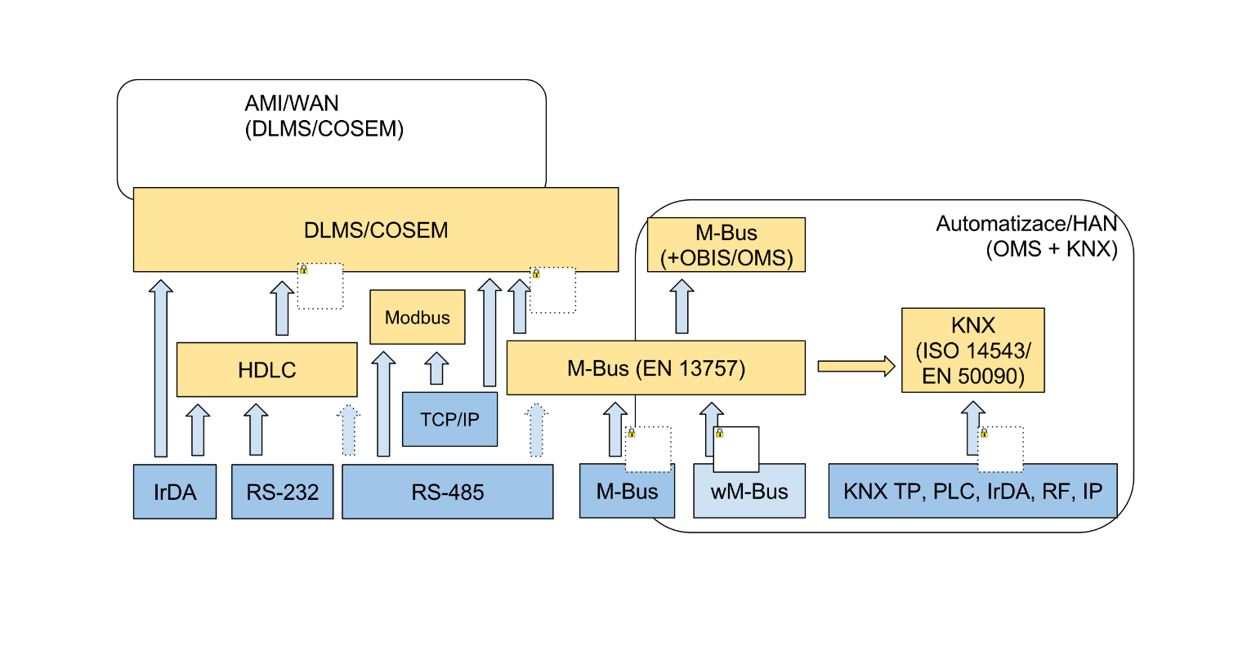
S4: Smart Metering, Demand Response and Dynamic Pricing
Design of the Smart-meter <> Home Area Network interfacing

Slide 23
S5: Big Data
Large computing and storage infrastructure available
CERIT Scientific Cloud
Both data-intensive and computation-intensive applications in smart grids based on deep learning

Slide 24
S6: Field trials, Standardization, Regulations
Smart-grid lab for ČEZ
Conception of lab control system
Both HW and SW part design and implementation
Test control system driven by Design of Experiments (DoE),
Inspired by SW testing standards, applied to cyber-physical systems
Expertise in Regulations on Telecommunications, Energy business, Cybersecurity, Privacy, and Critical Infrastructure Protection

Slide 25
Institutional collaboration

Slide 26
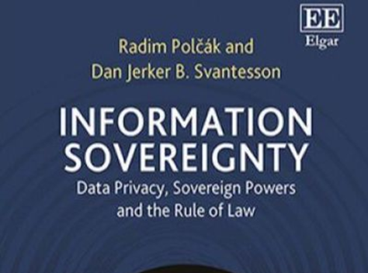
International cooperation
Europol (EC3)
taxonomy of cyber security incidents,
lectures for LEA
expert boards membership
ENISA
taxonomy
sharing of knowledge, expert boards membership
NATO
taxonomy,
study programs (Cyber Defense Master), exercises (CCDCOE)

Slide 27
International cooperation
UN
sharing of tools and knowledge
UNCITRAL and UNODC academic delegations
TF-CSIRT
sharing of tools, knowledge, best practices, etc.
National research and education institutions
ad-hoc cooperation, research projects, sharing of knowledge and tools

Slide 28
National cooperation
National Cyber and Information Security Agency
sharing of knowledge and tools
training and education: courses and exercises (Cyber Czech)
attendance at exercises: Locked Shields, Cyber Europe, EDA
Police
sharing of knowledge and tools, consulting
training and education – cooperation with Police academy
Army and Ministry of Defense
consulting and research focused on cyber defense tools

Slide 29
National cooperation
Intelligence services
consulting
Ministry of Interior
research and development projects (KYPO, SABU – sharing of cybersecurity events data)
Ministry of Justice
expert board on digital evidence
Judicial academy, Public prosecutors office, Judges
training and education, consulting

Slide 30
Other activities
CyberCon
spring conference on cybersecurity
started as an initiative by FSS students in 2014
now organized primarily by NCISA
Multinational Cyber Defense Education and Training Project
International Security Summer School

Slide 31
IndustrY

Slide 32
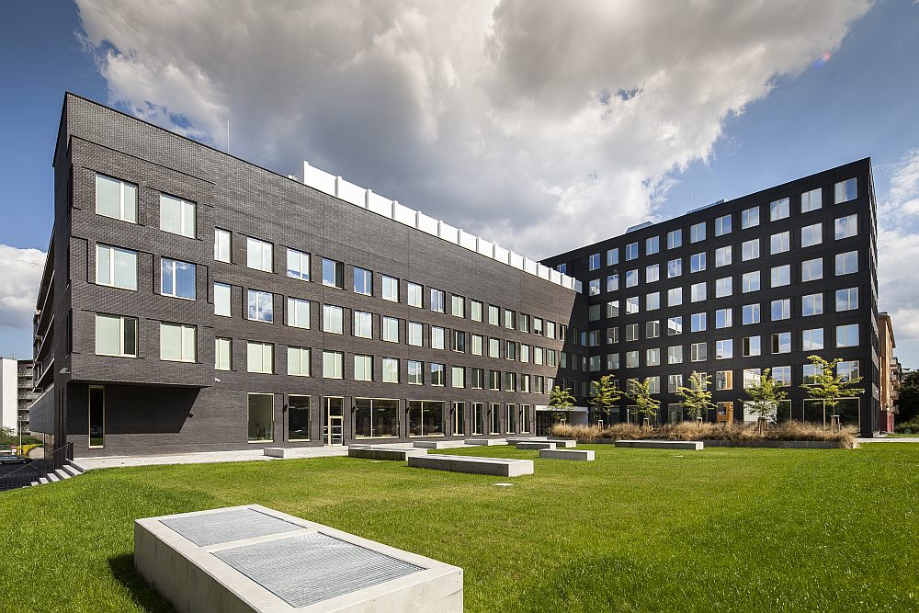
CERIT Science Park
Center for Education, Research and Innovation in ICT
Size (22.238 sq ft, capacity ̴ 20 companies)
Focus of companies:
Modeling and simulation of critical infrastructures
Computer network security
Infrastructure monitoring
High-performance multimedia processing
Development of systems for data processing
Visualization and graphic services
Web applications, analysis and marketing
Mobile security solutions
Open source systems

Slide 33
Association of Industrial Partners
Goal: long-term collaboration
Dominant indicators so far (*required)
Financial contribution* (mostly for students, equipment)
Student involvement* (# of graduation thesis)
Collaborative R&D
PhD sponsoring (requied at strategic level)

Slide 34
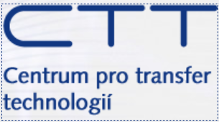
Technology transfer
(Central) Technology Transfer Office at MU
Framework: regulations, PR, IP management, legal services
Support at origin of research results
ICT as integrated pillar covering:
Faculty of Informatics
Institute of Computer Science
Science Park
Institute Law and Technology (Faculty of Law)
other units with ICT interrests

Slide 35
Education

Slide 36
Education – Faculty of Informatics
3-year Bachelor program in Informatics
2-year Master program in IT Security (technology) and Cybersecurity management
4-year Doctoral program in Computer Systems and Technology, research areas of Cybersecurity and Crititical Infrastructure Protection

Slide 37
Education – Faculty of Social Sciences
3-year Bachelor program in Security Studies
2-year Master program in Security Studies
new 2-year Master program Conflict and Democracy Studies
taught in English
both include courses on cybersecurity, information warfare, propaganda, hybrid conflicts, and emergent threats

Slide 38
Education – Faculty of Law
Lectures and trainings
Judicial and police academy (cybercrime investigation, digital evidence handling, intellectual property, data protection)
Ad-hoc trainings (for investigators, experts, public prosecutors)
KYPO hands-on training and exercises (sysadmins, CSIRT members)
Bachelor degree (ICT security) – in cooperation with University of technology
Masters degree (Cyber security – interdisciplinary and law)
Doctoral study program

Slide 39
Education – international
Joint doctoral degree – with University of Haifa
Masters study programs NATO (Multinational Cyber Defense Education and Training Project)
Ad-hoc courses and trainings – NATO

Slide 40
Education - regular events
Seminars:
iSysel
Cyber cake
Conferences
Cyberspace (cyberspace.muni.cz)
Czech law and information technology (cpit.law.muni.cz)
Energy Law Symposium
Summer school on ICT law
Notes:
iSysel – seminar where lawyers and IT profesionals discuss issues related to security, data protection, infrastructures protection, etc.
Cyber Cake – seminar where lawyers from relevant public and academic institutions discuss issues related to national cyber security and defence

Slide 41
FURTHER DEVELOPMENT

Slide 42
Strengths
Benefit from presence at University
Complex view from strategic and legal to technical aspects, from theoretical to applied
Unique ability to react to complex problems
Top international team and collaboration
Unique infrastructure (KyPo, Science Park, Cloud)
Based on strong research (C4e and many labs)

Slide 43
Opportunities
Extension of study programmes
Doctoral studies
Master programmes (cybersec management)
Professional programmes (experts for daily operations)
Lifelong learning programmes
Study programmes in international networks

